Slide 1
Problem 7: Worms
Team Croatia
Reporter: Luka Mikšić

Slide 2
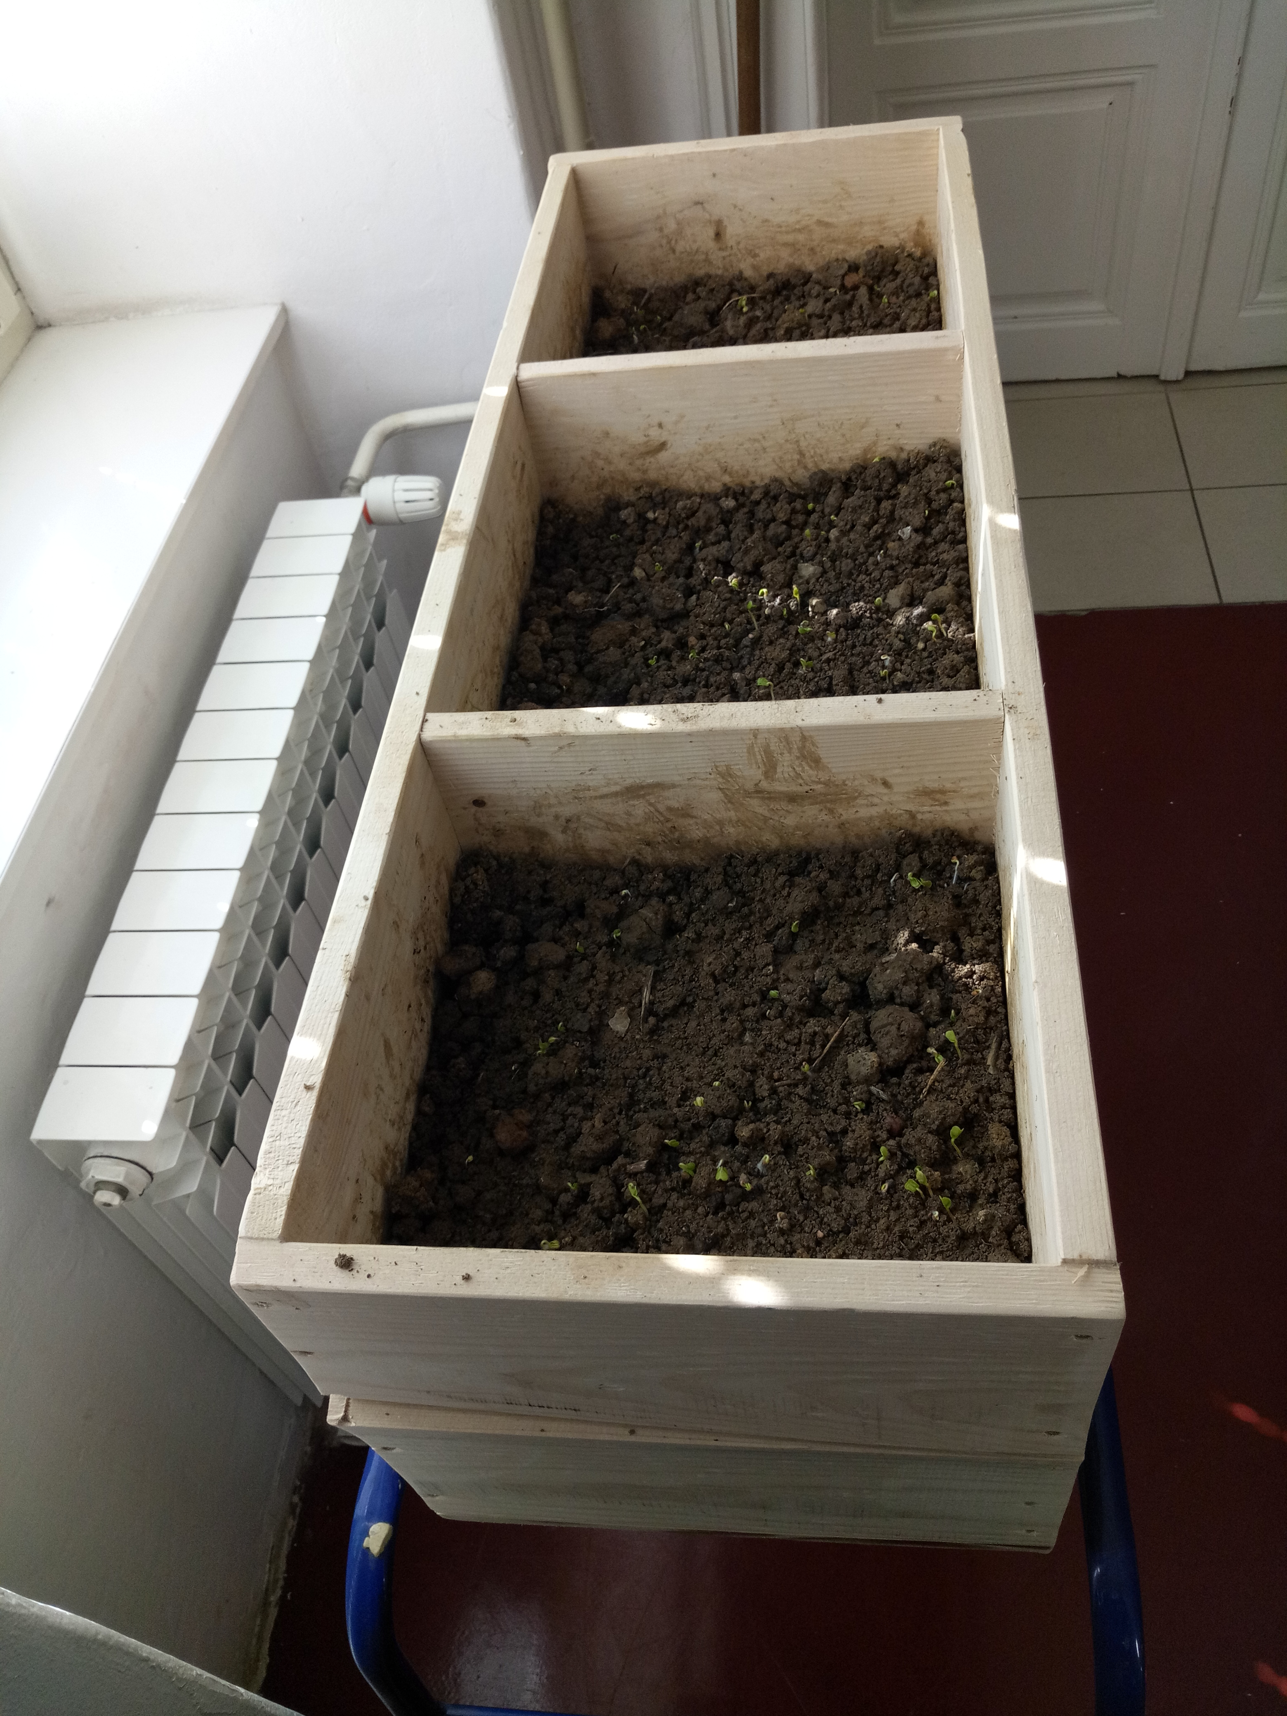
Problem 7: Worms
„Earthworms change the mechanical properties of soil and make the soil more porous. Investigate this process and introduce quantitative parameters. “

Slide 3
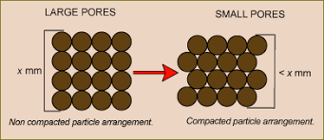
Demonstration of the phenomenon

Slide 4
Outline
Theoretical introduction
Experiment
Results
Earth worms
Common earthworm (Lumbricus terrestris Linnaeus, 1758)
Experiment 1
Experiment 2
Percentage of water and water flow
Porosity

Slide 5
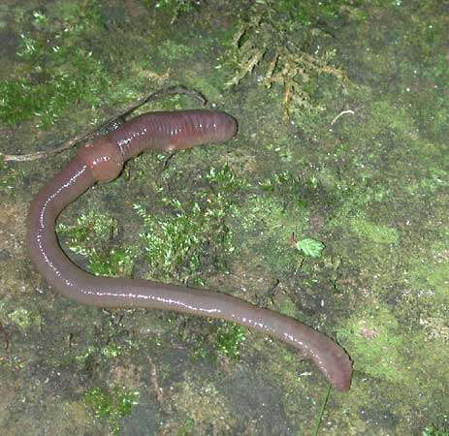
Earth worms
Oligochaetes→subclass of the Clitellate
Habitation: land waters and the land
live in the sediment or in the ground

Slide 6
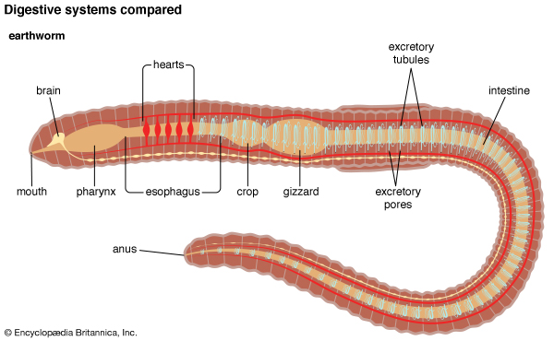
Common earthworm (Lumbricus terrestris Linnaeus, 1758)
processes large amounts of organic substances mixed with soil in the digestive tract
creating humus important in the process of mineralization of organic matter
enable better airiness, texture and soil structure

Slide 7
Hypotheses
Greater number of worms➔
increase in porosity
increase in humidity
increase in water flow
There is going to be a optimal number and limit of the
worms

Slide 8
First experiment
3 wooden boxes 25x25x30 cm
each box-clay soil mixed with herbal material (400 g) and humus (100 g)
1st box- earthworms, 2nd- 25 and the 3rd- 50
Temperature was 20 ° C ( ± 2° )
During 28 days 500ml of water was added every 48 hours
Notes:
Shema kutija, sa crvekima * boj crva u kutiji, u kutu staviti temp

Slide 9
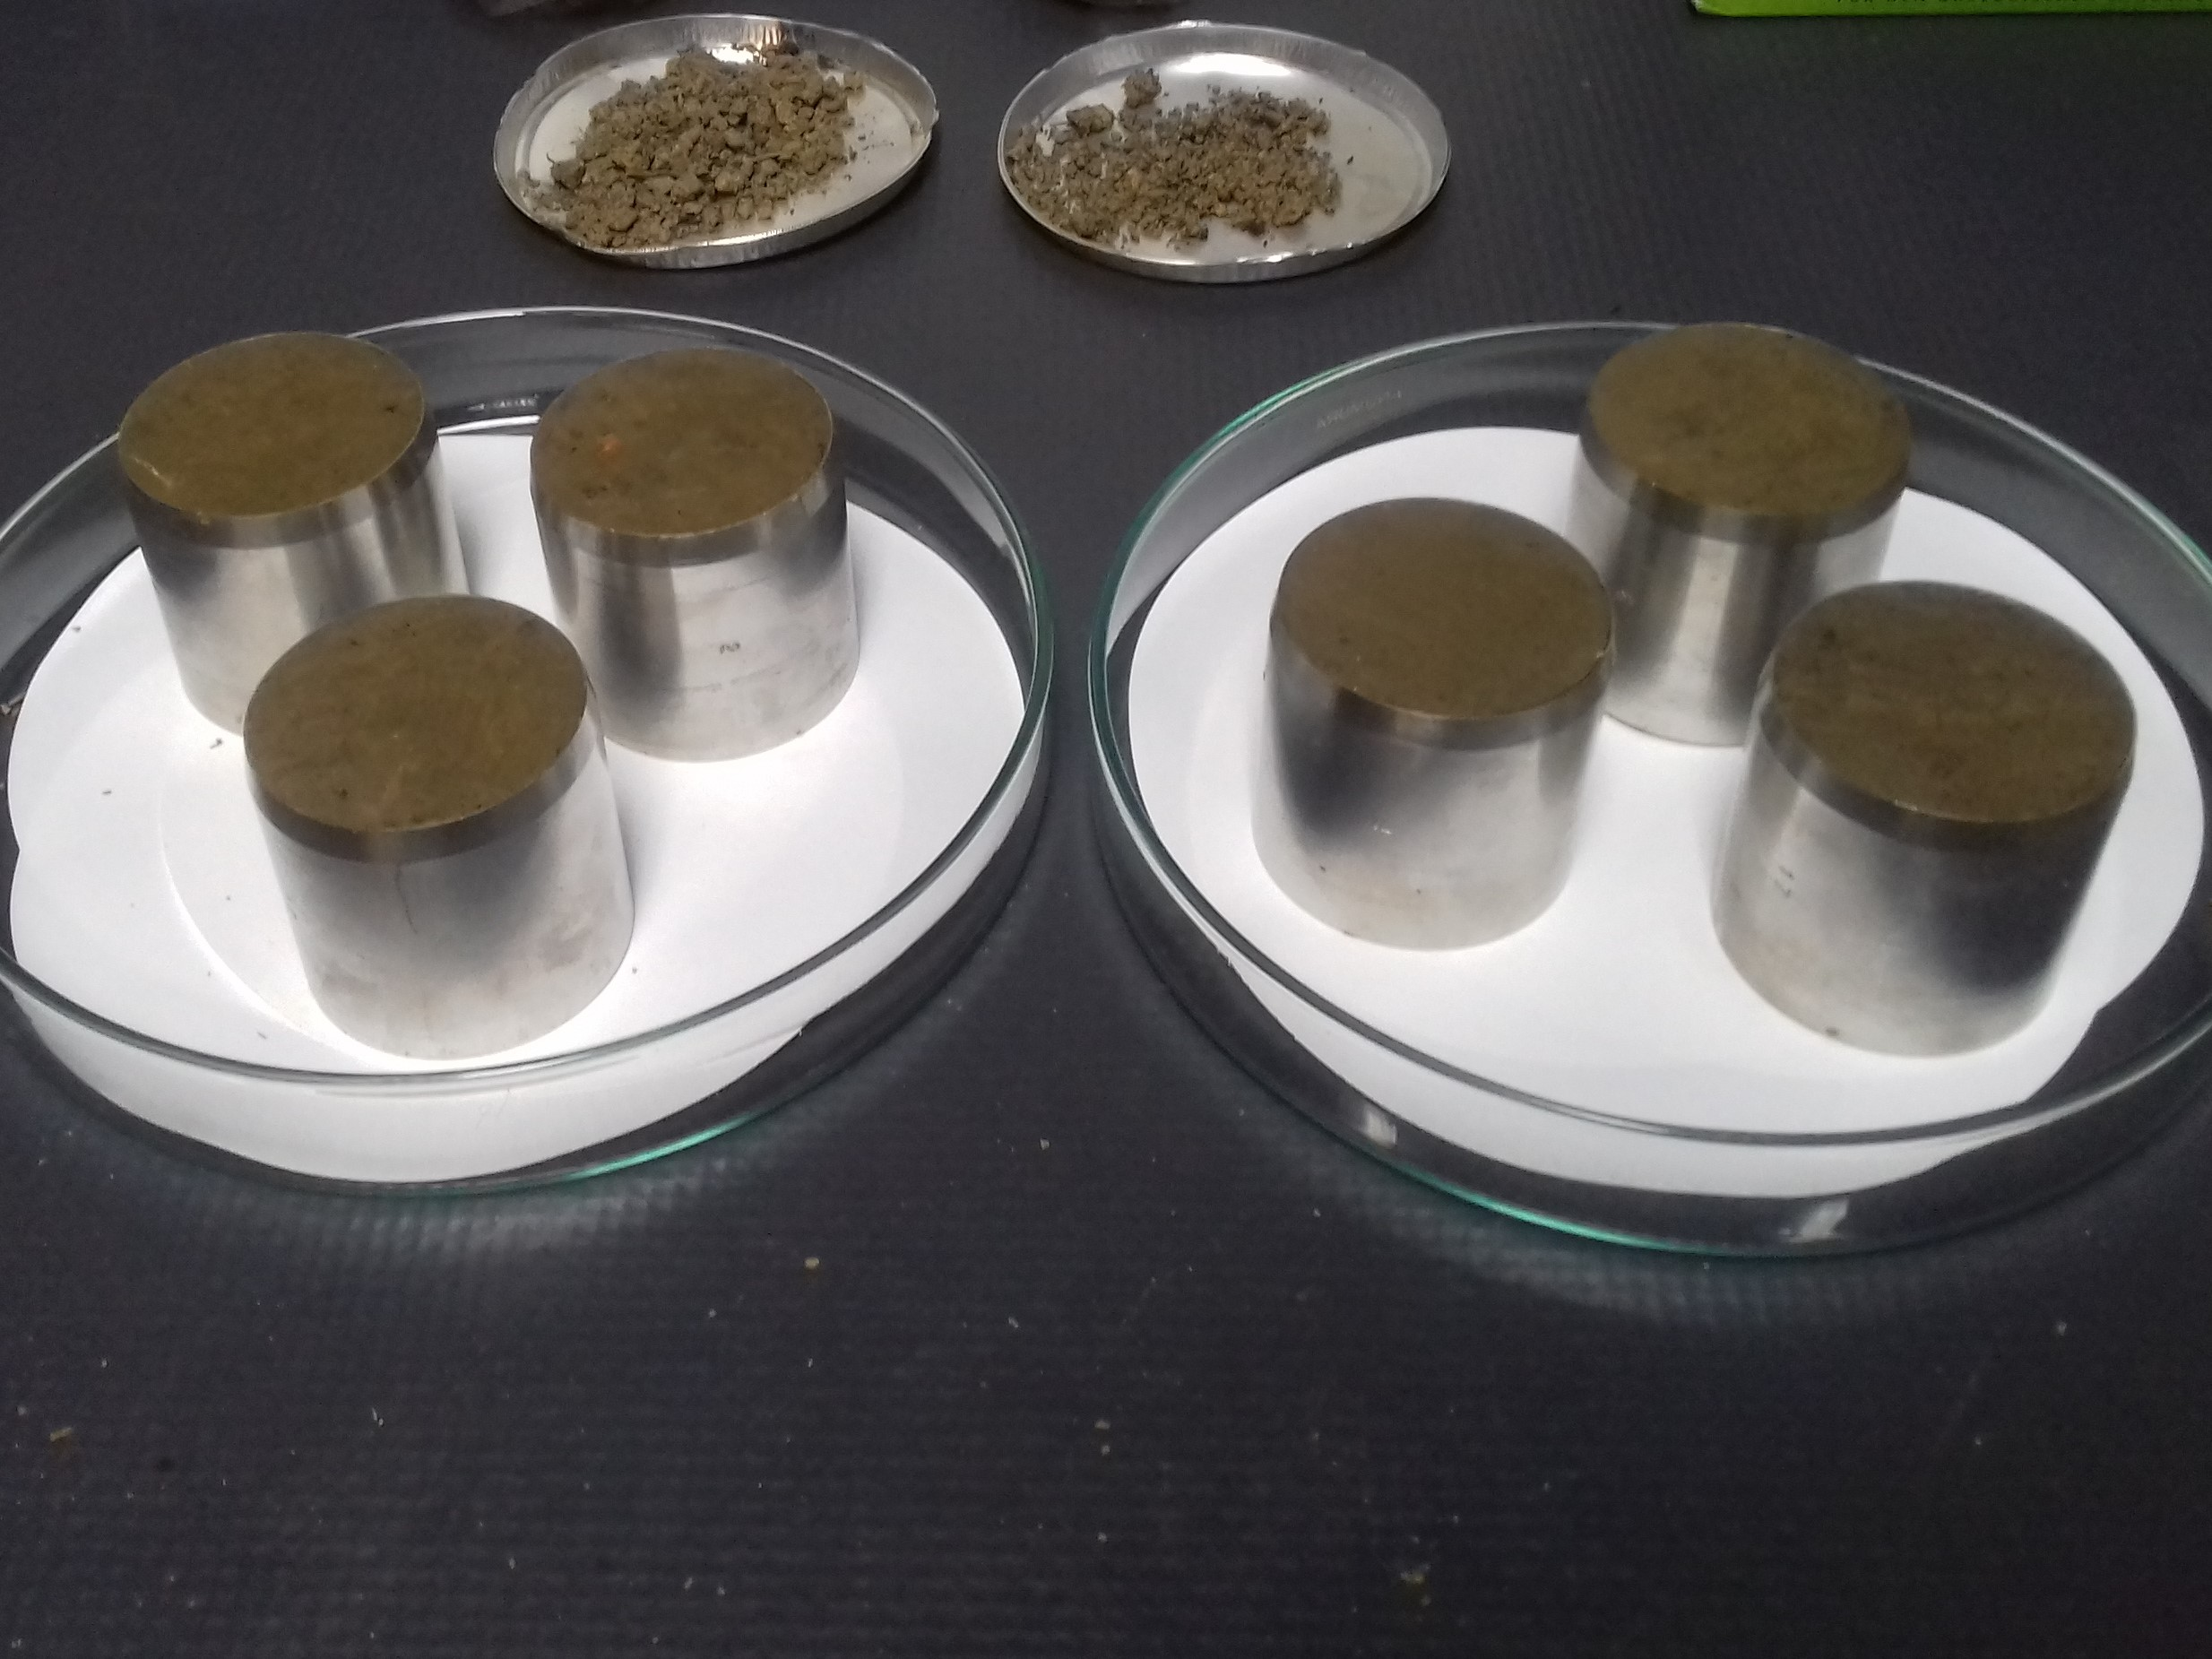
FIRST EXPERIMENT
.
Sampling → Kopecky cylinder
Measurements:
Porosity formula: P = (1- ) × 100
p_{v}-volume density
p_{s}-solid soil density
Kopecky cylinder

Slide 10
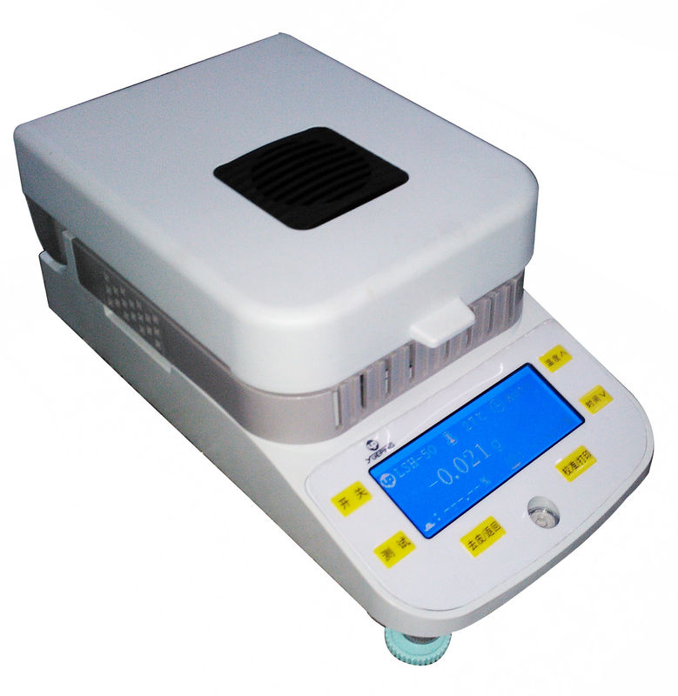
FIRST EXPERIMENT
Humidity- by drying the soil and weighing it
Water flow- by using the permeameter
infrared halogen moisture analyser
laboratory permeameter by Eikelkamp

Slide 11
Result-PERCENTAGE OF WATER IN THE SOIL
1st and 2nd box →water evaporated faster because capillarity established
3rd box →earthworm activity and their secretion of slime disarranged the establishment of capillarity and water evaporated slower

Slide 12
PERCENTAGE OF POROSITY
1st box → no earthworms = control (47.3%)
2nd box → 25 earthworms = increase in the porosity of the soil for 2.55%
3rd box → 50 earthworms = no difference in porosity comparing to 2nd box

Slide 13
WATER FLOW
1st box → no earthworms = control(286.8 cm/sek*10-5)
2nd box → 25 earthworms = increase in the water flow by 14 cm/sek*10-5
3rd box → 50 earthworms = increase in the water flow by 18.2 cm/sek*10-5

Slide 14
Conclusion
The greater number of earthworms increased water flow and percentage of water in the soil making greater area of the soil rich with the minerals from the water and increasing chance of life in the area
Maximum porosity was reached with 25 worms
50 worms destroyed each another's pores and the result was the same as with the 25 worms
Notes:
Maximum porosity was reached with 25 worms
50 je previse zbog …

Slide 15
Possibilities of further work
Research how do worms effect the soil in time periods?
Research how do the worms effect different types of soil ?
Discover the perfect ratio of soil and worms?

Slide 16
Literature
http://www.gf.uns.ac.rs- 24.4.2018
http://www.vguk.hr/- 24.4.2018
http://ljesnjak.pfos.hr/~jdanijel/literatura/OBsK/OBsK-_07%20Osnovne%20znacajke%20tla.pdf-24.4.2018

Slide 17
Thank you!
Team Croatia
Reporter: Luka Mikšić

Slide 18
KOPECKY CYLINDER
The cylinder has a cover and a mesh of the appropriate diameter on
both sides. When the sample is taken, the cylinder is placed on the
ground with a sharp edge and the top of the cylinder is lightly hammered
to pass through the ground, then the ground around the cylinder is ripped
to make the sample easier to separate. On both sides of the cylinder, the
sample is straight and covered with a mesh and lid.

Slide 19
Waterflow measuring
Waterflow is measured in certain conditions where water flows through a sample of soil in the permeameter.
The sample of soil is put in the cylinder which is under constant pressure and water is flowing.

Slide 20
Porosity measuring
DEFINITION: Soil density is a number that shows how many times a volume of soil is weighing or lighter than of the same volume of water. We differentiate the volume density of soil (ρ) and the density of solid particles (ρ v). Relationship between mass of completely dry soil (Mst) and its volume in natural state represents the volume density of soil (100 cm 3 for Kopeck cylinder), and if ground mass is distributed with its pore volume (Vt) then it is the density of solid particles of soil

Slide 21
Porosity measuring
Volumetric density v = Mst / 100, g / cm 3. The values ​​of the volume density with the depth increase and are usually within the range of 1.0 to 1.6 Solid particles density Determination method: Fully dry soil, dried at 105 ° C, is crushed in tarionica, sifted through the sieve, and then pull 10 g into the ceramic bowl. 30 ml of distilled water and cooking is added with a light mixing with a glass burner stomach for the purpose of removing air. The soil and water suspension must be cooled, transferred to a pycnometer, supplemented by a pycnometer distilled water, close with the clogged mash, temper and dip.

Slide 22
Porosity measuring
The pierced piknometer is filled with boiled distilled water, it also temperates and is effective. The volume of non-porous soil mass is calculated according to the following equation: Vt = (Tp + 10) - Tpt, cm 3 where: Tp - weight of the pycnometer with water Tpt - weight of the pycnometer with water and soil together. Ρ = 10 / Vt, g / cm 3 Hard particle density values ​​range from 2.4 to 2.9. Fair and volume density soils have a very wide application in practice, so they are used, for example, to calculate the weight organic soil layer, then in calculating physiologically active nutrients in the soil, for calculation of hydropedological constants, transformation of mass. % moisture in soil in volume, calculating the amount of organic matter in soil, total porosity and the like.

Slide 23
SECOND EXPERIMENT
measuring the water flow in a simpler way
5 containers ➔ same soil conditions as in the first experiment, but containers with holes at the bottom
3 worms in each of them, every 3 days - 500 ml of water in the soil to see how much water passed through
From these results we can see how does water flow change over time
Notes:
Nacrtati shemu posuda I naznačiti 3,6 I 9 dana

