Slide 1
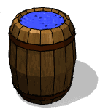
NO.9 bottle tone
Asal hosseinian
TEAM IRAN

Slide 2
9:bottle tone
Take an empty bottle and blow air across its mouth to produce a sound .now fill the bottle with some water and study how the sound changes .

Slide 3
Main approach
comprehension
EXPERIMENT AND RESULT
CONCLUSION
Theory

Slide 4
comprehension

Slide 5
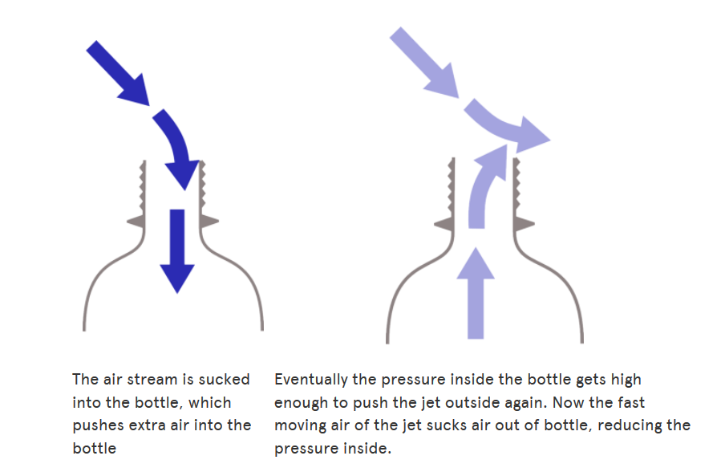
What's the sound made in bottle?
When you blow on the edge of the bottle you are making a jet of air, If you are making a noise this jet of air could either be deflected into the bottle or over the top of it, and it only takes a small force to change between these two paths.

Slide 6
theory

Slide 7
Sin & cos
sin
$$sinα:\frac{c}{a}$$
$$cosα:\frac{b}{a}$$
$$θ$$
cos
cos
Chord (a)
$$tgα→\frac{sinα}{cosα}$$
$$cotgα→\frac{cosα}{sinα}$$
(c)
$$α$$
(b)

Slide 8
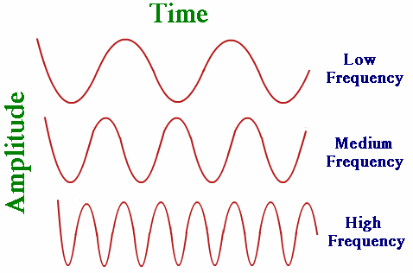
wave
When you compare this three shapes we get they're different is speed of hand.

Slide 9
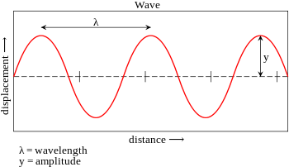
T(PERIOD)

Slide 10
In the bottle we have wave
This formula is the relationship between the speed (v) of the wave, the wavelength (λ)and the period (T) or frequency ( f ).
• it follows from Æ speed = distance / time.
• the wave travels one wavelength in one period, so wave speed v = λ / T,
• v = λ f • this is the “Golden Rule ” for waves
$$v=\frac{λ}{T}=λf speed of the wave$$

Slide 11
$$n\frac{λ}{2}$$
$$f=\frac{v}{x}=n\frac{v}{2l}$$
$$l=n\frac{λ}{2}$$
$$\frac{2l}{n}=λ$$

Slide 12
EXPERIMENT

Slide 13
Different parameter
Depth
Temperature
Concentration
intake

Slide 14
WE NEED AIR IN SAME SIZE
We need balloon and straw.
We plug in Straw head balloon and tightly to the does not outside air.

Slide 15
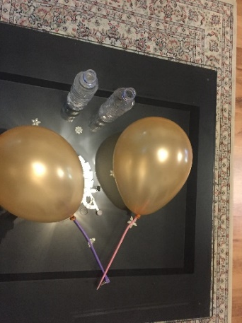
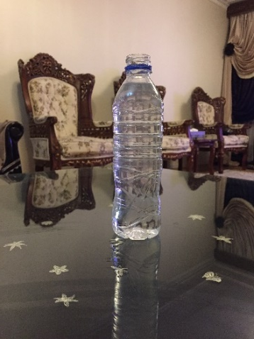
Then we have air in balloon and get the balloon and straw on the bottle . then free up head of the straw. Then Record the sound

Slide 16
depth

Slide 17
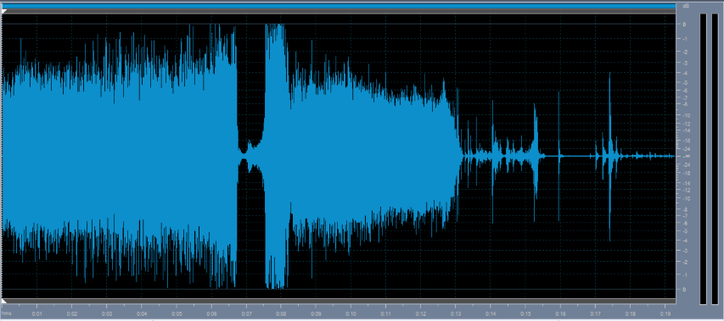
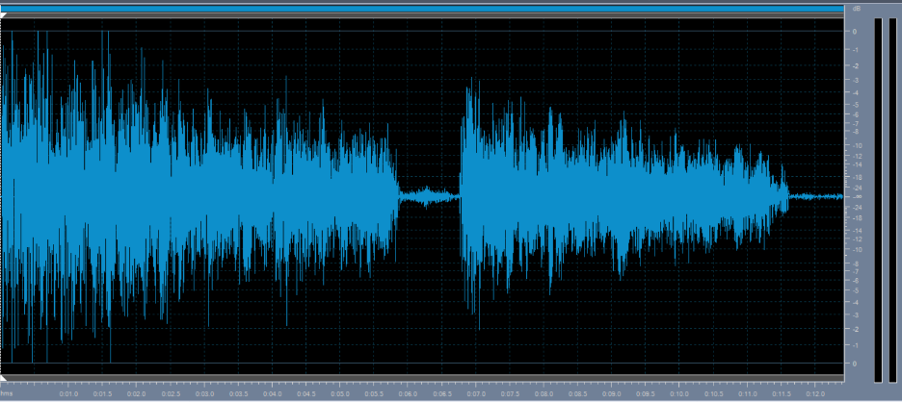
Empty bottle
With straw:
With mouth:

Slide 18
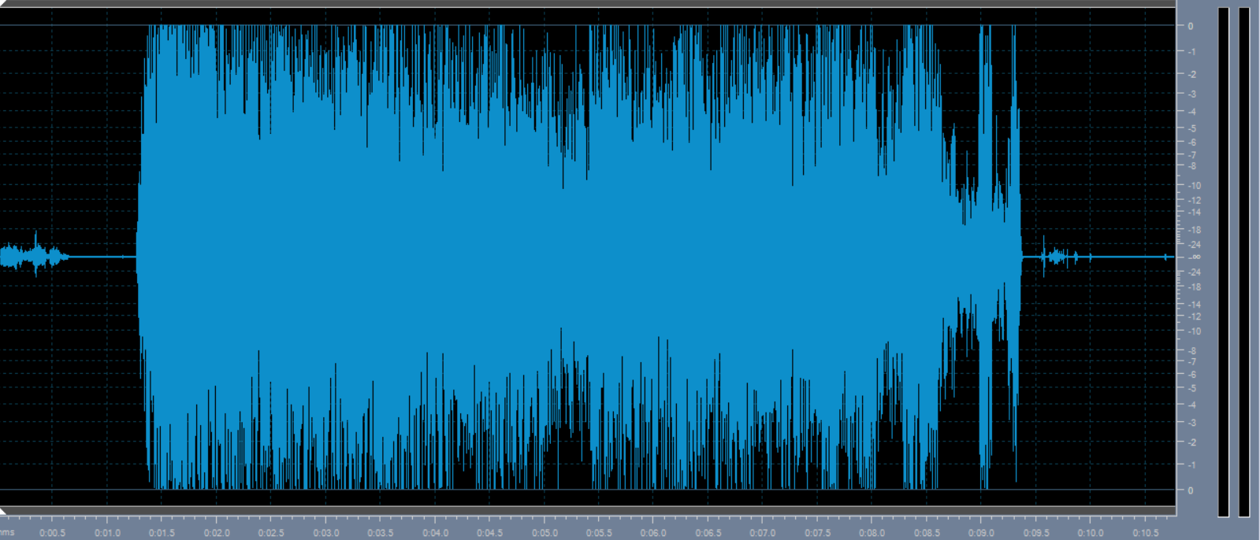
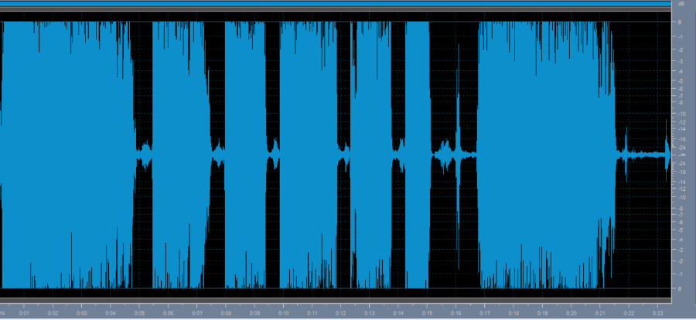
4cm water
With straw:
With mouth:

Slide 19
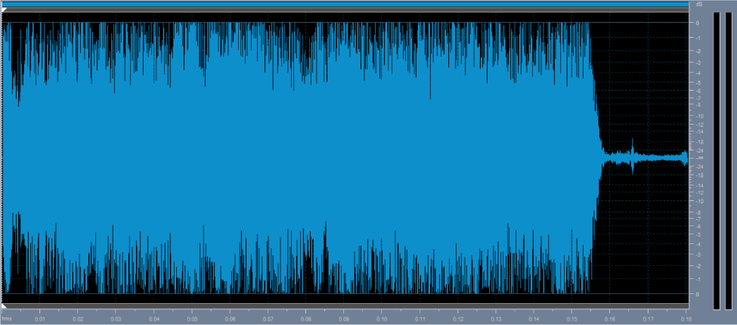
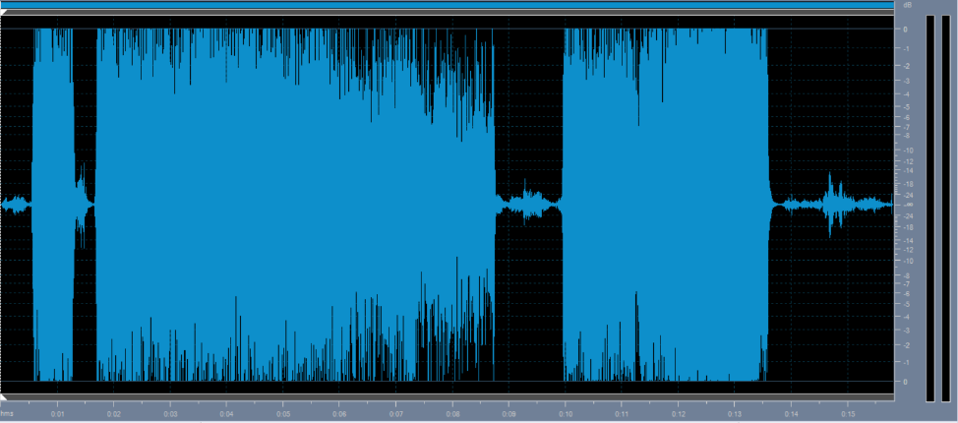
8cm water
With straw:
With mouth:

Slide 20
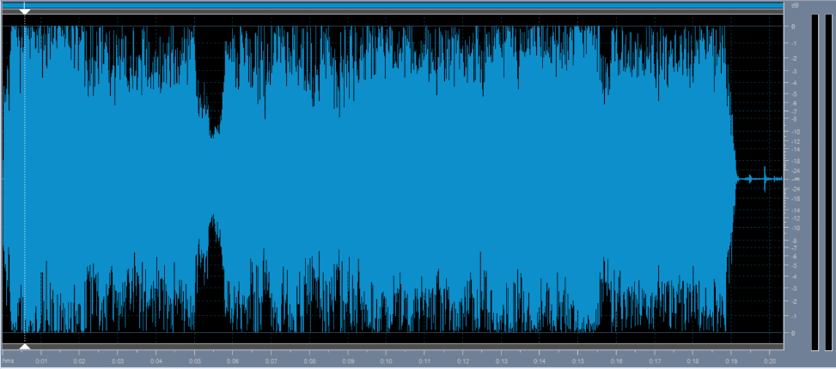
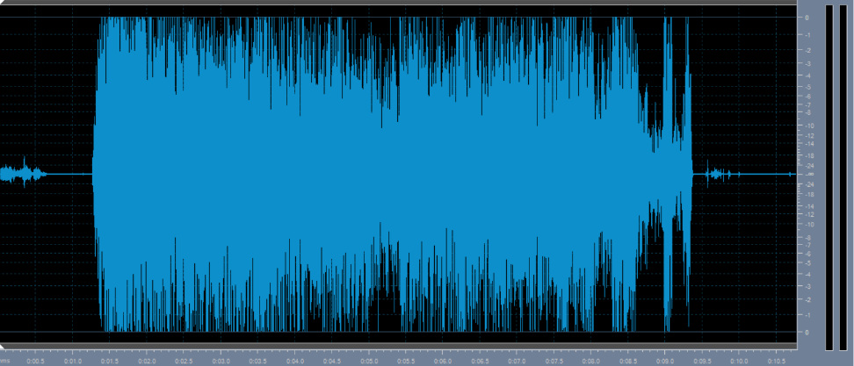
12cm water
With straw:
With mouth:

Slide 21
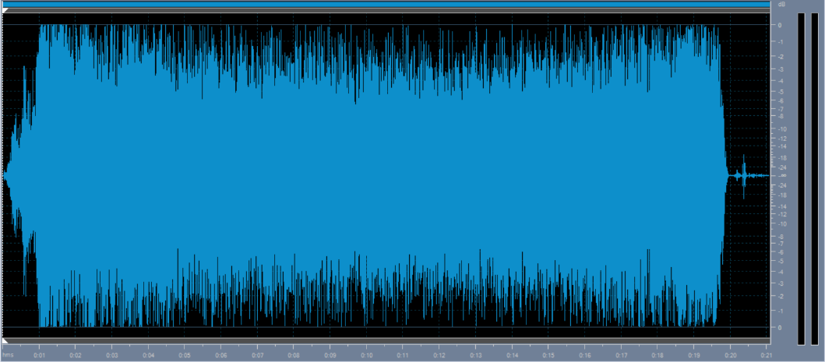
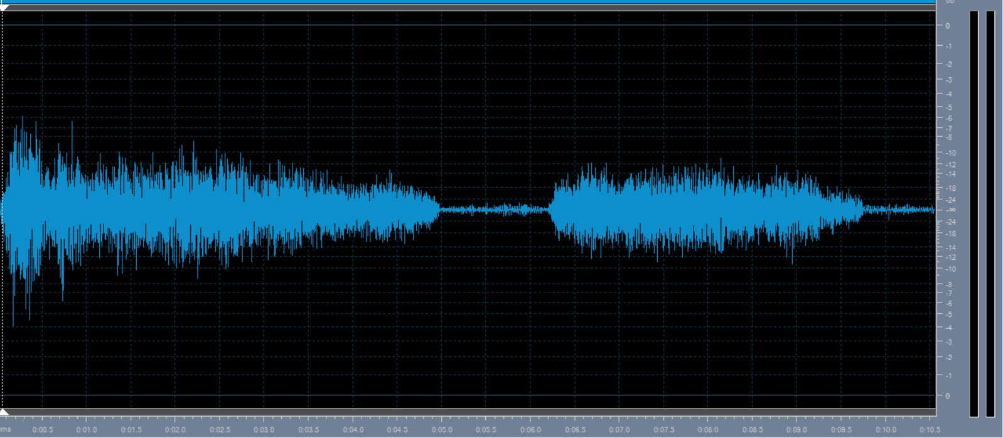
16cm water
With straw:
With mouth:

Slide 22
result
When the height of the water going to be upper the frequency going to be upper too.
And when we had water in the bottle the frequency is upper.

Slide 23
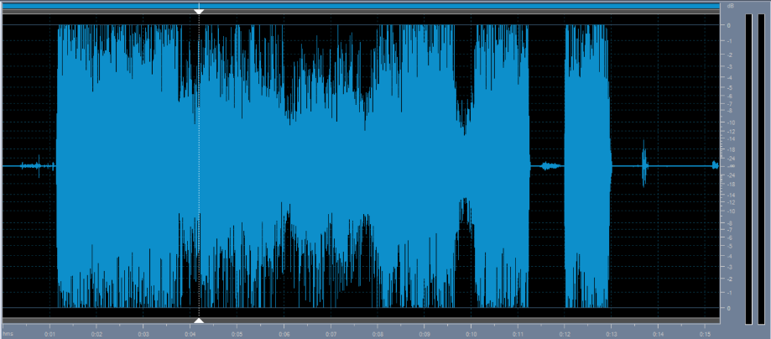
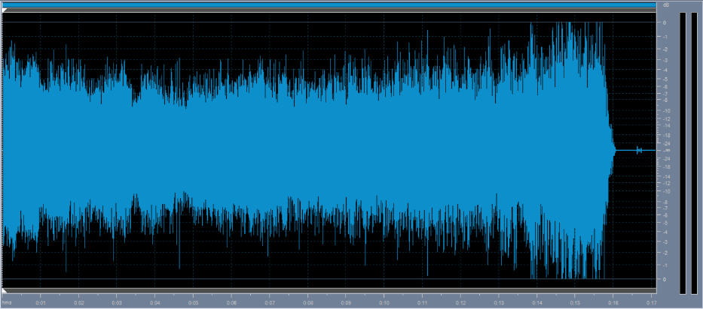
Solid(chocolate)
With straw:
With mouth:

Slide 24
Result
When we had solid in bottle the frequency is lower than when we had liquid and gasses.

Slide 25
Different temperature

Slide 26
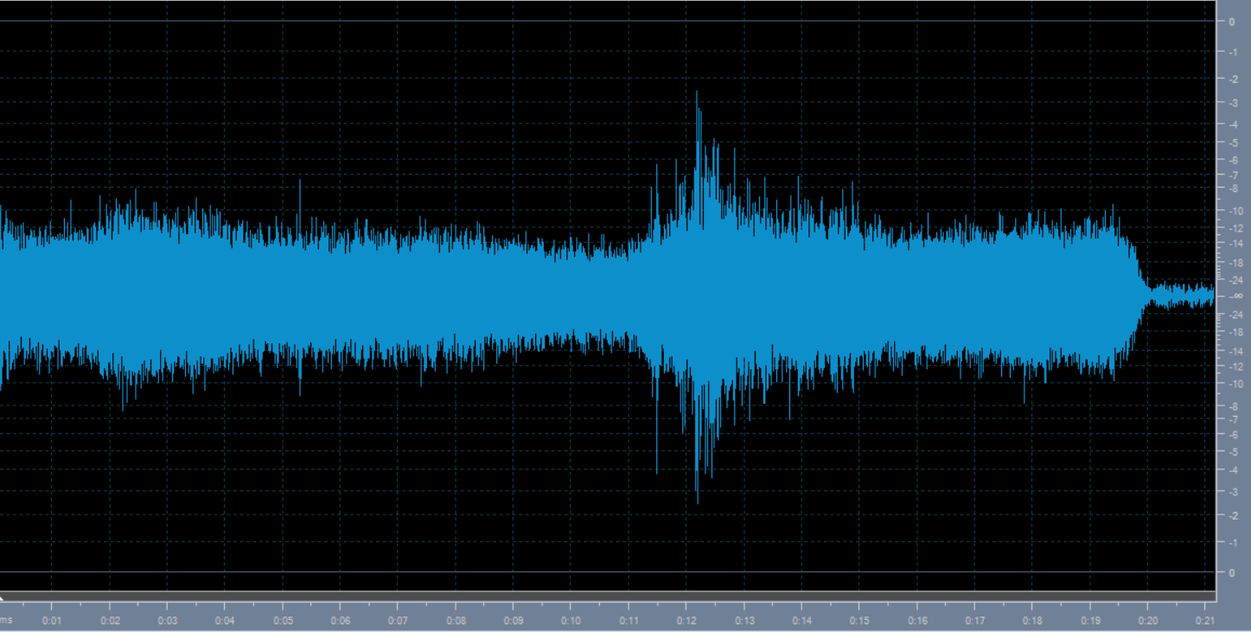
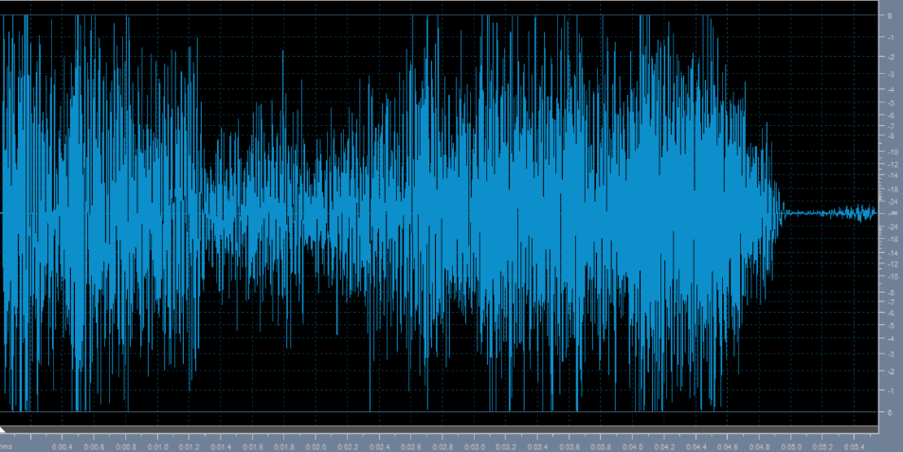
Warm water
With straw:
With mouth:

Slide 27
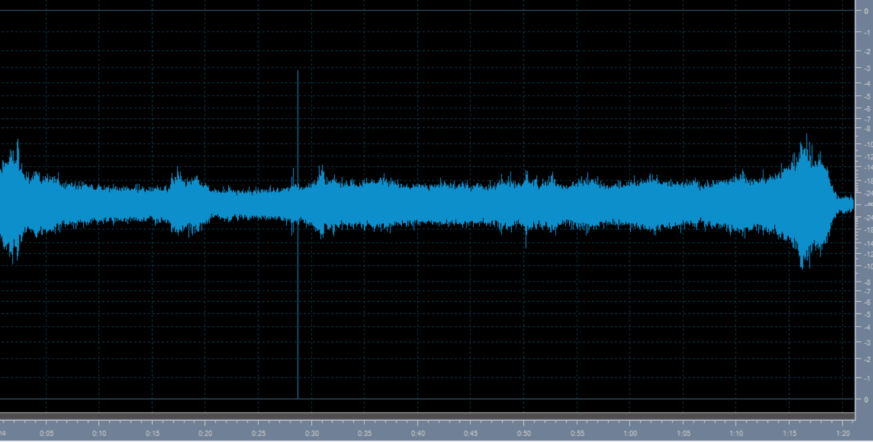
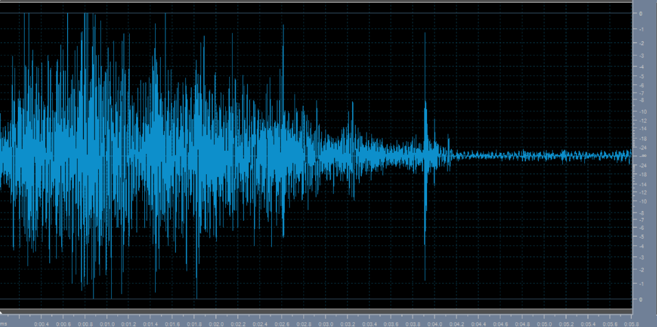
Cold water
With straw:
With mouth:

Slide 28
Result
Warm water had more frequency than cold water.

Slide 29
Concentration

Slide 30
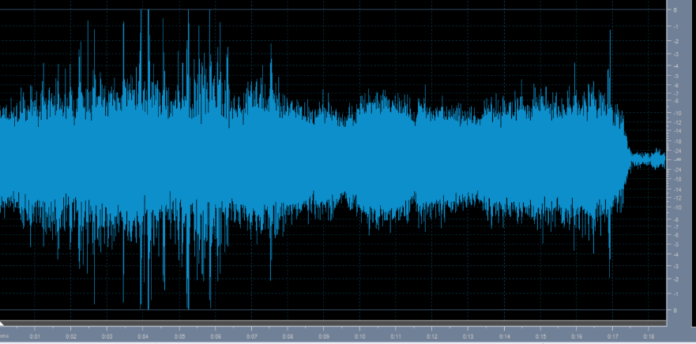
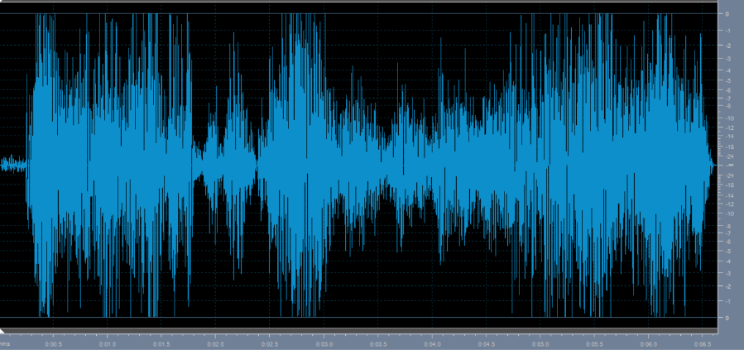
thick
With straw:
With mouth:

Slide 31
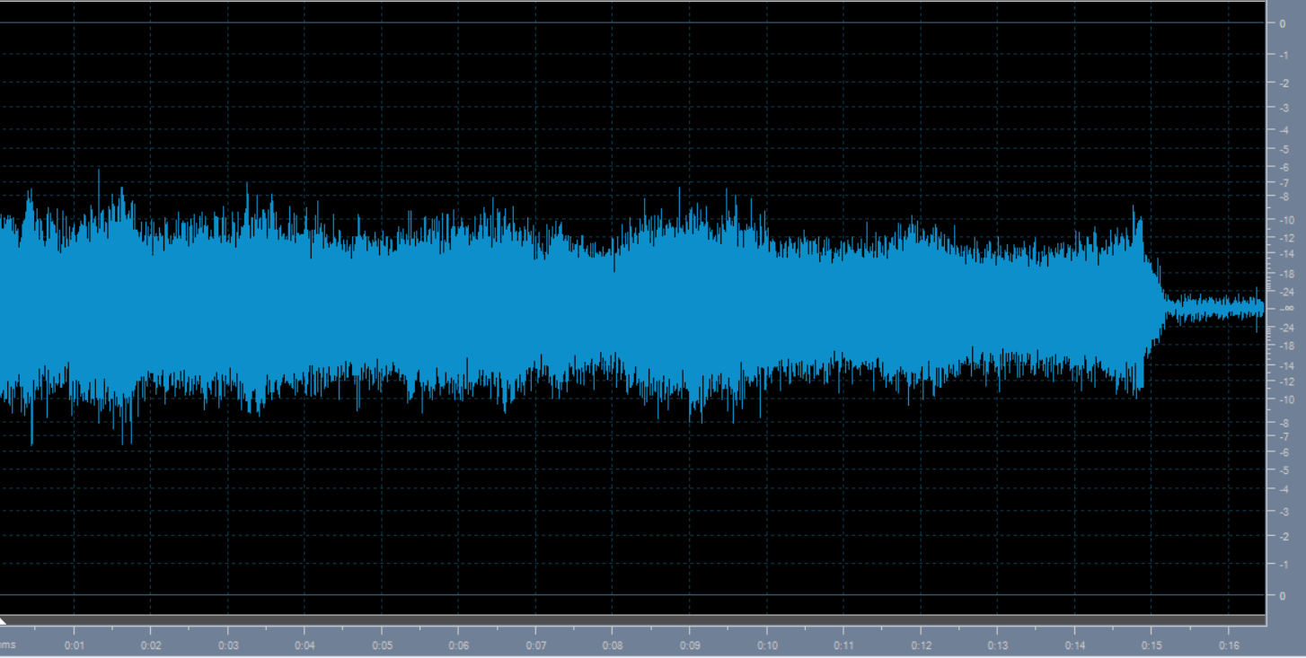
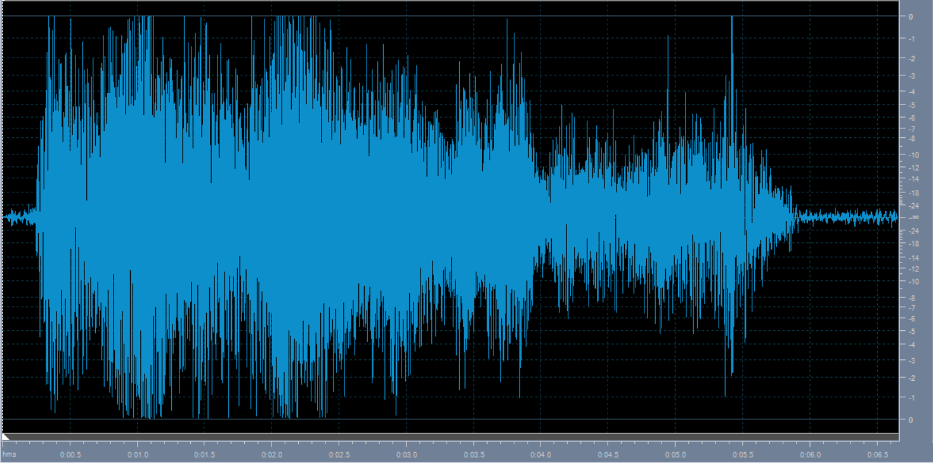
diluted
With straw:
With mouth:

Slide 32
result
In the thick liquid the frequency is more than the diluted liquid.

Slide 33
intake

Slide 34
With more air
With straw:
With mouth:

Slide 35
With less air
With straw:
Wth mouth:

Slide 36
result
When we had more air the frequency is more than when we had less air.

Slide 37
conclusion
Frequency in liquid is over then gasses and in gases over than solid.
When the height of the water going to be upper the frequency going to be upper too.
Warm water had more frequency than cold water.
In the thick liquid the frequency is more than the diluted liquid.
When we had more air the frequency is more than when we had less air.

Slide 38
references
David-Halliday-Robert-Resnick-Jearl-Walker-10ed
physics.stackexchange.com
wikipedia

