Slide 1
Reviewer problem #8 fair coin
moujan Naderi moshaei
Team Iran 2

Slide 2
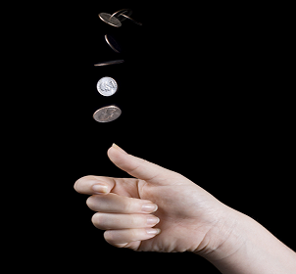
Problem
In many cases, disputes are resolved with a coin toss. It is presumed that this procedure gives equal chances of winning to both sides. Investigate how the chances depend on the tossing mechanism and the coin properties.

Slide 3
Reporter
Cons
He could measure the force
One of the experiments didn’t flip the coin the machine leave it
Pros
He had graph
He had machine

Slide 4
Opponent
Cons
She could ask better questions
Pros
she talk about the formula

Slide 5
Miss points
Reporter:
He didn’t talk about the force of the flipping.
Opponent:
She didn’t challenge about theory

Slide 6
Thank you all for your attention!

