Slide 1
5. Collision
Ella ‘Crazy Vixen’ Blakely
New Zealand

Slide 2
The Problem | Testing | Theory and Physics | Results | Conclusion
The Problem | Testing | Theory and Physics | Results | Conclusion
The Problem | Testing | Theory and Physics | Results | Conclusion
The Problem | Testing | Theory and Physics | Results | Conclusion
The Problem | Testing | Theory and Physics | Results | Conclusion

Slide 3
Problem
“A highly elastic Super Ball collides with a rigid surface. How can one determine the collision time? Propose various techniques and compare the experimental results.”
333
The Problem | Testing | Theory and Physics | Results | Conclusion
Notes:
I defined a collision as a period of time where there was a normal force exerted on the ball
and a rigid surface is something that keeps it shape and doesn't deform of deforms very little (unnoticeably so) when the ball will hit it.

Slide 4
Theory
Elastic and inelastic collision
-COR – coefficient of restitution
Energy transfer – conservation of energy
Momentum

Slide 5
Theory
momentum
Notes:
If an object is moving it has momentum. Momentum can be defined as ”mass in motion”

Slide 6
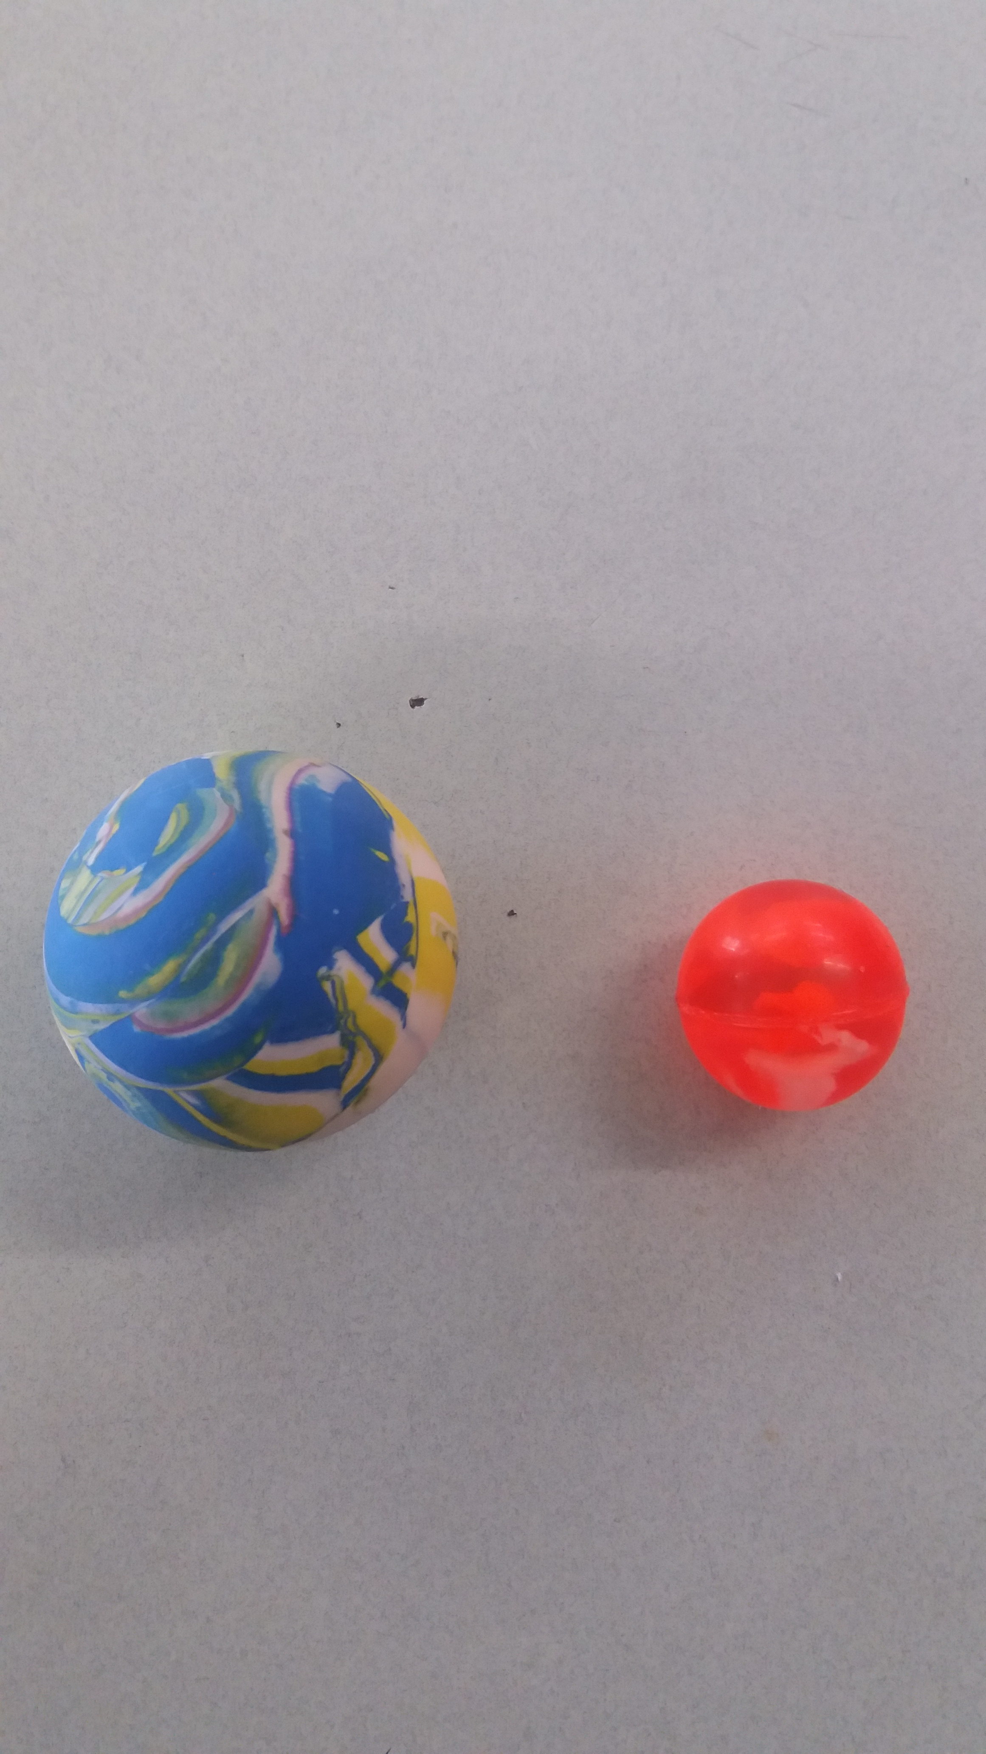
Different methods of testing
High speed video
Piezo disk– Voltage over time
Sound
Motion sensor
Big Ball
0.075kg
Small Ball
0.01kg
The Problem | Testing | Theory and Physics | Results | Conclusion
Notes:
For each method of testing I dropped the ball from set of different heights in order to change the velocity, as I had read that the velocity would effect the collision time and proved that with initial testing.

Slide 7
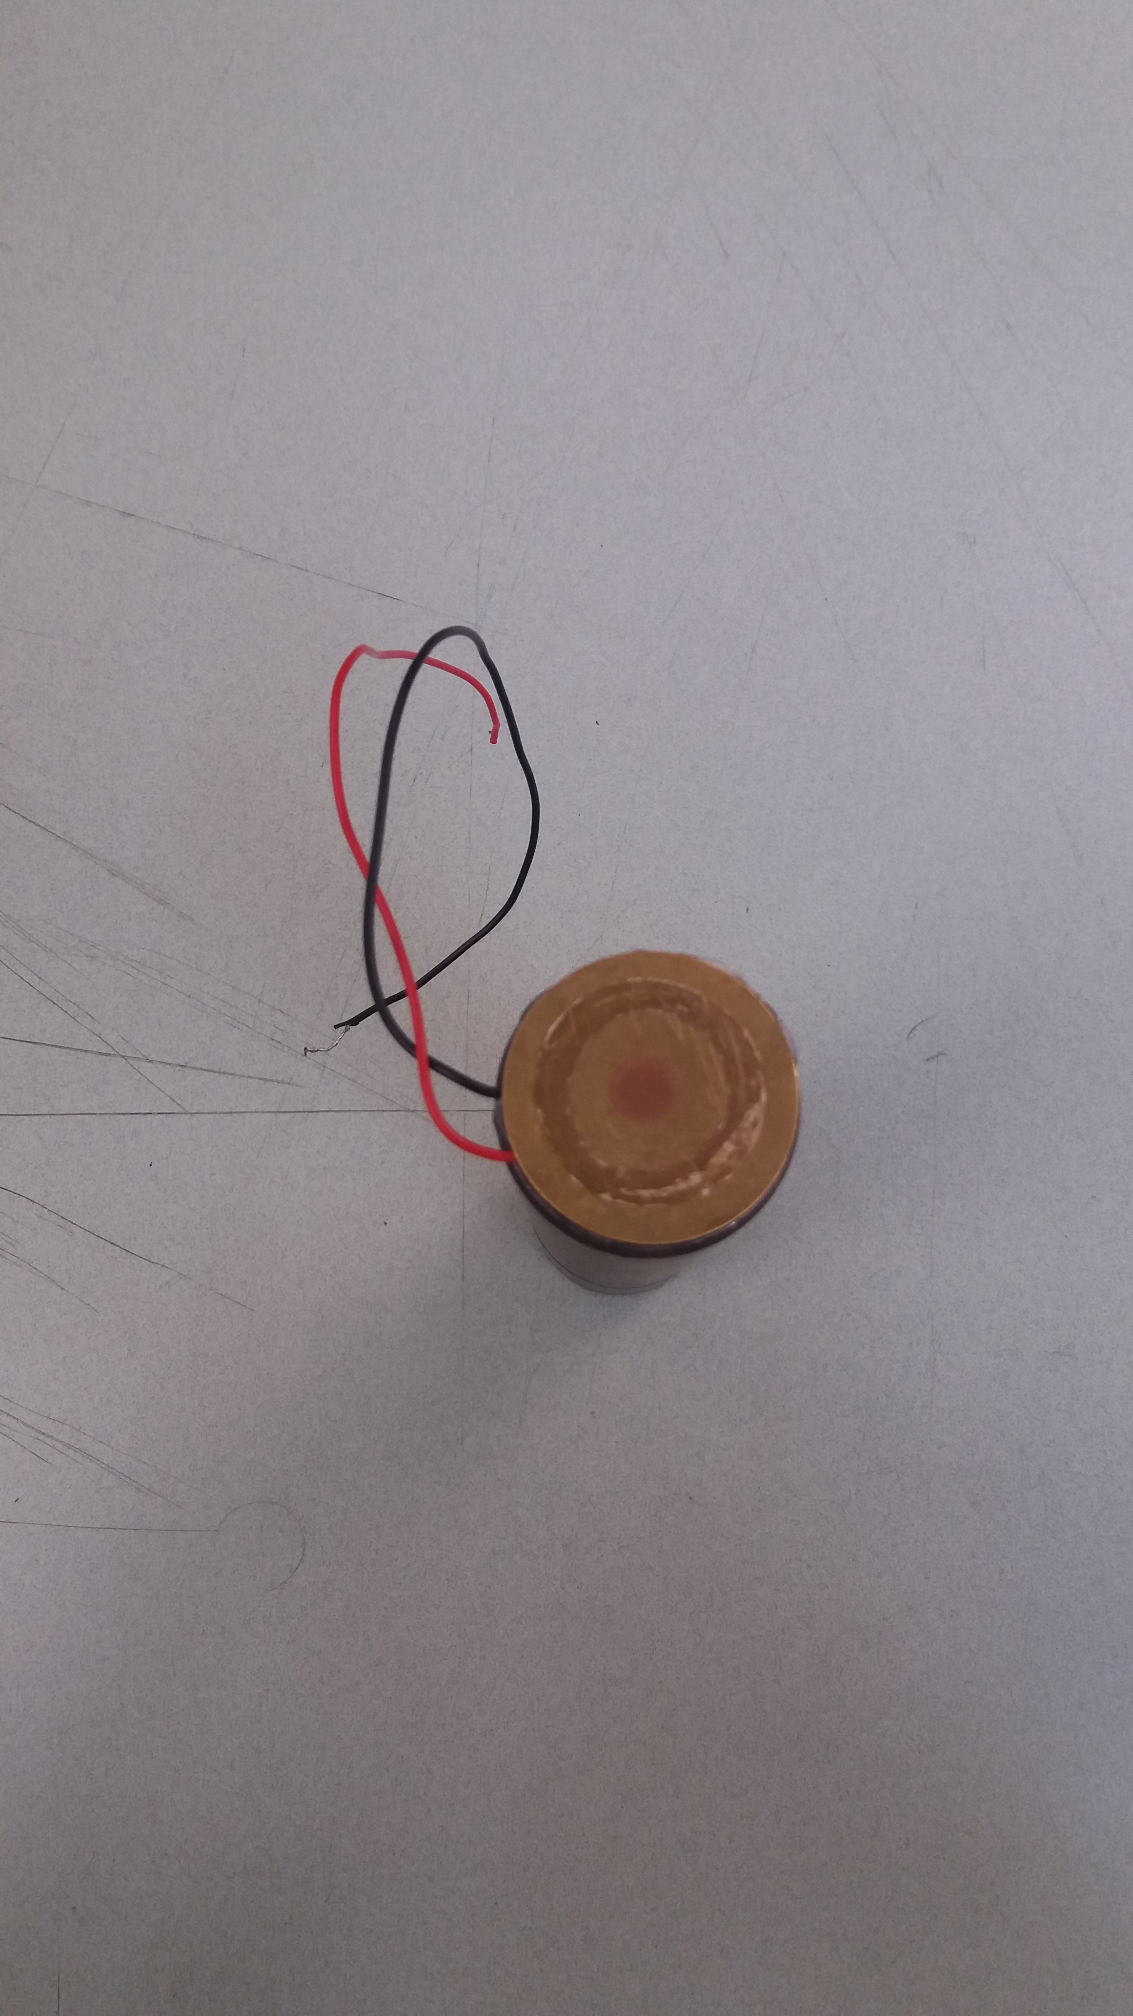
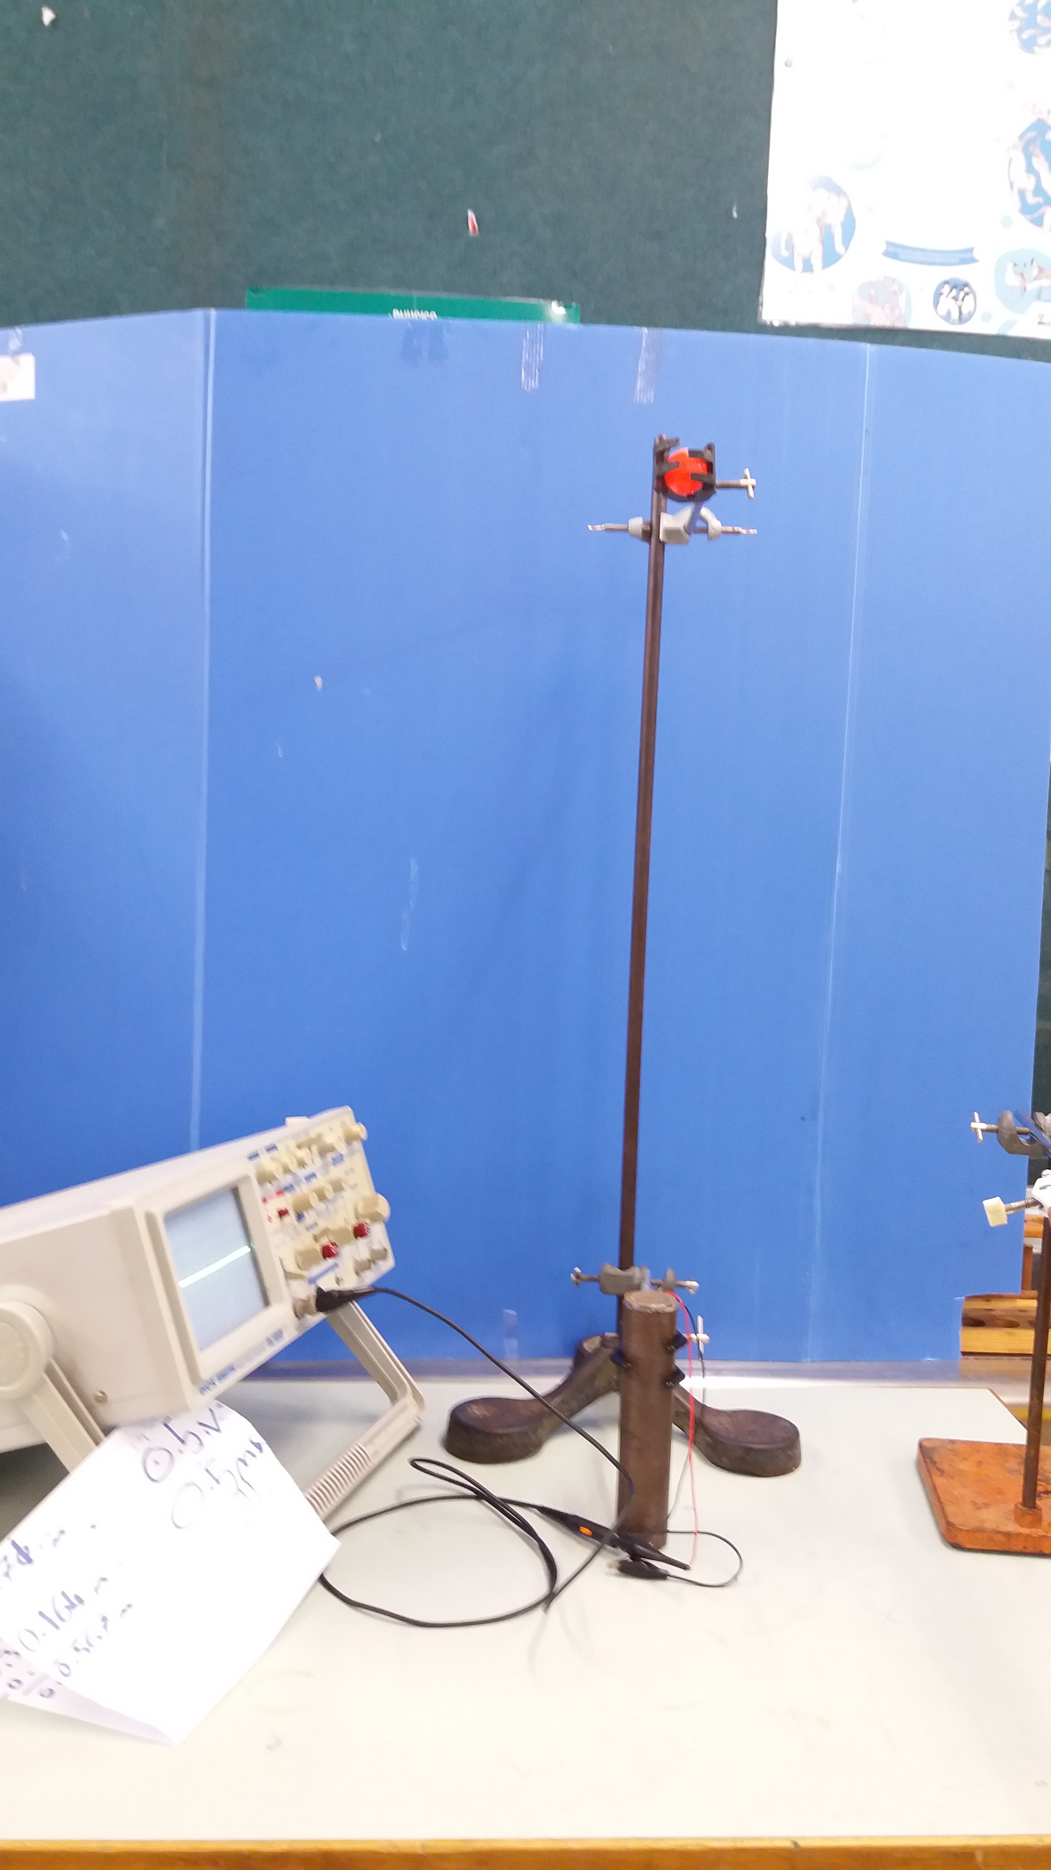
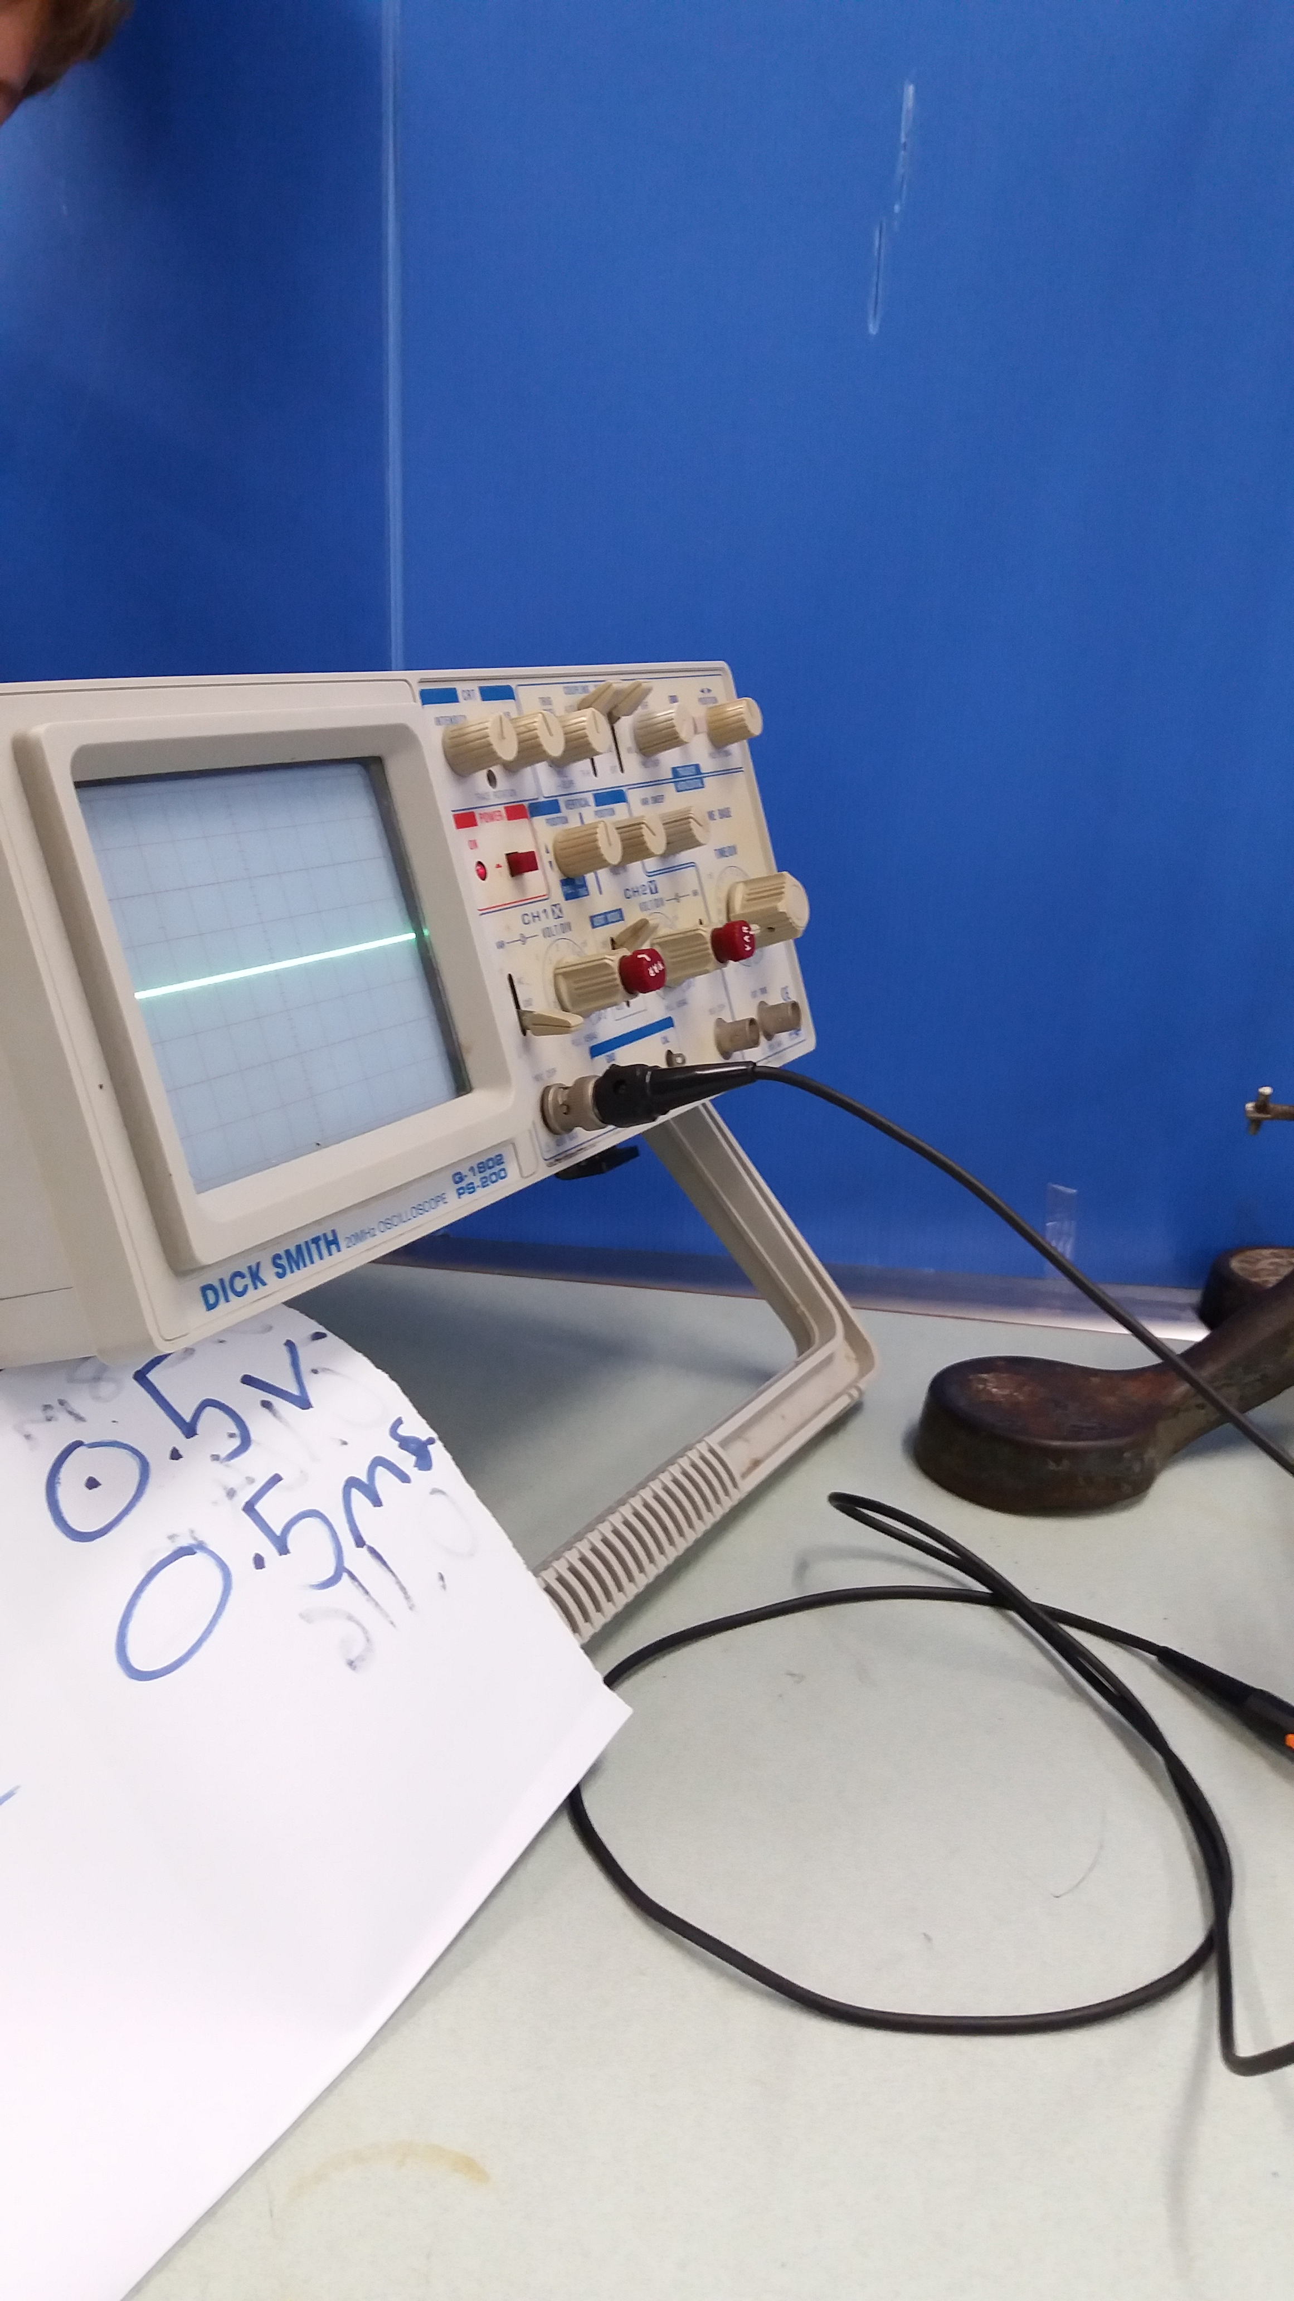
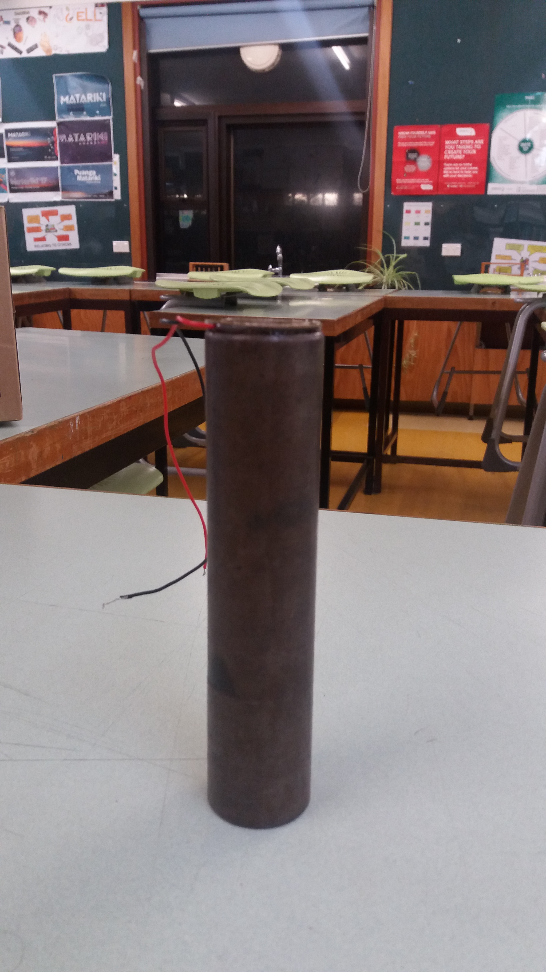
Piezo chip:
Ball
Piezo
Oscilloscope
Piezo
Rod
Connecting wires
Rod
The Problem | Testing | Theory and Physics | Results | Conclusion

Slide 8
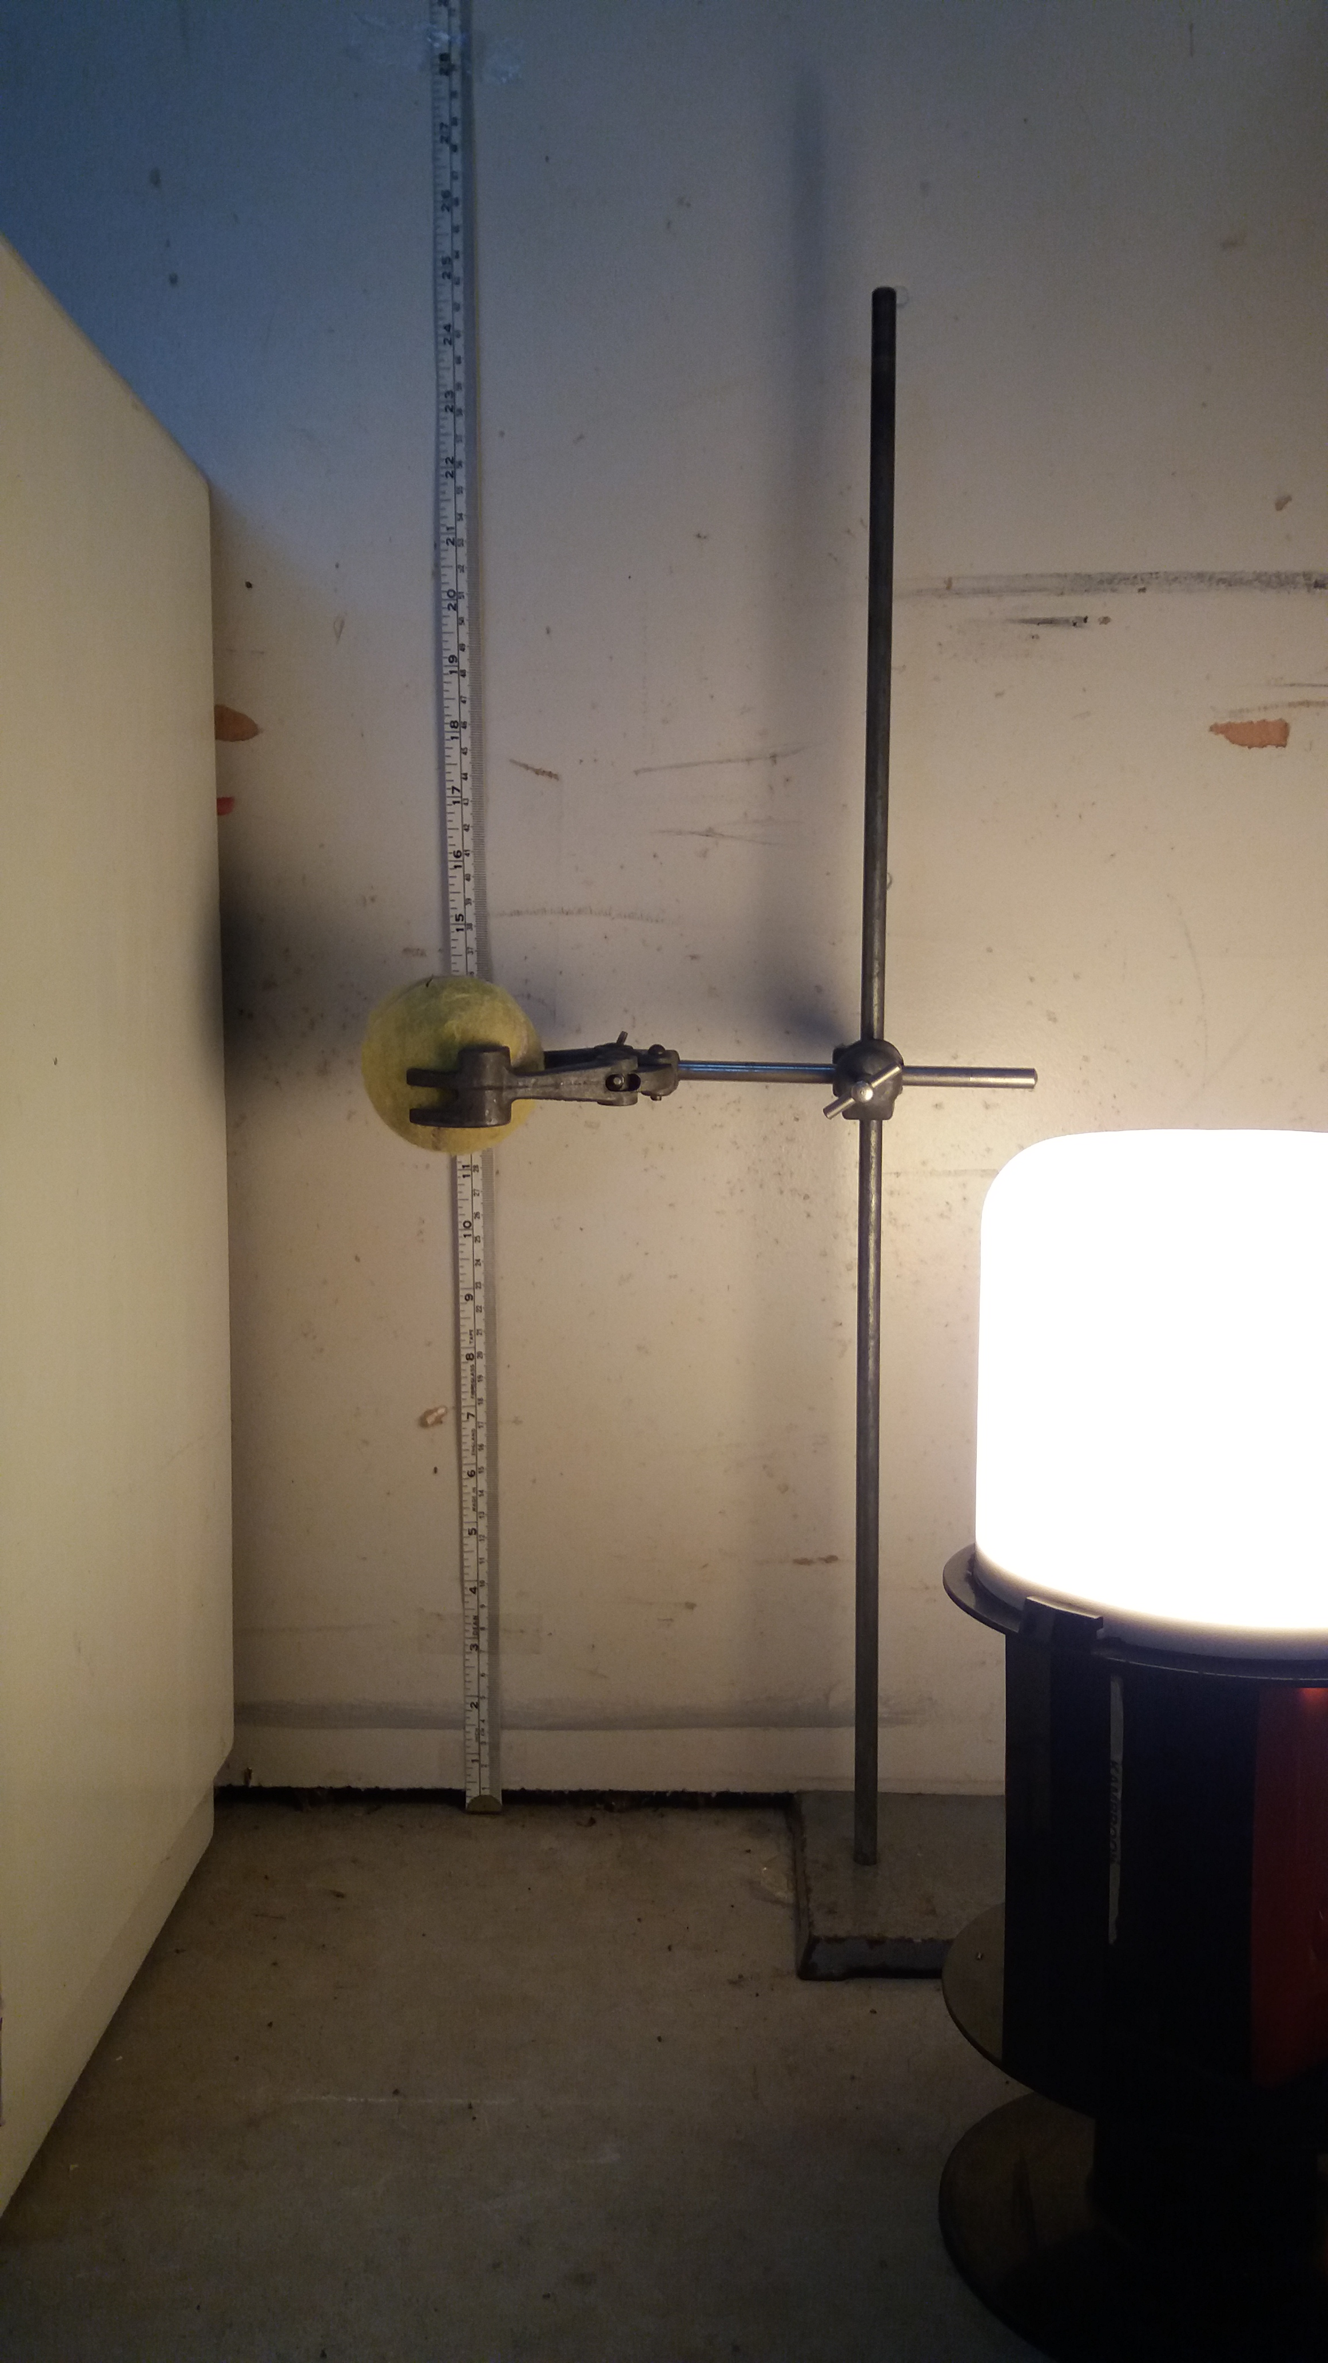
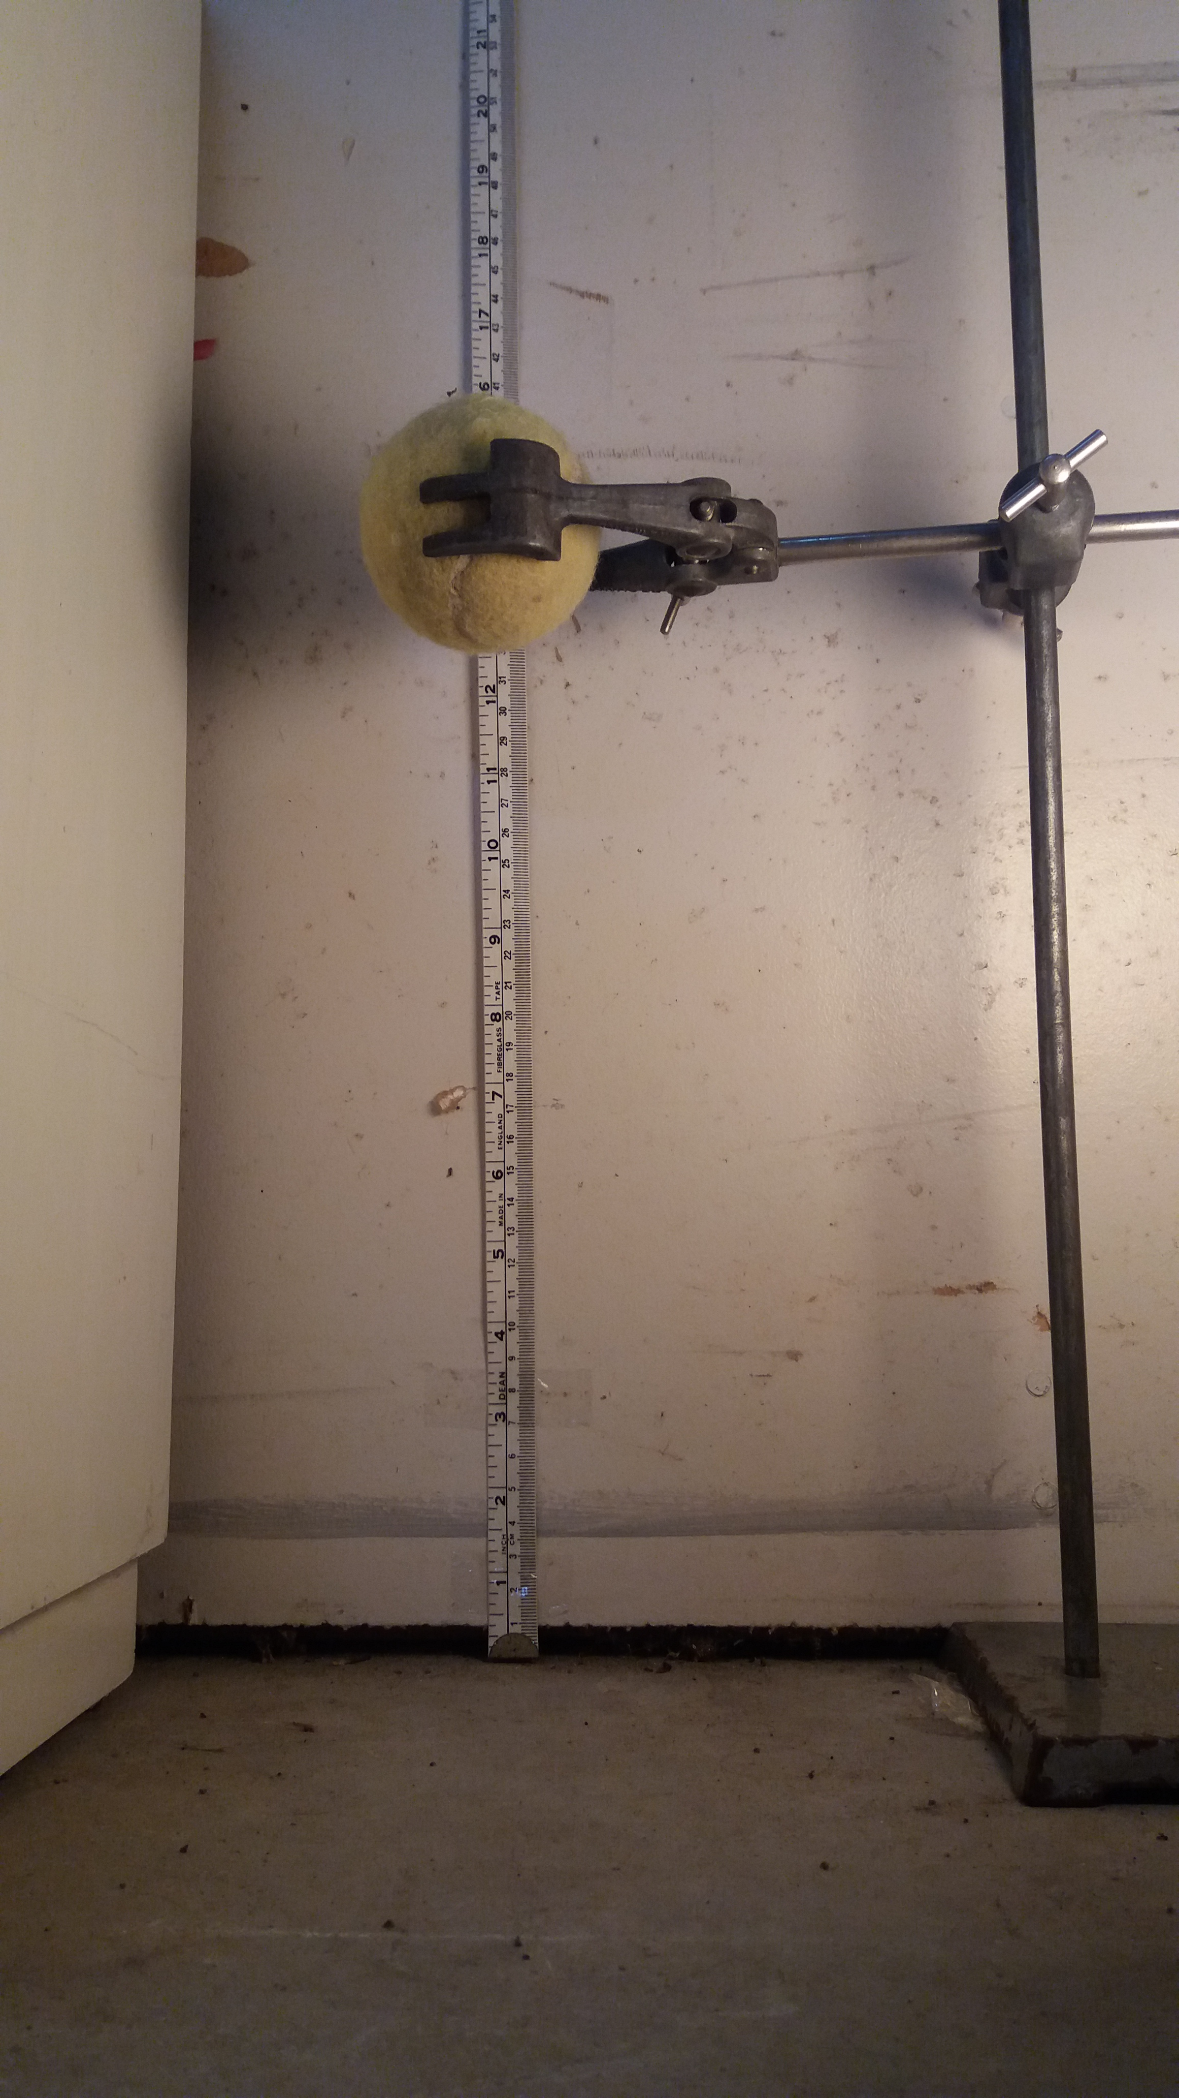
High Speed Video:
Measuring Tape
Clamp Stand
Ball
Piezo
Ball
Light
Ball
Clamp
Camera
The Problem | Testing | Theory and Physics | Results | Conclusion

Slide 9
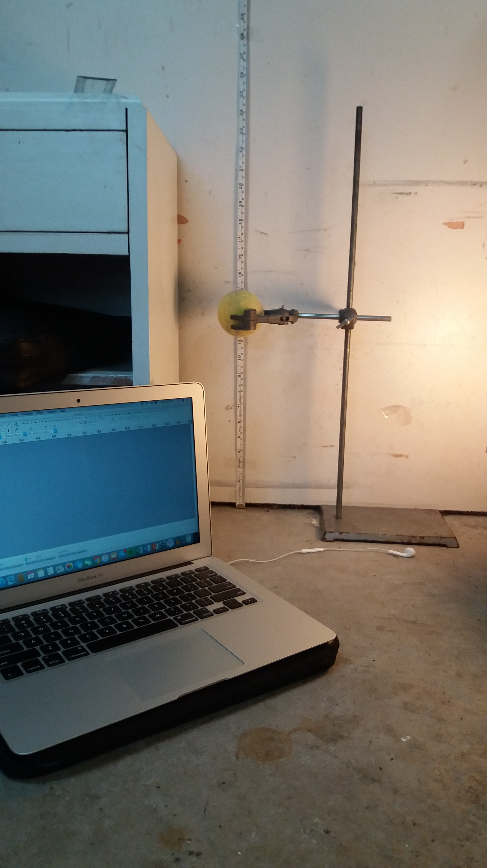
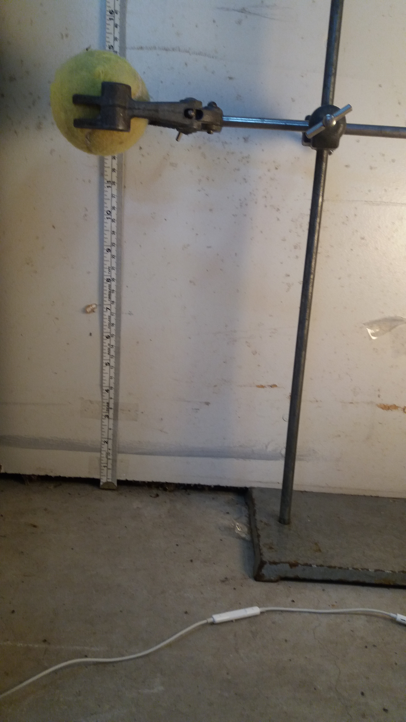
Sound:
Measuring Tape
Ball
Piezo
Clamp Stand
Clamp
Ball
Ball
Clamp Stand
Microphone
Microphone
Laptop Recording Data
The Problem | Testing | Theory and Physics | Results | Conclusion

Slide 10
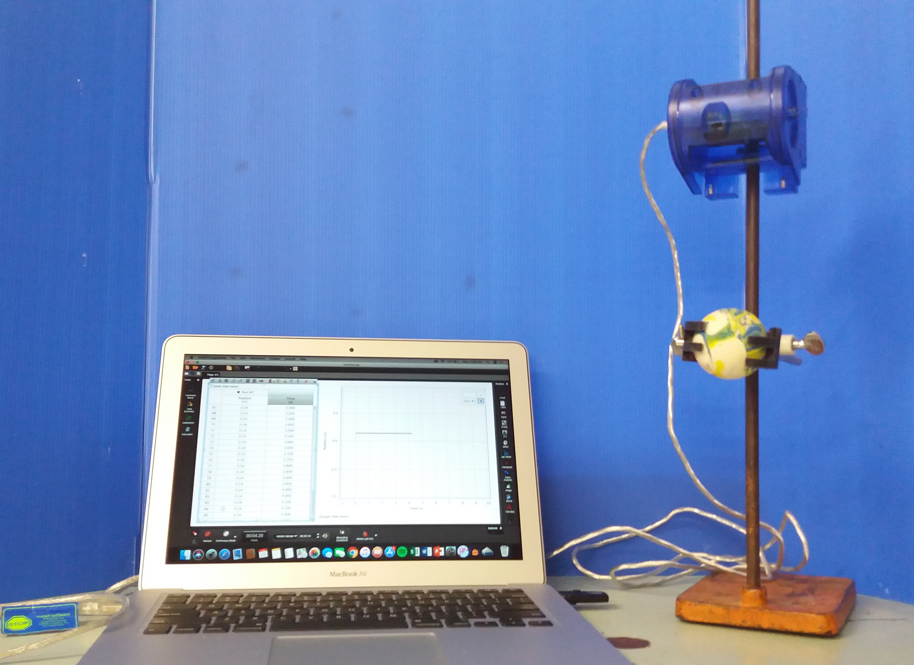
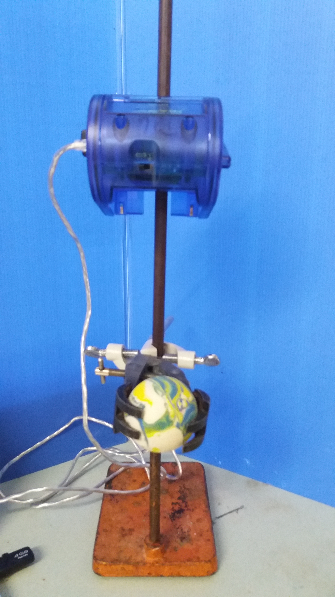
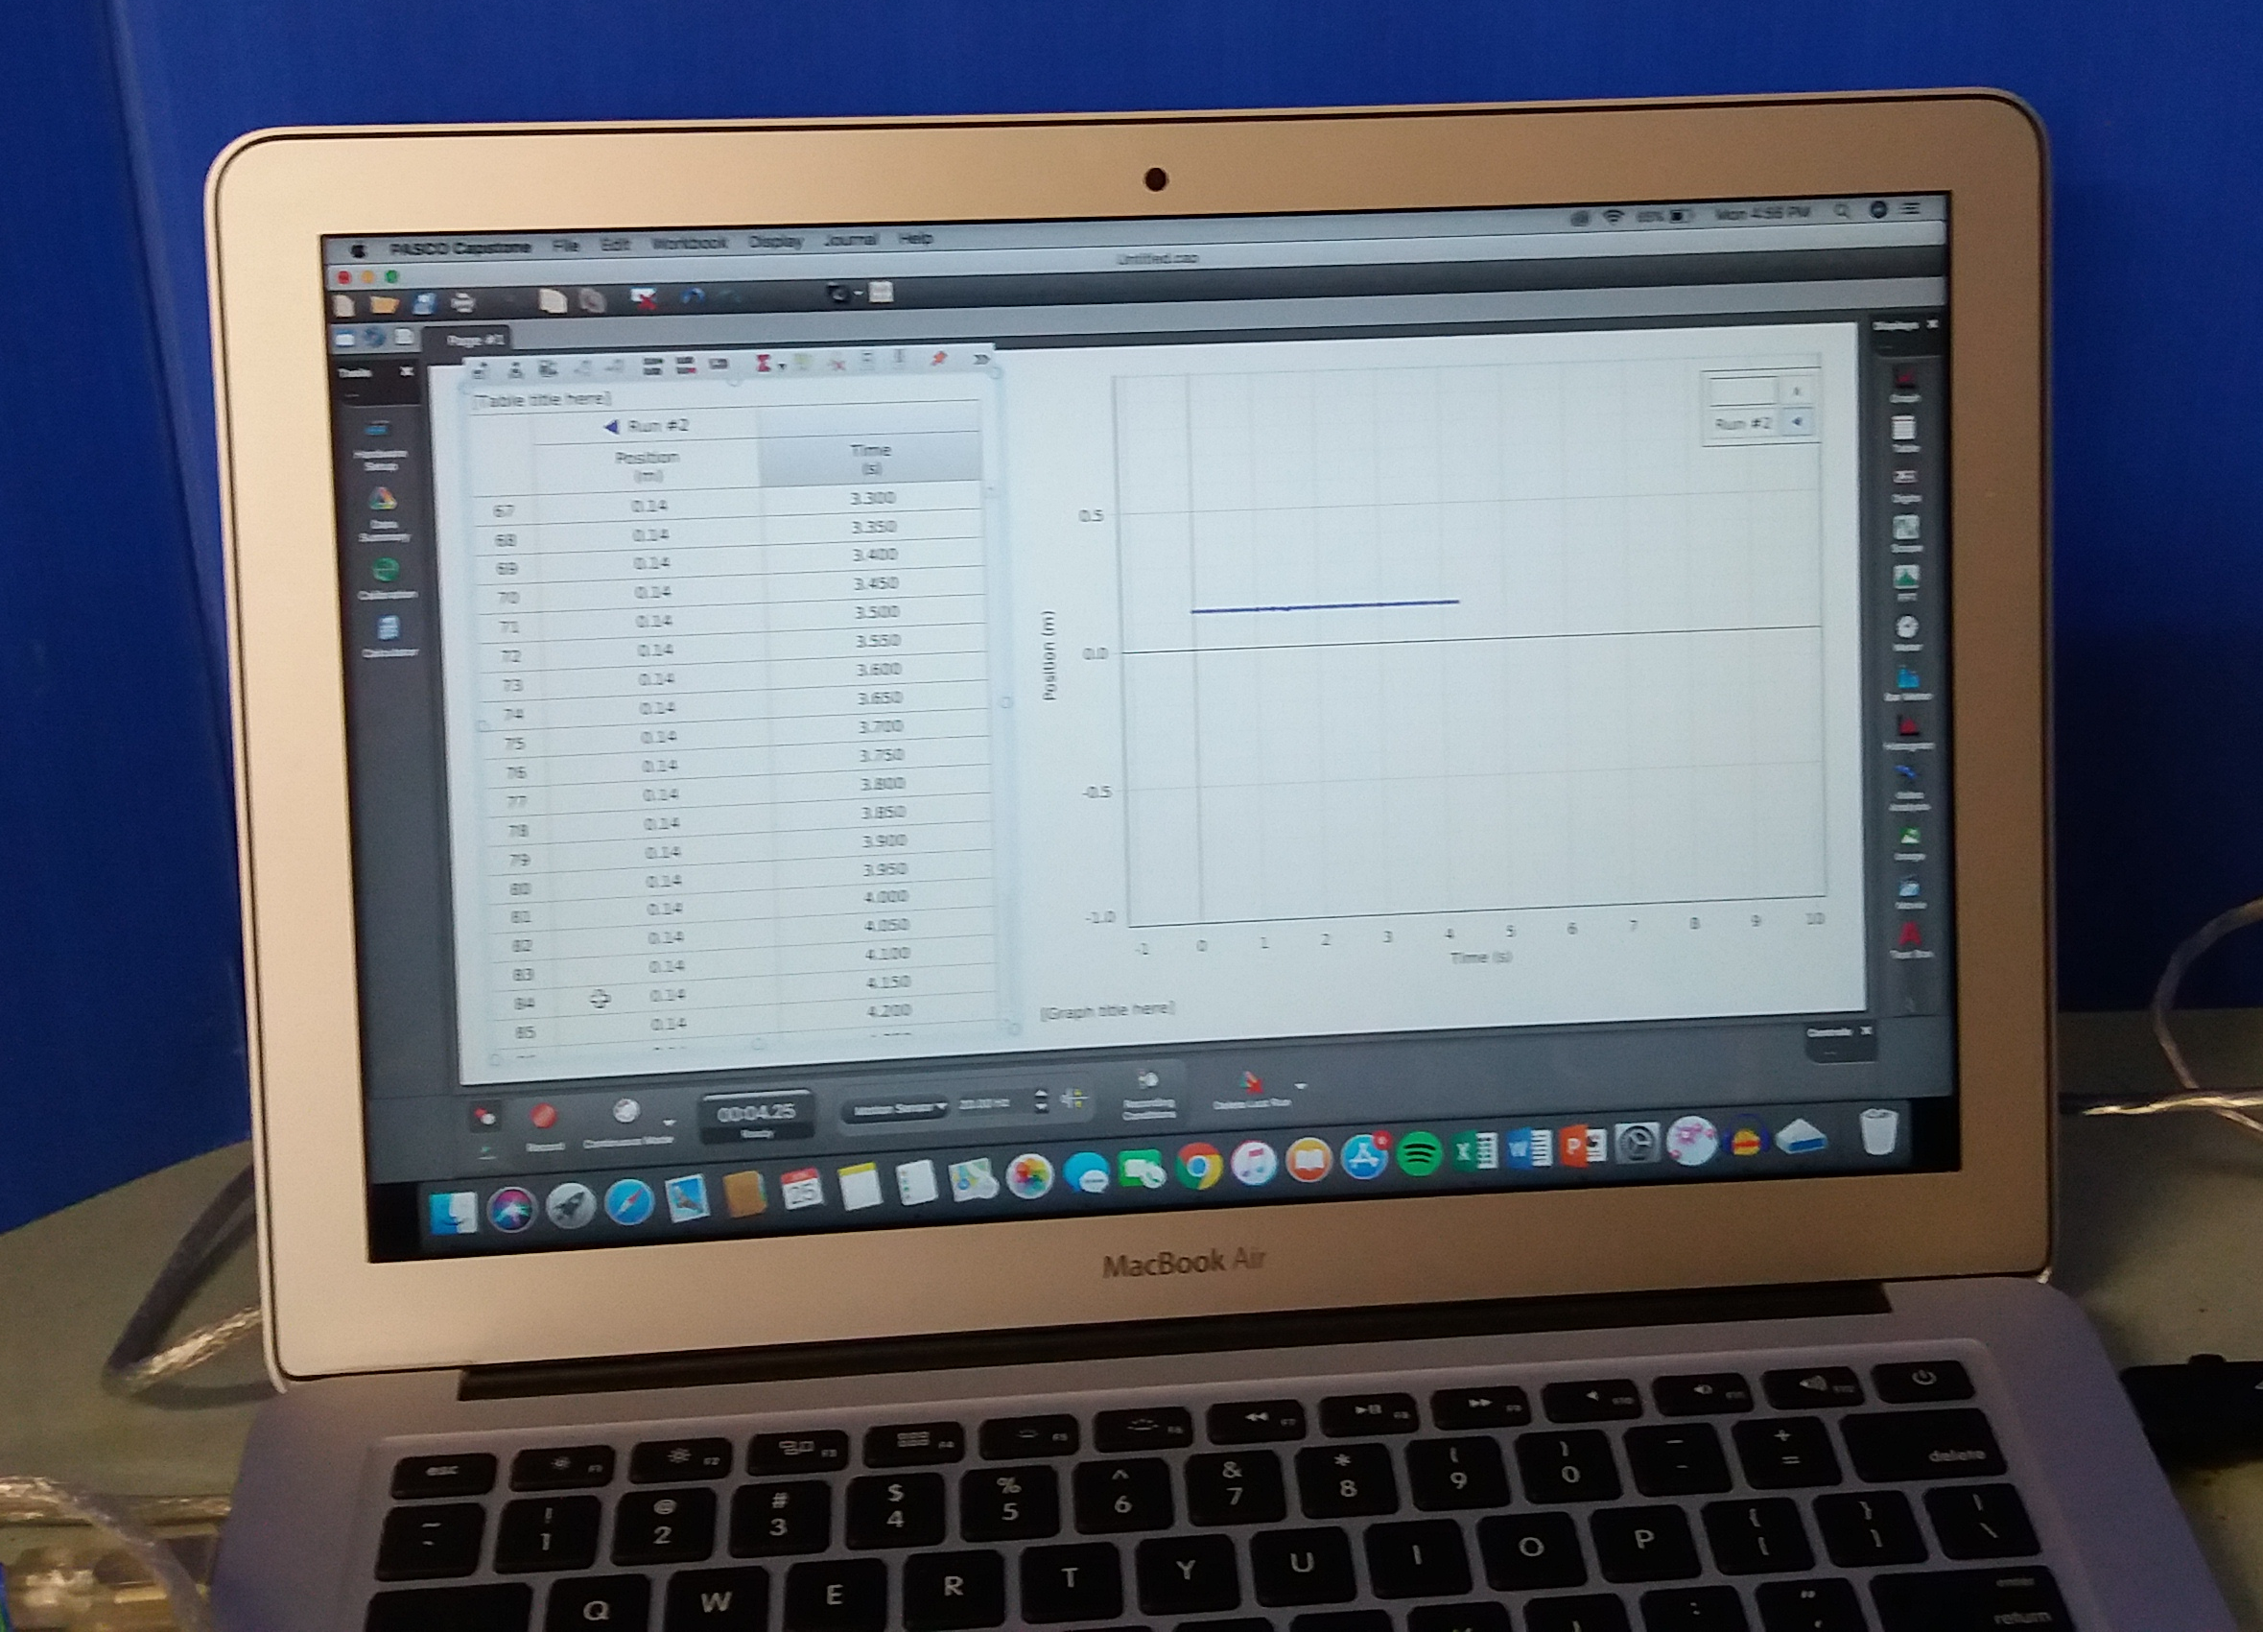
Motion Sensor:
Ball
Piezo
Motion Sensor
Laptop Recording Data
Clamp Stand
Motion Sensor
Clamp
Ball
Ball
PASCO
Capstone
The Problem | Testing | Theory and Physics | Results | Conclusion

Slide 11
The Problem | Testing | Theory and Physics | Results | Conclusion
Notes:
The motion sensor was unreliable as the refresh rate was not high enough. It didn’t work all the time as it wouldn’t always pick up the ball. this graph shows the data for one of the times it did work, the points when the ball is furthest away from the sensor and seems to be at rest is the collision time.

Slide 12
What methods work best?
Method: | Accuracy: | Force:
Piezo chip | Analog | Yes
Sound | 4.s.f + | No
High Speed Video | 1.s.f | No
Motion Sensor | 1.s.f | No
The Problem | Testing | Theory and Physics | Results | Conclusion

Slide 13
Theory
Elastic and inelastic collision
COR – Coefficient of Restitution
The Problem | Testing | Theory and Physics | Results | Conclusion
Notes:
There are two different type of collision. Elastic and inelastic.
An elastic collision happens when two things collide and the net amount of energy does not change, in the case of the ball, it would be dropped and travel back up to the same point it started from. This is because both momentum and kinetic energy is conserved. Because the net amount of energy does not change this means that the ball would continue to drop and bounce back to the starting point indefinitely.
An inelastic collision is what occurs with the ball in this problem. An inelastic collision is when some kinetic energy is lost, but the momentum of the system is still conserved. The kinetic energy that is lost is transferred into something else. An inelastic collision occurs when in this case the ball is dropped from height 1 and bounce back to height 2, lower than the original starting height. This is the most common type of collision.
A perfectly inelastic collision occurs when the maximum amount of kinetic energy is lost, in the case of the ball it would drop and not bounce back.
The coefficient of restitution is a ratio the initial and final velocity between two objects after they collide. It ranges from 0 to 1. 0 would be a perfectly inelastic collision, and 1 would be a perfectly elastic collision. The numbers in-between show inelastic collisions.
I used the COR to determine whether the ball was highly

Slide 14
Theory
Elastic collisions
  No energy lost
  Only occur on atomically level
Drop Height
Ground
The Problem | Testing | Theory and Physics | Results | Conclusion
Notes:
An elastic collision happens when two things collide and the net amount of energy does not change, in the case of the ball, it would be dropped and travel back up to the same point it started from. This is because both momentum and kinetic energy is conserved. Because the net amount of energy does not change this means that the ball would continue to drop and bounce back to the starting point indefinitely.

Slide 15
Theory
Inelastic collisions
  Energy is lost
  Most common type of collision
Drop Height
Bounce/Final Height
Ground
The Problem | Testing | Theory and Physics | Results | Conclusion
Notes:
An inelastic collision is what occurs with the ball in this problem. An inelastic collision is when some kinetic energy is lost, but the momentum of the system is still conserved. An inelastic collision occurs when in this case the ball is dropped from height 1 and bounce back to height 2, lower than the original starting height. This is the most common type of collision.
A perfectly inelastic collision occurs when the maximum amount of kinetic energy is lost, in the case of the ball it would drop and not bounce back.

Slide 16







Theory
$$Cr=\frac{V_{f}}{V_{i}}$$
COR - Coefficient of Restitution
$$√$$
$$\frac{2gh_{f}}{2gh_{i}}$$
$$Cr=$$
$$√$$
$$\frac{h_{f}}{h_{i}}$$
$$Cr=$$
The Problem | Testing | Theory and Physics | Results | Conclusion
Notes:
The coefficient of restitution is a ratio the initial and final velocity between two objects when they collide. It ranges from 0 to 1. 0 would be a perfectly inelastic collision, and 1 would be a perfectly elastic collision. I used the COR to determine whether the ball was highly elastic or not, if it was over 0.8 I decided it would be highly elastic.
The COR is collision dependent as well as ball dependent, the COR can change depending on the surface of which it collides with.

Slide 17
Theory
Gravitational Potential
Energy transfers – conservation of energy
Gravitational Potential
Kinetic
Elastic Potential
Kinetic
Kinetic
Kinetic
Sound
Thermal
Thermal
Sound
Elastic Potential
The Problem | Testing | Theory and Physics | Results | Conclusion
Notes:
The law of conservation of energy states that the total amount of energy remains constant in an isolated system. It implies that energy can neither be created nor destroyed, but can be change from one form to another.
Main energy transfer = kinetic to elastic potential back to kinetic.
The ball creates a sound as it hits the ground due to the air between the ball and the surface it is hitting being pushed out of the way. This creates an audible pressure wave perceived as sound.
We already know that that some of the energy is transferred, as we are dealing with inelastic collisions. The kinetic energy in these collision is usually transferred into sound energy, thermal energy and deformation of the ball. Energy can also be stored in the ball and used to return the ball to its original shape.

Slide 18
Theory
Fw= ball mass x 9.8
Fw
The Problem | Testing | Theory and Physics | Results | Conclusion
Notes:
As the ball is dropped it acts as a projectile, as the only thing acting upon it is gravity. So the force pulling it down is its weight force = to its mass.

Slide 19
Fw
The Problem | Testing | Theory and Physics | Results | Conclusion
Notes:
When the ball is travelling though the air it gains kinetic energy as it accelerates towards the ground.

Slide 20
Fw
The Problem | Testing | Theory and Physics | Results | Conclusion
Notes:
This is when the ball changes from not being part of the collision to being part of the collision. Transition

Slide 21
Fn
Fw
The Problem | Testing | Theory and Physics | Results | Conclusion
Notes:
When the ball starts to compress an upwards normal force is exerted on the ball from the surface the balls collides with. The normal force will be many orders magnitudes larger than the weight force.

Slide 22
Fn
Fw
The Problem | Testing | Theory and Physics | Results | Conclusion
Notes:
When the ball reaches its point of greatest compression the normal force exerted is at at its greatest point. These forces are unbalanced with a greater upwards force so the ball starts to expand, and accelerate upwards.

Slide 23
Fn
Fw
The Problem | Testing | Theory and Physics | Results | Conclusion
Notes:
The upward normal force has decreased from when the ball was most compressed but is still greater than the downwards force, so the ball continue to travel in upwards direction.
Because the normal forces is larger it is what forces the ball to decompress and then accelerate in an upwards direction.

Slide 24
Fw
The Problem | Testing | Theory and Physics | Results | Conclusion
Notes:
The ball will then travel up into the air but wont travel the full way up to its original starting point, as it has lost some of the energy it had gained.

Slide 25





Finding the spring constant
$$F = Force$$
$$k = Spring Constant$$
$$x = Extension or Compression$$
Hooke’s Law – Hertz Adjustment
Spring:
Ball:
$$F=−kx^{(\frac{3}{2})}$$
$$F=−kx$$
$$k=−\frac{F}{x}$$
$$k=−\frac{F}{x^{(\frac{3}{2})}}$$
The Problem | Testing | Theory and Physics | Results | Conclusion
Notes:
According to Hooke's law the extension of a spring is directly proportional to the force applied. The spring constant is the ratio between the force and displacement.
In this situation of a ball colliding the ball almost acts as a spring how ever it does not follow Hooke's law exactly, but instead uses the hertz adjustment.

Slide 26
5cm
5cm
The Problem | Testing | Theory and Physics | Results | Conclusion

Slide 27
1kg
4cm
4cm
The Problem | Testing | Theory and Physics | Results | Conclusion

Slide 28
1kg
1kg
3cm
3cm
The Problem | Testing | Theory and Physics | Results | Conclusion

Slide 29
1kg
1kg
1kg
2cm
2cm
The Problem | Testing | Theory and Physics | Results | Conclusion
Notes:
This ball is compressing 1 cm to every 1kg.

Slide 30
1cm
1cm

Slide 31
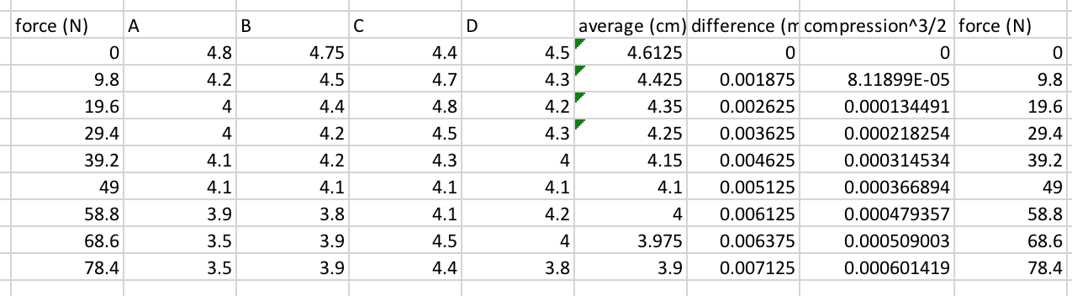
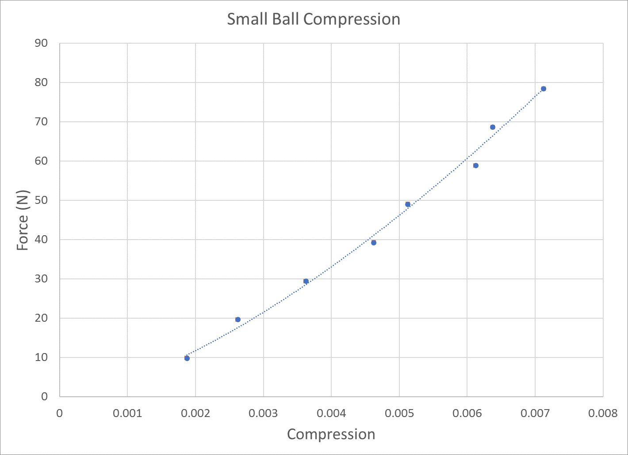

Spring constant without Hertz adjustment.
$$k=−\frac{F}{x}$$

Slide 32
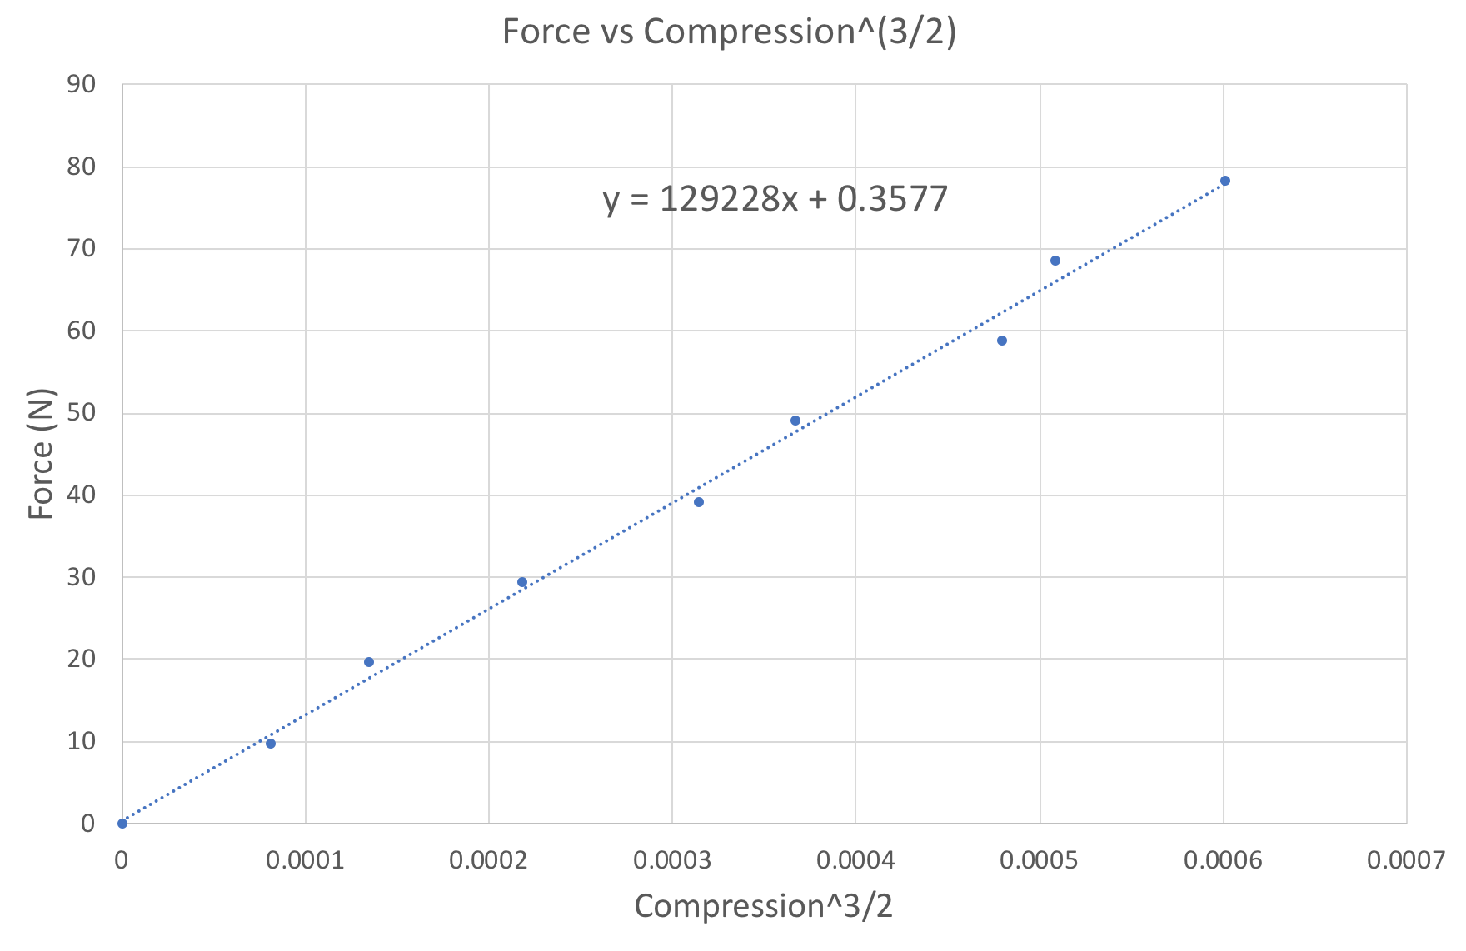


Spring constant with Hertz adjustment.
$$k=−\frac{F}{x^{(\frac{3}{2})}}$$
$$k=129000N/m^(\frac{3}{2})$$
Notes:
To get the spring constant you take the difference in average cm, then ^(3/2) it will give you x. F is equal to the weight times 9.8. After graphing f over x the spring constant will be the gradient of the line.
Linear relationship shows force is proportional to compression ^(3/2).

Slide 33
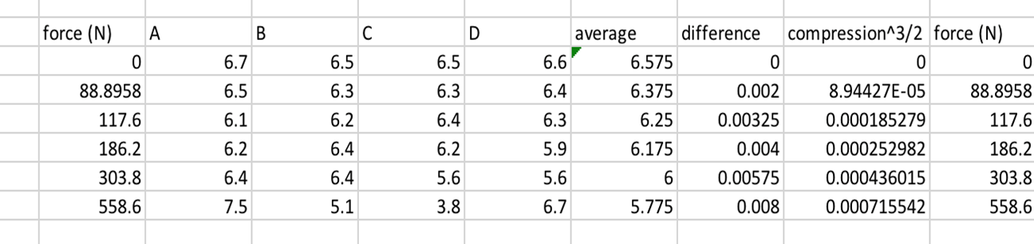

Spring constant without Hertz adjustment.
$$k=−\frac{F}{x}$$

Slide 34
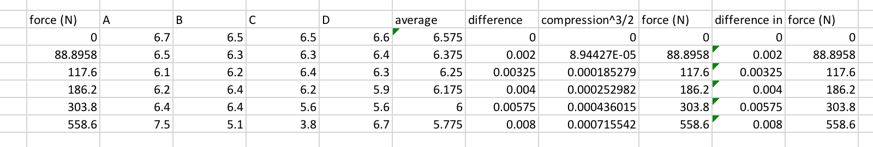


Spring constant with Hertz adjustment.
$$k=−\frac{F}{x^{(\frac{3}{2})}}$$
$$k=761000N/m^(\frac{3}{2})$$
Notes:
To get the spring constant you take the difference in average cm, then ^(3/2) it will give you x. F is equal to the weight times 9.8. After graphing f over x the spring constant will be the gradient of the line
Linear relationship shows force is proportional to compression ^(3/2).

Slide 35
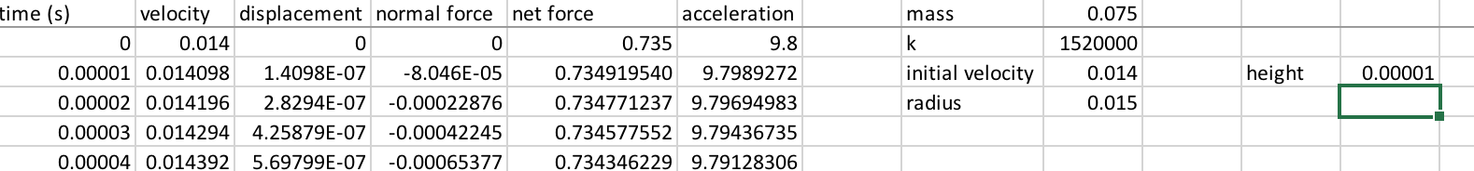
Theoretical Model
Looks at displacement over time to predict collision time using:
  Velocity
  Spring Constant
  Weight Force
  Normal Force
  Acceleration
  Mass
Notes:
I made and iterative model using time steps of 0.00001 or 10 microseconds, that uses these variables to predict the collision time of different balls based on their mass, spring constant, and drop height.
The model I made was iterative and used these variables to make a prediction of the collision time.
10 micro seconds

Slide 36


Theoretical Model
Looks at displacement over time to predict collision time using:
  Velocity
  Spring Constant
  Weight Force
  Normal Force
  Acceleration
  Mass
$$V_{i}=√2gh$$
$$V_{f}= V_{i}+at$$

Slide 37

Theoretical Model
Looks at displacement over time to predict collision time using:
  Velocity
  Spring Constant
  Weight Force
  Normal Force
  Acceleration
  Mass
$k=−\frac{f}{x^{(\frac{3}{2})}}$

Slide 38


Theoretical Model
Looks at displacement over time to predict collision time using:
  Velocity
  Spring Constant
  Weight Force
  Normal Force
  Acceleration
  Mass
$$F_{w}=mass ×9.8$$
$$F_{N}=kx^{(\frac{3}{2})}$$

Slide 39

Theoretical Model
Looks at displacement over time to predict collision time using:
  Velocity
  Spring Constant
  Weight Force
  Normal Force
  Acceleration
  Mass
$$a=\frac{F_{net}}{m}$$

Slide 40
Height: 1m
Spring Constant: 258000
Mass: 0.01kg
Collision time=0.00259 sec
.
- - - - - - - - - - - - - - - - - - -
.
- - - - - - - - - - - -
- - - - - - - - - - - - - - - - - - - -
Displacement
or d
Notes:
Displacement of the centre of mass of the ball
Spring constant is double because only one side of the ball is being compressed.

Slide 41
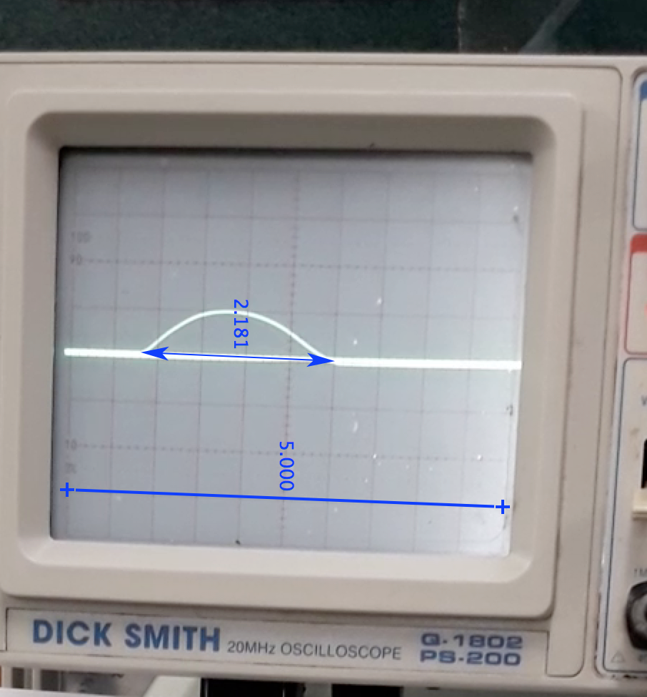
Piezo Chip
Voltage over time
Oscilloscope
The Problem | Testing | Theory and Physics | Results | Conclusion
Notes:
I connected my piezo chip to an oscilloscope. I then set up a camera to record the screen while I drop the ball onto the piezo chip. The oscilloscope would show a voltage output on the screen whenever there was a force applied to it. Because I knew the time and voltage per division I could then analyze the video on a video analysis program called tracker to the find the collision time of the ball.

Slide 42


Ball Mass = 0.010kg
$$k=129000N/m^(\frac{3}{2})$$
$$Velocity (V)=√2gh$$
$$g (gravity) = 9.8$$
$$h = drop height$$
The Problem | Testing | Theory and Physics | Results | Conclusion
Notes:
This graph shows the average of tests done at different heights. During testing I dropped the ball from each height five times then calculated the averages which is shown on the graph.
The x axis shows the change in velocity as the ball was dropped from different heights. The y axis shows the collision time of the ball at different velocities.

Slide 43


Ball Mass = 0.075kg
$$k=761000N/m^(\frac{3}{2})$$
$$Velocity (V)=√2gh$$
$$g (gravity) = 9.8$$
$$h = drop height$$
The Problem | Testing | Theory and Physics | Results | Conclusion
Notes:
This graph shows the average of tests done at different heights. During testing I dropped the ball from each height five times then calculated the averages which is shown on the graph.
The x axis shows the change in velocity as the ball was dropped from different heights. The y axis shows the collision time of the ball at different velocities.

Slide 44
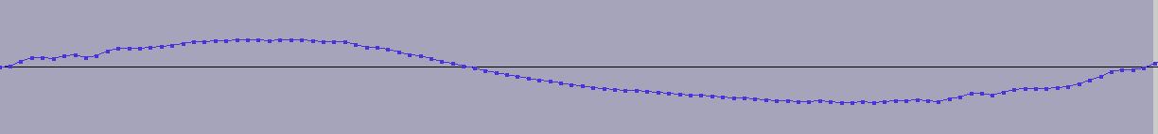


Sound:
Sample rate (HZ) = 44100
$$\frac{101}{44100}=0.00229ms$$
Collision Time =
The Problem | Testing | Theory and Physics | Results | Conclusion

Slide 45


Ball Mass = 0.010kg
$$k=129000N/m^(\frac{3}{2})$$
$$Velocity (V)=√2gh$$
$$g (gravity) = 9.8$$
$$h = drop height$$
The Problem | Testing | Theory and Physics | Results | Conclusion
Notes:
This graph shows the average of tests done at different heights. During testing I dropped the ball from each height five times then calculated the averages which is shown on the graph.
The x axis shows the change in velocity as the ball was dropped from different heights. The y axis shows the collision time of the ball at different velocities.

Slide 46
Ball Mass = 0.075kg
$$k=761000N/m^(\frac{3}{2})$$
$$Velocity (V)=√2gh$$
$$g (gravity) = 9.8$$
$$h = drop height$$
The Problem | Testing | Theory and Physics | Results | Conclusion
Notes:
This graph shows the average of tests done at different heights. During testing I dropped the ball from each height five times then calculated the averages which is shown on the graph.
The x axis shows the change in velocity as the ball was dropped from different heights. The y axis shows the collision time of the ball at different velocities.

Slide 47
High Speed Video
Frame Rate – 1000fps
Set up
Notes:
i recorded the ball as it collided then analyzed the fotage on a video analsis program called tracker.

Slide 48


Ball Mass = 0.010kg
$$k=129000N/m^(\frac{3}{2})$$
$$Velocity (V)=√2gh$$
$$g (gravity) = 9.8$$
$$h = drop height$$
The Problem | Testing | Theory and Physics | Results | Conclusion
Notes:
This graph shows the average of tests done at different heights. During testing I dropped the ball from each height five times then calculated the averages which is shown on the graph.
The x axis shows the change in velocity as the ball was dropped from different heights. The y axis shows the collision time of the ball at different velocities.

Slide 49
Ball Mass = 0.075kg
$$k=761000N/m^(\frac{3}{2})$$
$$Velocity (V)=√2gh$$
$$g (gravity) = 9.8$$
$$h = drop height$$
The Problem | Testing | Theory and Physics | Results | Conclusion
Notes:
This graph shows the average of tests done at different heights. During testing I dropped the ball from each height five times then calculated the averages which is shown on the graph.
The x axis shows the change in velocity as the ball was dropped from different heights. The y axis shows the collision time of the ball at different velocities.

Slide 50
Option 1:
Option 2:
1.7ms
1.7ms
.001
.002
.003
.004
.005
.006
.007
.008
.009
Option 1= 0.001sec or 1ms
Option 2 = 0.002sec or 2ms
The Problem | Testing | Theory and Physics | Results | Conclusion
Notes:
One of the main errors if found with measuring collision time was due to the frame/refresh rate. If it was only 1000fps I found it was a less accurate way of measuring collision time. This is because each frame is a millisecond and a collision time is only a few milliseconds. Say if the collision time was actually 1.7 milliseconds, it could be shown by 2 very different measurements 1 or 2 milliseconds shown in this diagram.
An error with high speed video is that the highest frame rate I could shoot in was 1000fps. This means shown by this diagram that if the actual collision time was lets say 1.7ms or 0.0017 seconds it could be shown as either 1ms or 2ms on high speed video. If the balls collision starts just after start of a frame it will not be in this frame but only in the next 1 frame, shown by option 1. If the ball collides just before that start of a frame it will shown and that frame and also the next shown in option 2, this means it will show a collision time of 2ms compared to 1ms from option 1. This is what makes high speed video unreliable as it does not film in a high enough frame rate to give and accurate measure of collision time.

Slide 51
The Problem | Testing | Theory and Physics | Results | Conclusion
Notes:
no data point will ever match a model exactly, however most of the methods follow the same pattern.
As you can see the theoretical model shows the same sort of pattern shown by the data from audio and piezo. However highspeed video is very unpredictable and you can see it does not follow a uniform pattern, due to it being very hard to read the collision time from the data from to the error explained in the previous slide. All of the data points from the different methods curve up as the x axis gets closer to zero. This is because when a ball has 0 velocity it collision time would be infinitely long.
This graph shows the collision time (y axis) compared to the velocity (x axis). It compares the different methods for measuring collision time.

Slide 52
The Problem | Testing | Theory and Physics | Results | Conclusion
Notes:
no data point will ever match a model exactly, however most of the methods follow the same pattern.
This graph shows the collision time (y axis) compared to the velocity (x axis). It compares the different methods for measuring collision time. As you can see the theoretical model shows the same sort of pattern shown by the data from all methods. All of the data points from the different methods curve up as the x axis gets closer to zero. This is because when a ball has 0 velocity it collision time would be infinitely long.

Slide 53
Conclusion:
“A highly elastic Super Ball collides with a rigid surface. How can one determine the collision time? Propose various techniques and compare the experimental results.”
High speed video
Piezo disk – Voltage over time
Sound
Motion sensor
Fw
Notes:
To restate the question
In this presentation I have looked at various methods of measuring collision time. I have explained what happens during a collision including different forces, and changes in energy. I have then graphed and compared the different methods of testing to each other and to a theoretical model I made.
In conclusion I think that voltage over time and sound is the best method as it gives me the exact time there if a force being applied and shows this a voltage measure. Although it does not match my iterative theoretical model,.
I have found that main effect to having a good experimental result is the sampling rate (more than 1000fps).

Slide 54
Acknowledgments:
Murray Chisholm
Family
Ryan ‘Hell Fire’ Bright & other minions
The NZ IYNT Team
The Problem | Testing | Theory and Physics | Results | Conclusion

Slide 55
References:
https://www.khanacademy.org/science/physics/work-and-energy/hookes-law/a/what-is-hookes-law
https://www.google.com/url?q=https://www.khanacademy.org/science/physics/linear-momentum/elastic-and-inelastic-collisions/a/what-are-elastic-and-inelastic-collisions&source=gmail&ust=1530332829232000&usg=AFQjCNHGWgs526nu4jBELjt6HMoXmwukwg
https://www.khanacademy.org/science/physics/work-and-energy/hookes-law/a/what-is-hookes-law
http://www.physicscentral.com/experiment/askaphysicist/physics-answer.cfm?uid=20080509042817
https://physics.stackexchange.com/questions/141822/are-there-perfect-elastic-collisions-in-nature
https://pdfs.semanticscholar.org/d542/6e2ee5da56d87ca2004f77e0521c26580b71.pdf
https://arxiv.org/pdf/physics/0402036.pdf
https://www.nde-ed.org/EducationResources/HighSchool/Sound/tempandspeed.htm
http://www.softschools.com/formulas/physics/inelastic_collision_formula/91/
http://www.physicsclassroom.com/class/momentum/Lesson-2/Momentum-Conservation-Principle
http://hyperphysics.phy-astr.gsu.edu/hbase/elacol.html
http://www.physicsclassroom.com/class/newtlaws/Lesson-1/Inertia-and-Mass
http://hyperphysics.phy-astr.gsu.edu/hbase/mi.html
The Problem | Testing | Theory and Physics | Results | Conclusion

Slide 56
5. Collision
Ella Blakely
New Zealand

Slide 59
Notes:
Piezoelectricity (also called the piezoelectric effect) is the appearance of an electrical potential (a voltage, in other words) across the sides of a crystal when you subject it to mechanical stress (by squeezing it).

Slide 60
Lasers:
Laser
Ground
The Problem | Testing | Theory and Physics | Results | Conclusion

Slide 61
Lasers:
Laser
Ground
The Problem | Testing | Theory and Physics | Results | Conclusion

Slide 62
Lasers:
Laser
Starts Timing:
Ground
The Problem | Testing | Theory and Physics | Results | Conclusion

Slide 63
Lasers:
Laser
Ground
The Problem | Testing | Theory and Physics | Results | Conclusion
Notes:
The motion sensor was very unreliable as it couldn’t always pick up the ball so would not give and accurate graph of the data for the balls collision.

Slide 64
Lasers:
Laser
Ground
The Problem | Testing | Theory and Physics | Results | Conclusion

Slide 65
Lasers:
Laser
Stops Timing:
Ground
The Problem | Testing | Theory and Physics | Results | Conclusion
Notes:
I could not use a laser as the one I had access to did not have a high enough refresh rate

Slide 66
Why sound works?
Rarefaction
Compression
Notes:
When the ball collides it compresses the air that is under it, when it starts to expand the air is rarefacted.
This compression and rarefaction is heard as sound wave.
The blue line shows the compression which is followed by the rarefaction (orange line)

Slide 67
Impulse and Momentums
Notes:
Momentum when and object with mass is moving with velocity it has a certain ‘quantity of motion’ this ‘quantity of motion’ is called momentum.
In a collision an object experiences a force for a specific amount of time, resulting in a change of momentum.
Impulse is usually used when a force acts for a short amount of time. Such as the collision of the ball. Impulse is the same as the change in momentum of an object.
Change in momentum (kg m s-1) = force x time taken.
As the COR decreases impulse decreases, the ball contact time decrease as the ball speed increases.

Slide 68
Theory
Energy transfers – conservation of energy
Gravitational Potential
Kinetic
Elastic Potential
Kinetic
Sound
Thermal
The Problem | Testing | Theory and Physics | Results | Conclusion
Notes:
The law of conservation of energy states that the total amount of energy remains constant in an isolated system. It implies that energy can neither be created nor destroyed, but can be change from one form to another.
The ball creates a sound as it hits the ground due to the air between the ball and the surface it is hitting being pushed out of the way. This creates an audible pressure wave perceived as sound.
We already know that that some of the energy is transferred, as we are dealing with inelastic collisions. The kinetic energy in these collision is usually transferred into sound energy, thermal energy and deformation of the ball. Energy can also be stored in the ball and used to return the ball to its original shape.

Slide 69
Notes:
Motion sensor velocity graph.

Slide 70
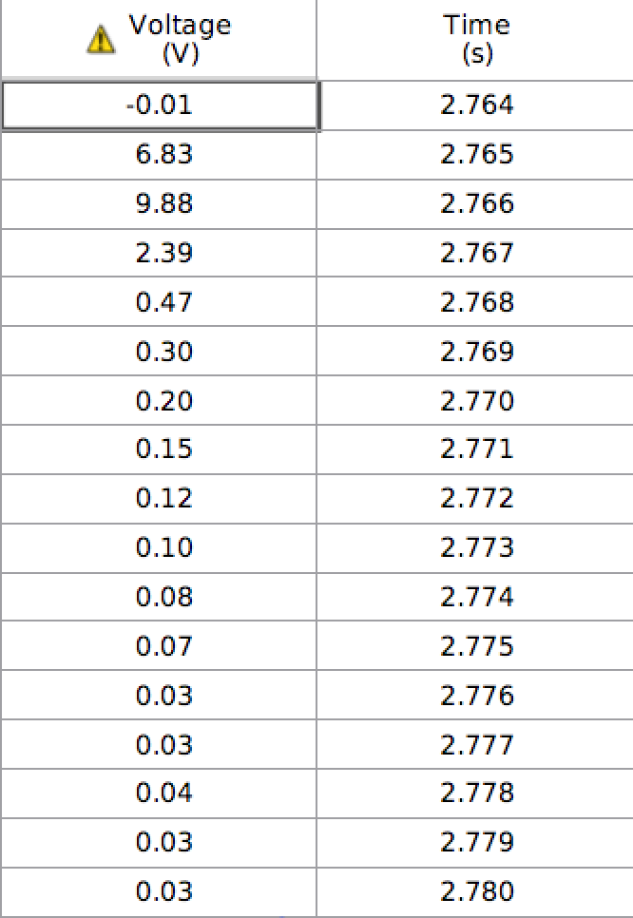
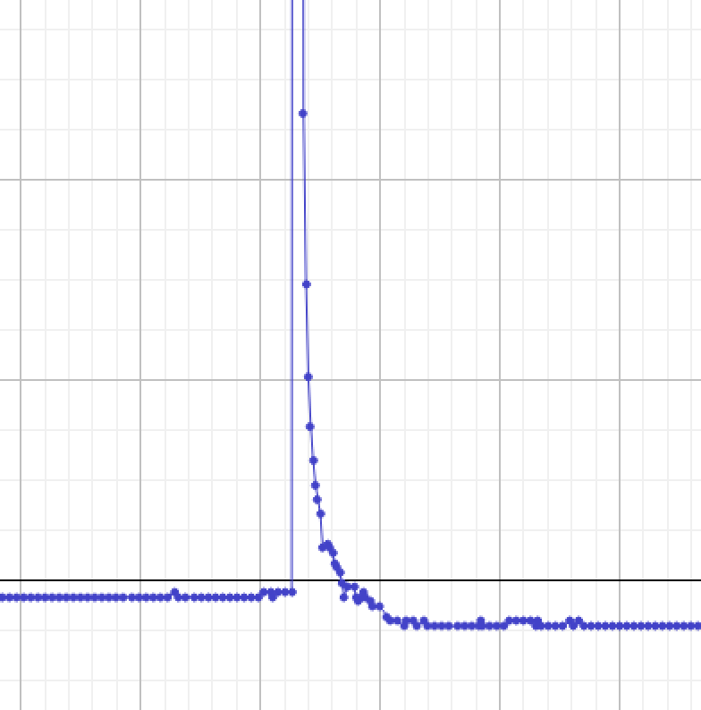
Piezo chip:
Voltage over time
Capstone
Collision Time: 0.016sec or 16ms
The Problem | Testing | Theory and Physics | Results | Conclusion

Slide 71
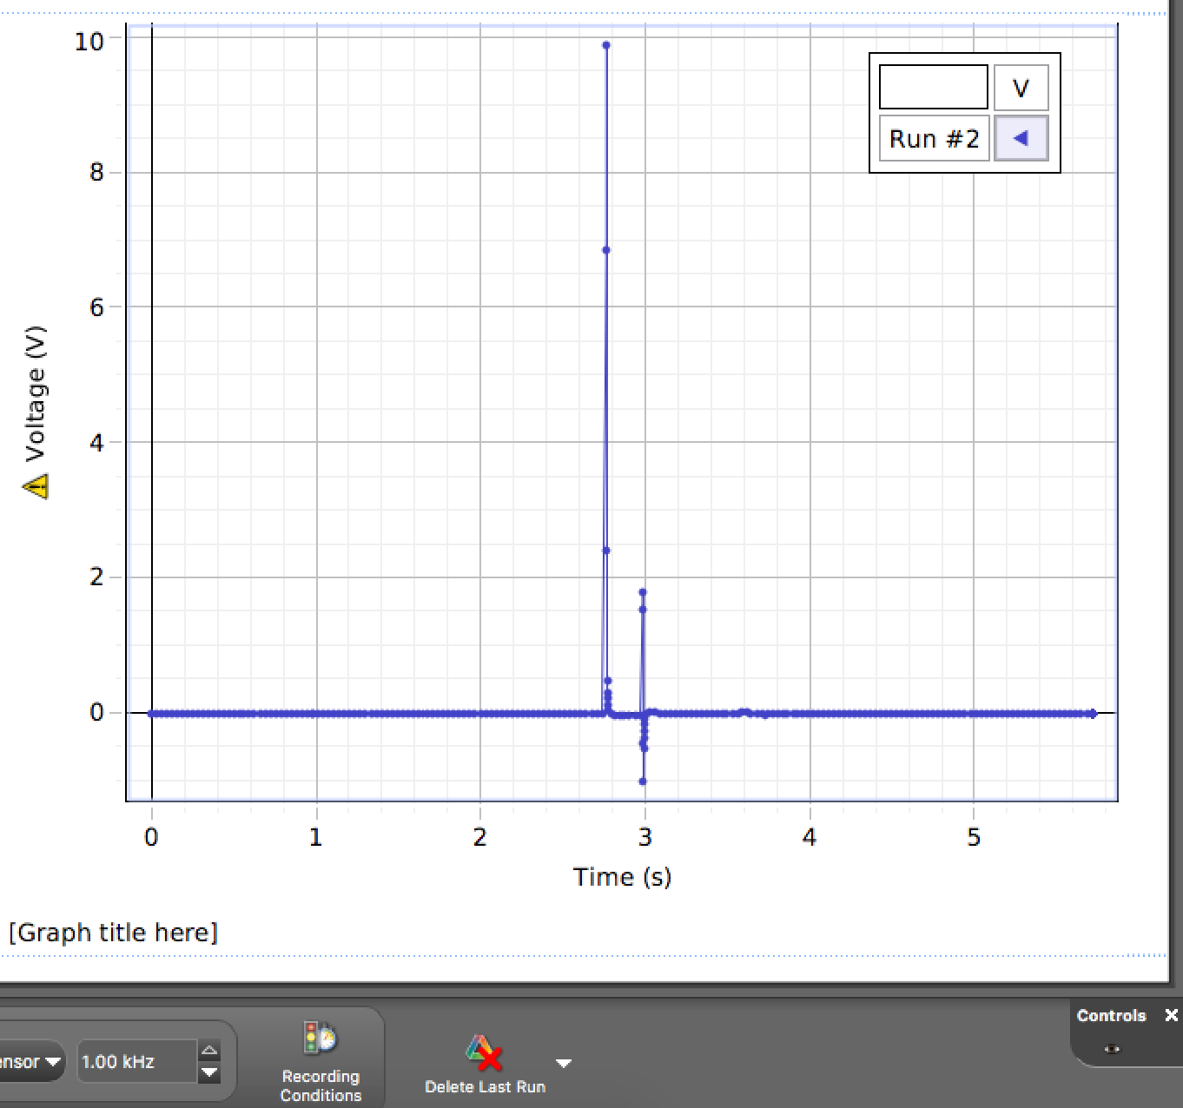
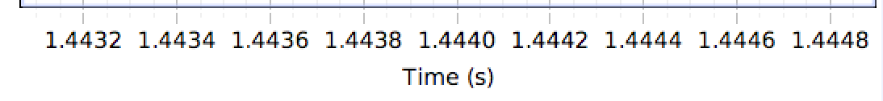
Piezo chip:
Voltage over time
Capstone
The Problem | Testing | Theory and Physics | Results | Conclusion

Slide 72
Calculate Spring Constant:
Find average compression for each side in cm
Calculate the difference in compression each time weight is added
Compression^(3/2)
Get the weight force in newtons
Graph F to X : Gradient = k

Slide 73
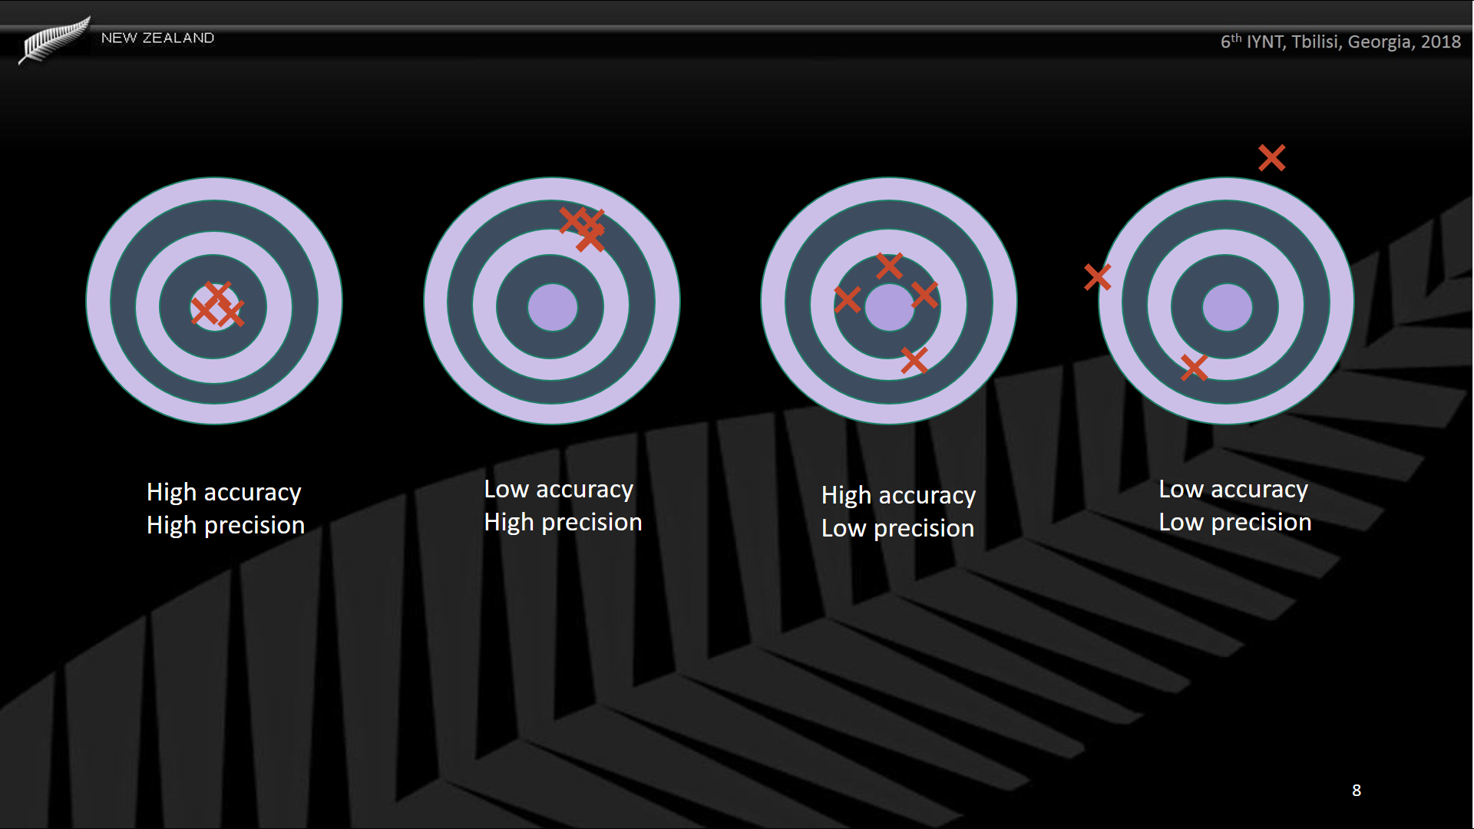
The Problem | Testing | Theory and Physics | Results | Conclusion

Slide 74
Motion sensor:
The Problem | Testing | Theory and Physics | Results | Conclusion
The Problem | Testing | Theory and Physics | Results | Conclusion
Notes:
The motion sensor was very unreliable as it couldn’t always pick up the ball so would not give and accurate graph of the data for the balls collision.

Slide 75
Force meter:
The Problem | Testing | Theory and Physics | Results | Conclusion
Notes:
The motion sensor was very unreliable as it couldn’t always pick up the ball so would not give and accurate graph of the data for the balls collision.

