Slide 1
24. Mysterious Catalase
Tom Divehall
New Zealand

Slide 2
Problem
An enzyme called catalase influences on the rate of decomposition of hydrogen peroxide. Make tests to identify catalase-positive and catalase-negative organisms and materials.

Slide 3
outline
Theory
-enzymes
-catalysts
Testing
conclusions

Slide 4
Catalase
Catalase is a common enzyme found in nearly all living organisms exposed to oxygen. It catalyzes the decomposition of hydrogen peroxide to water and oxygen.

Slide 5
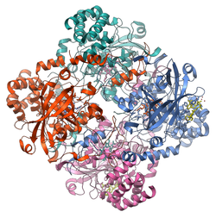
Enzymes
Enzymes are biological catalysts
Notes:
Read definition/. Catalase is an enzyme.
Enzymes are made up of a bundle

Slide 6
Catalysts
$H_{2}O_{2}+catalase=H_{2}+O_{2}$
This reaction is catabolic
Notes:
Catalysts speed up a reaction without being used up in it. They lower the activation energy required for a reaction to occur. How this works is the reactant (hydrogen peroxide) fits into the enzymes active site. This means that the hydrogen peroxide is able to catlyse the reaction, causing hydrogen peroxide to be broken down into it components, hydrogen and oxygen. We can measure whether a material is catalase positive if it produces oxygen
Just to note, enzymes are specific (they will only catalase a single reaction)

Slide 7
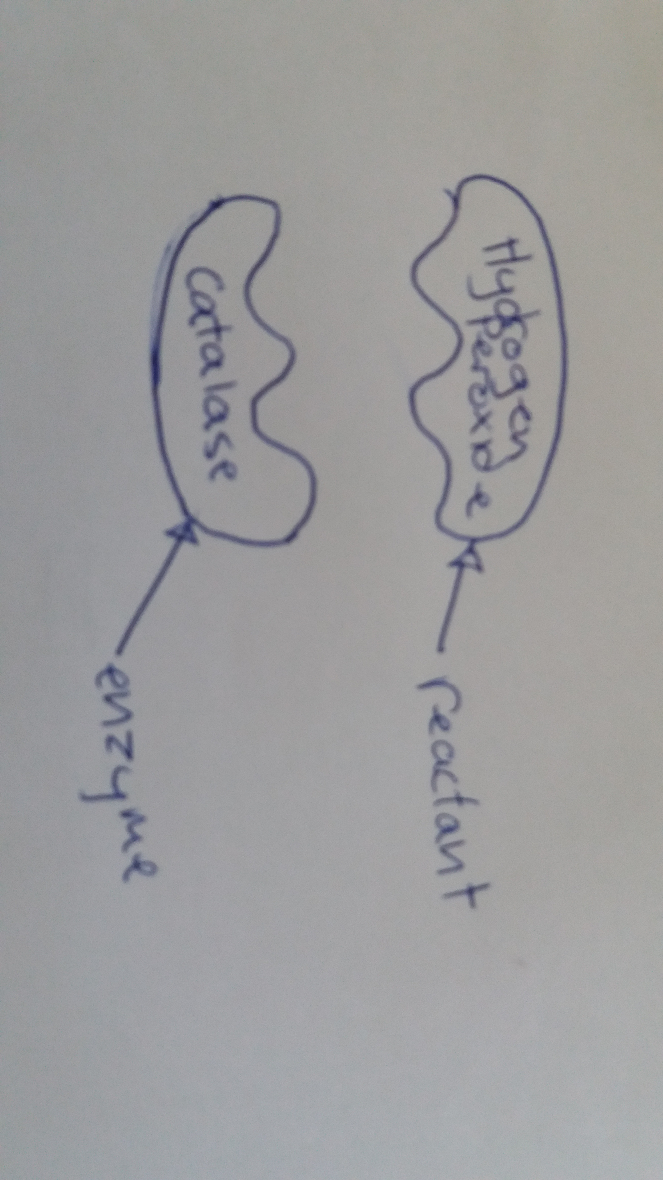
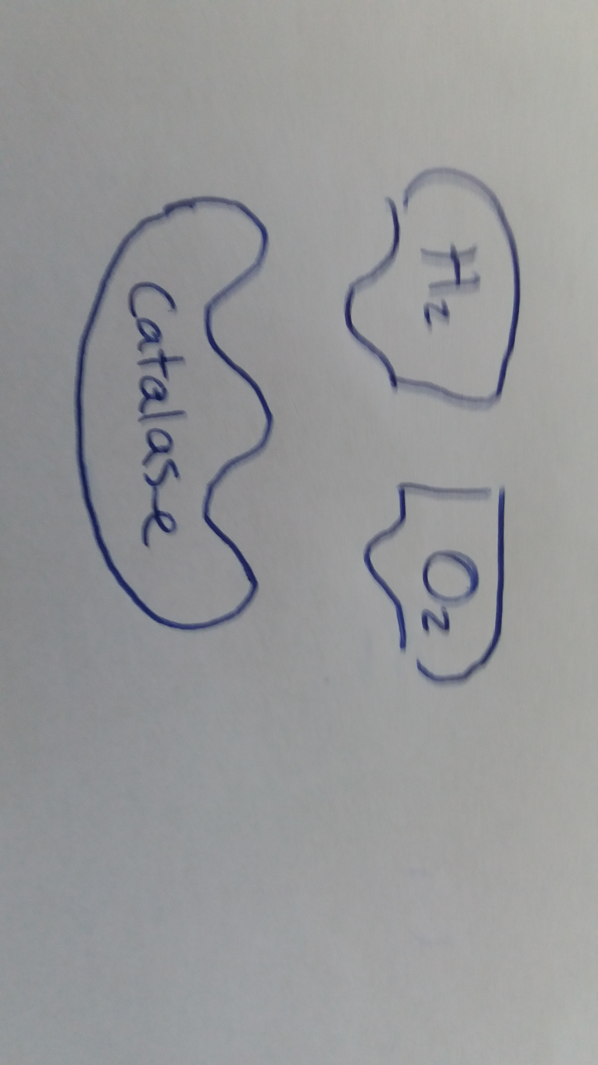
Notes:
As you can see the substrate fits into the

Slide 8
Ways of measuring oxygen
Dishwashing liquid (measuring the height of the bubbles)
Balloon (measuring how much it expands)
Watching for bubbles
Notes:
Though watching for bubbles is a less quantitative measure (you cannot measure the exact volume) we did not have any dishwashing liquid and the balloon did not noticeable expand

Slide 9
Testing
Measure out 1cm of material pulp in to the bottom of a test tube
Measure out 5mL of Hydrogen Peroxide into a syringe
Add the hydrogen peroxide into the test tube
Quickly place a finger of a latex glove over the top of the test tube and seal with tape
Wait for 5 minutes and record how much the balloon inflates
Compare results between materials

Slide 10
Materials used:
Apple
Onion
potato
Notes:
Materials we thought would contain catalase are:

Slide 11
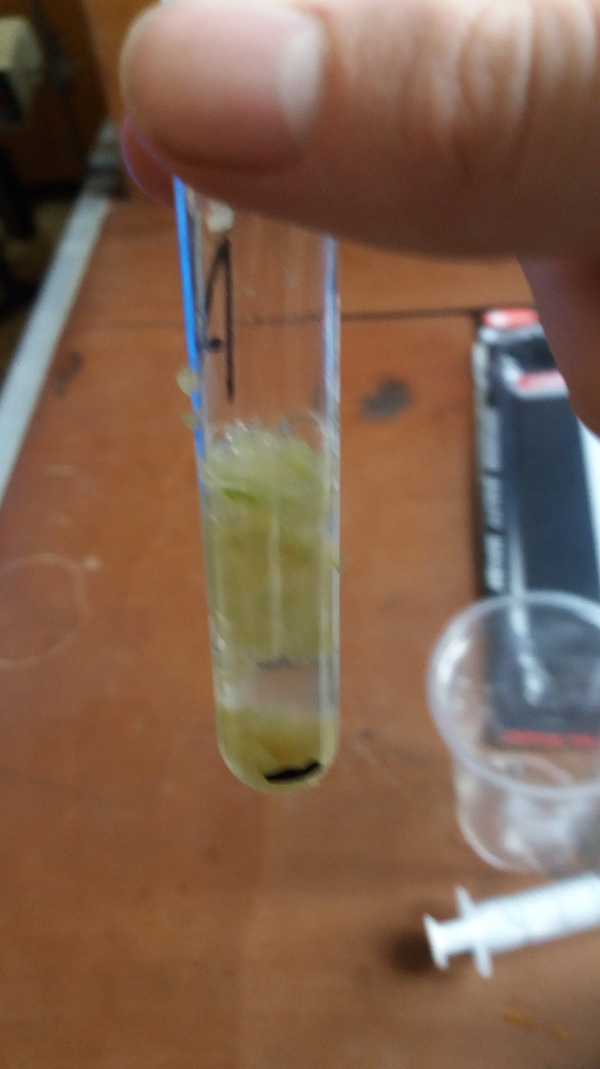
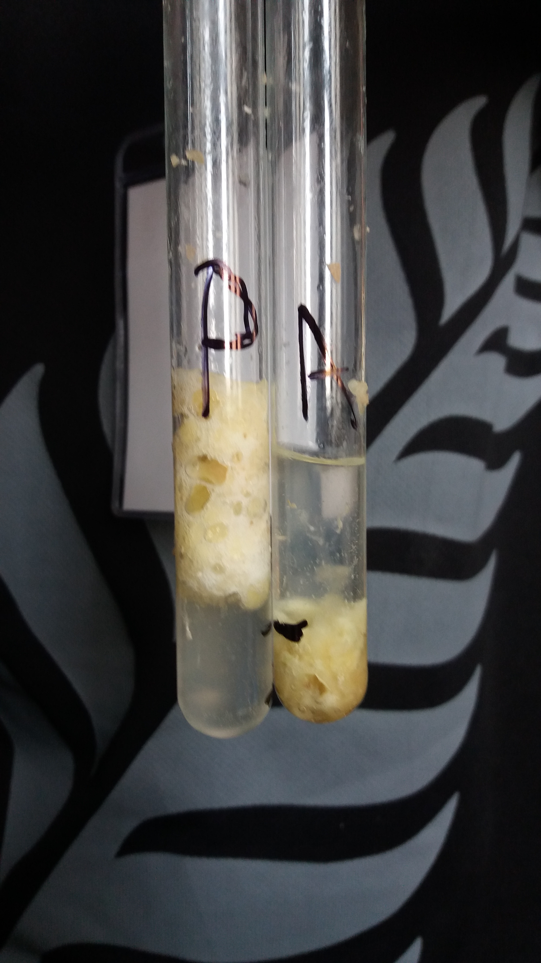

Slide 12
Denature
What causes enzymes to denature?
High temperature
High or low pH
Notes:
For another experiment, we heated a test tube of potato pulp (a material we had deemed catalase positive) Enzymes are shape specific –the reactant needs to fit into the active site of the enzyme for the reaction to occur. If the enzyme catalase is exposed to high or low pH, or high temperature, then the enzyme will denature. If an enzyme denatures then it loses its shape. The hydrogen bonds and disulphide bridges holding the proteins together break, the the enzyme loses ts shape, and so the reactant can no longer fit into the active site of the enzyme nd the reaction will not occur.

Slide 13
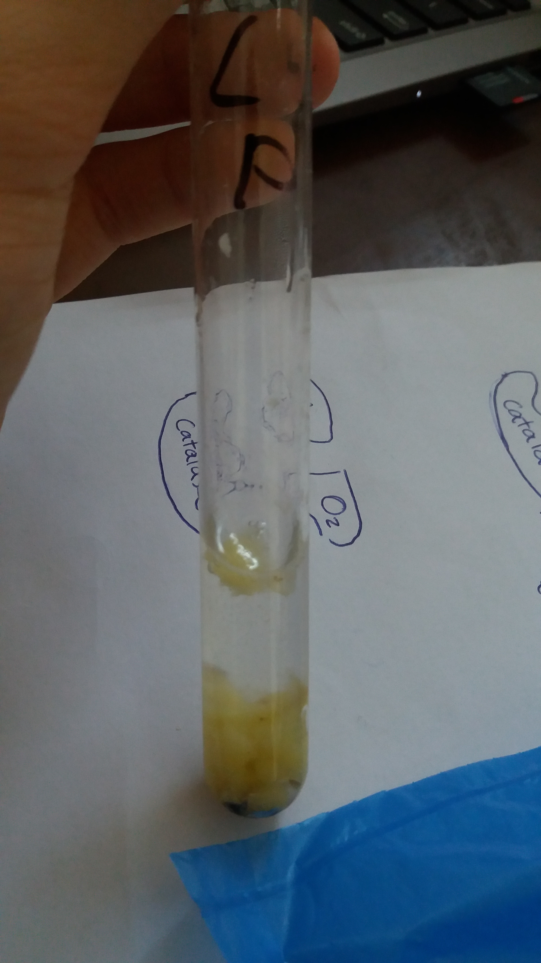
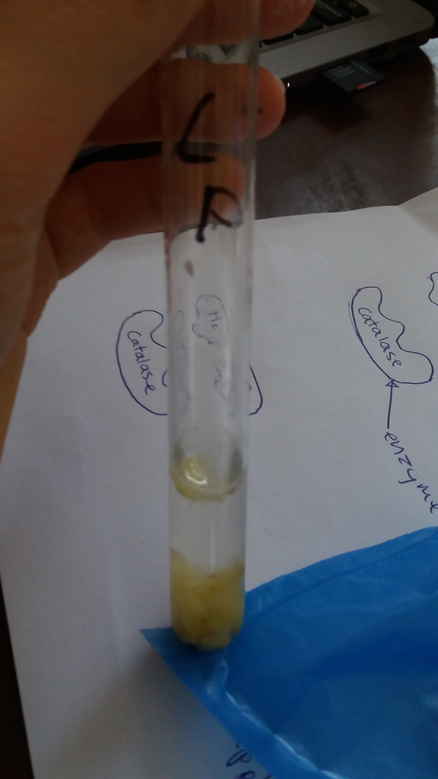
High temperature
Notes:
We exposed the pottoe to high tempertaturw and found that this had a significant effect on the bubble produced.

Slide 14
Conclusion
Material | Oxygen produced? | Catalase positive?
Potato | Yes | Yes
Cooked potato | no | Denatured catalase so no
apples | Verry little | Very little
Onion | no | no

