Slide 1
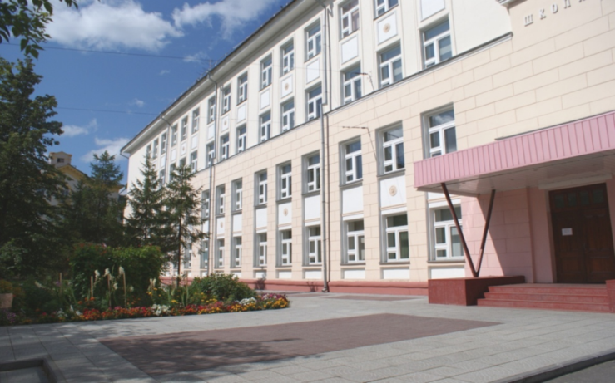
The 6th International Young Naturalists’ Tournament
Problem № 7 «Worms»
Team «12FM»
Petr Semenikhin
chnmk@mail.ru

Slide 2
The task
Earthworms change the mechanical properties of soil and make the soil more porous. Investigate this process and introduce quantitative parameters.

Slide 3
Hypothesis
If there are worms in the soil, they will affect its mechanical properties, including porosity.
Aim of the study
Investigate the influence of earthworms on the porosity of the soil.

Slide 4
Objectives
Study the literature;
Determine the porosity of different soil types;
Determine the dependence of changes in soil porosity on the presence, amount and biological activity of worms;
Define the dependence of changes in soil porosity from its moisture and salinity;
Substantiate the conclusions.

Slide 5
Mechanical properties of soil:
plasticity;
density;
sickness;
porosity.
Theory

Slide 6
Activity of earthworms
Theory
Creating a huge number of small burrows filled with air making the soil more loose
The role of decomposers: recycle organic remains, making minerals more accessible to plants

Slide 7
Theory
Chemical composition of earthworms’ feces:
5 times more nitrogen;
7 times more phosphorus;
11 times more potassium.

Slide 8
Theory

Slide 9
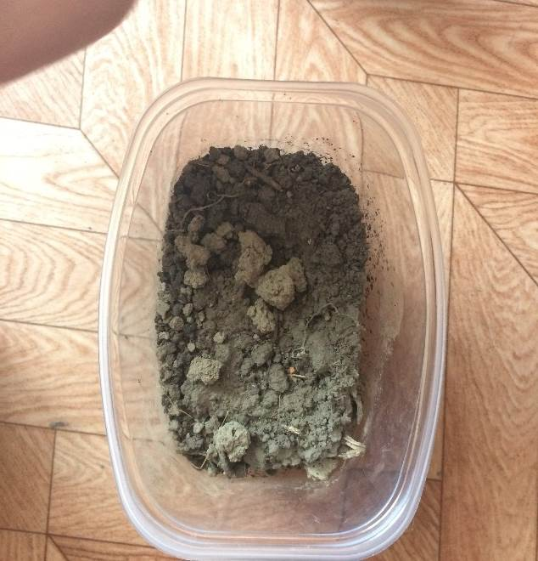
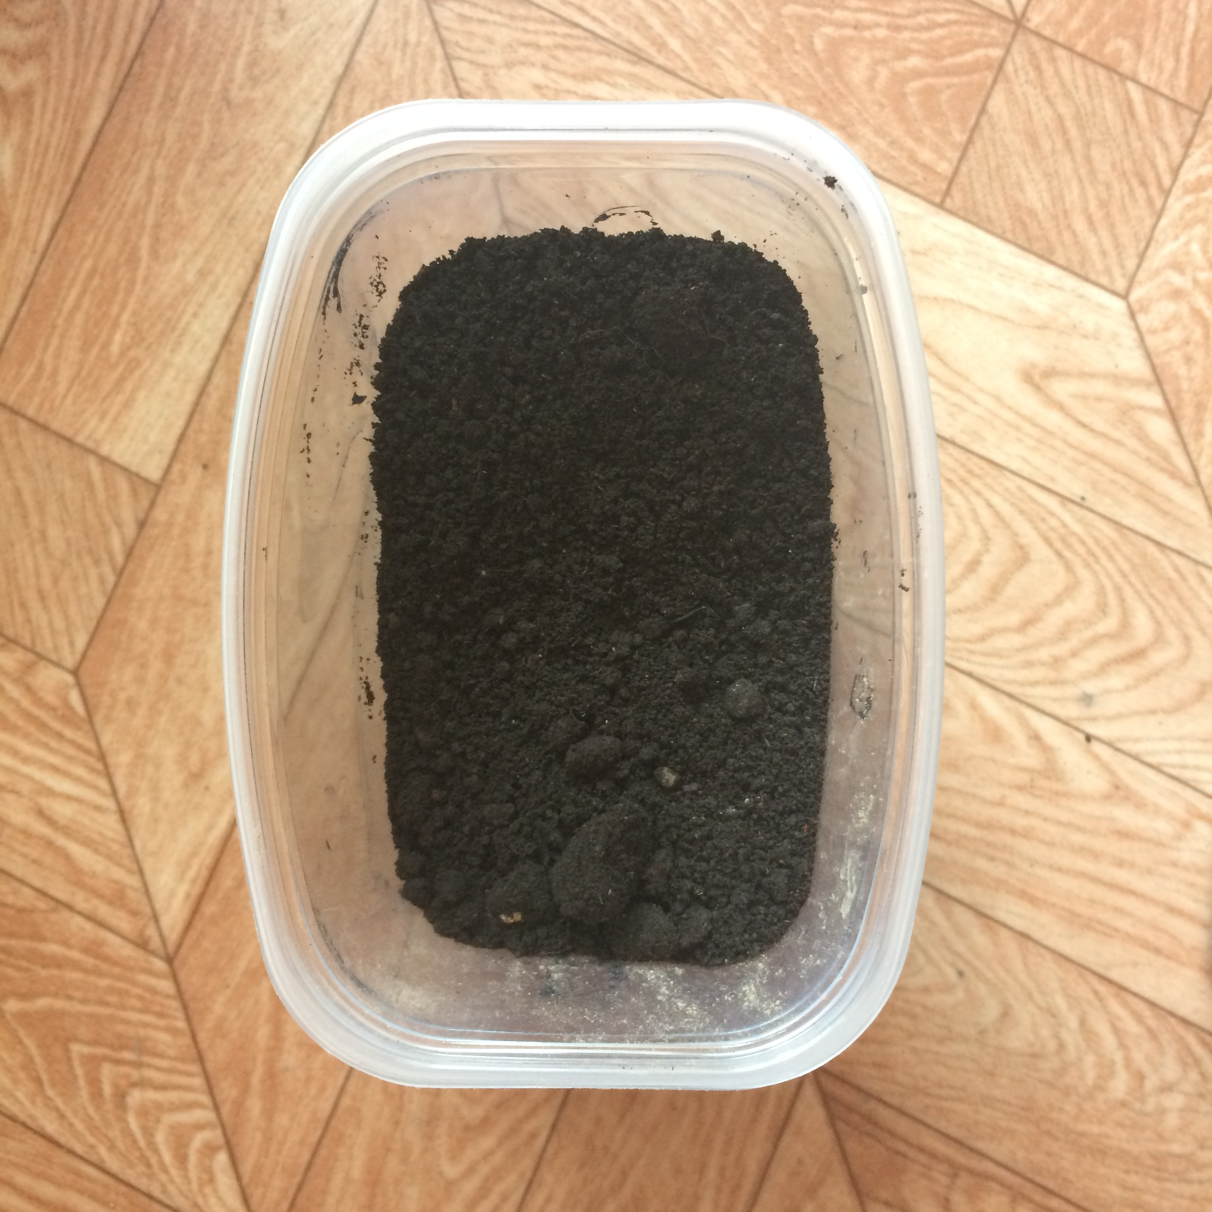
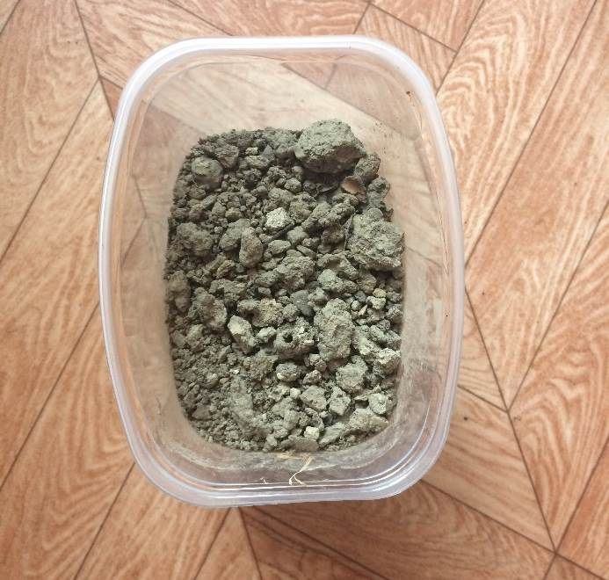
Experiment 1
Photo 2. Gray forest soil
Photo 1. Loam
Photo 3. Peat

Slide 10
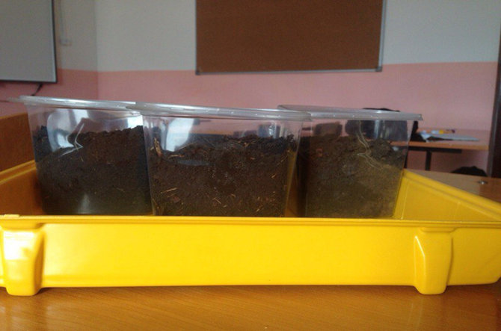
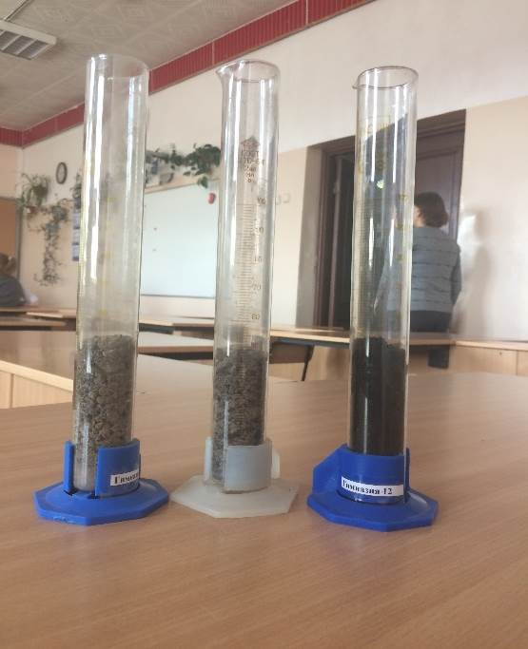
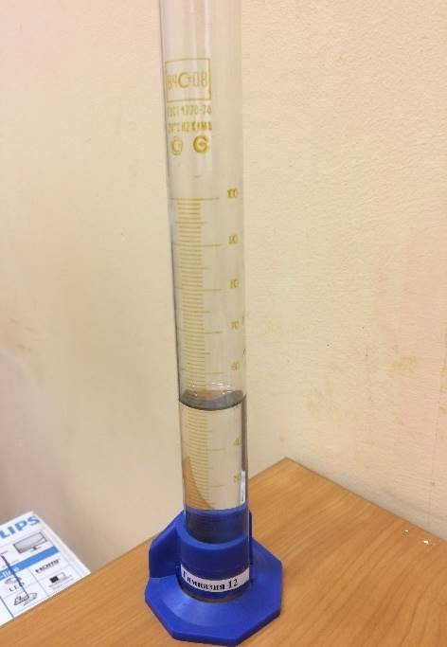
Experiment 1
Purpose: to calculate the porosity of three soil types.
Photo 4. Different soil types:
loam;
gray forest soil;
peat.
Photo 5. Soil types in the beakers (50 cm³)
Photo 6. The beaker with water

Slide 11
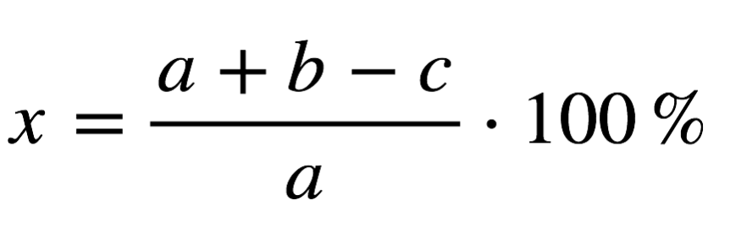
Table 1. The comparison of the different soil types’ porosity
The formula for measuring the porosity of soils
х — porosity of the soil; %
а — volume of the soil, cm³;
b — volume of the water, cm³;
с — volume of the mixture, cm³.
Soil type | а, cm³ | b, cm³ | c, cm³ | Porosity (%)
Gray forest soil | 50 | 50 | 80 | 40
Loam | 50 | 50 | 74 | 52
Peat | 50 | 50 | 65 | 70
Conclusion: the porosity of the soil depends on its type and structure.

Slide 12
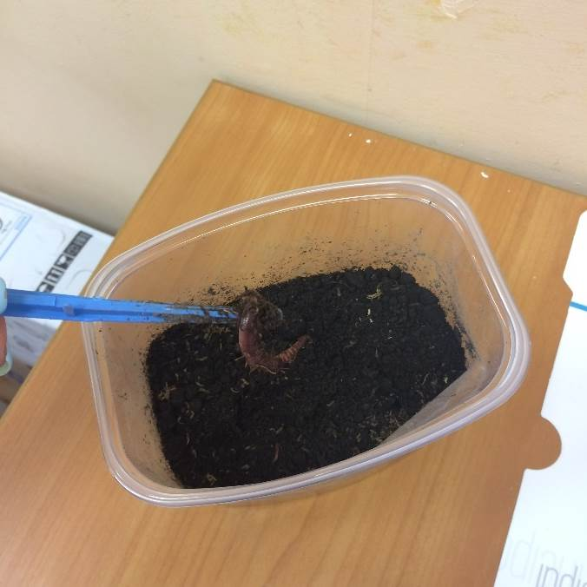
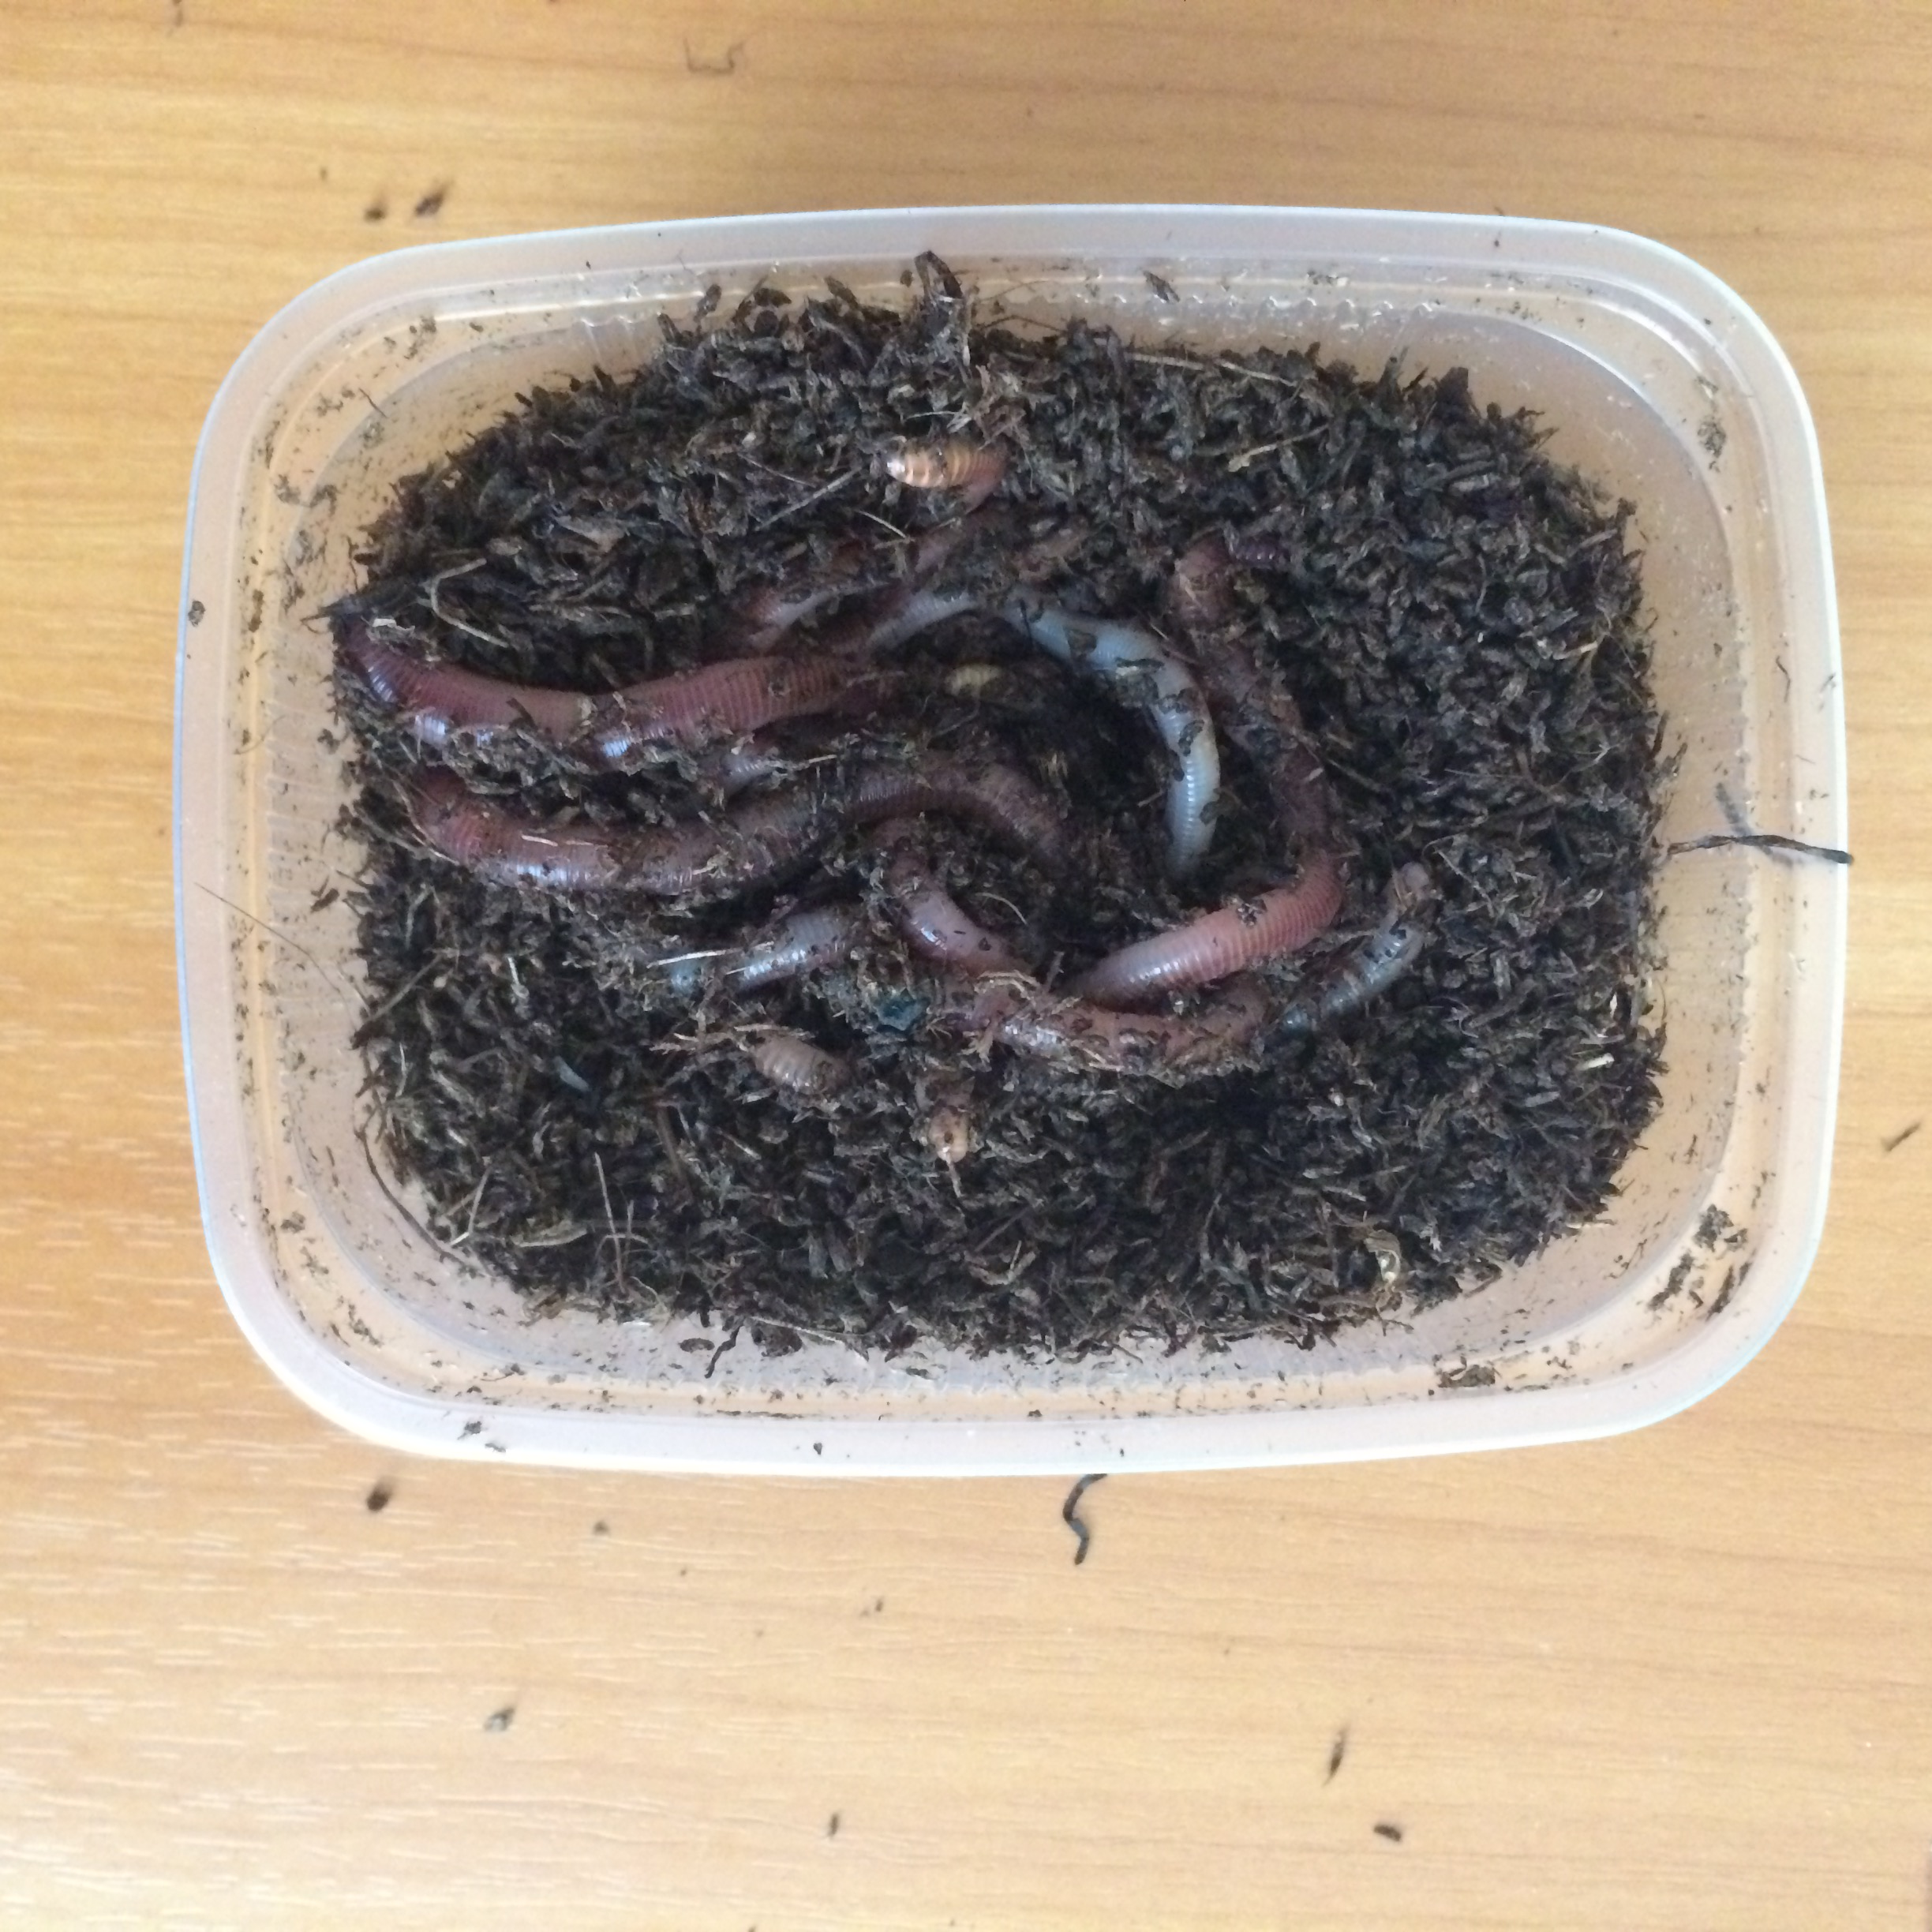
Photos 6,7. Containers with worms
Experiment 2
Purpose: to determine whether the earthworms affect the porosity of soils.

Slide 13
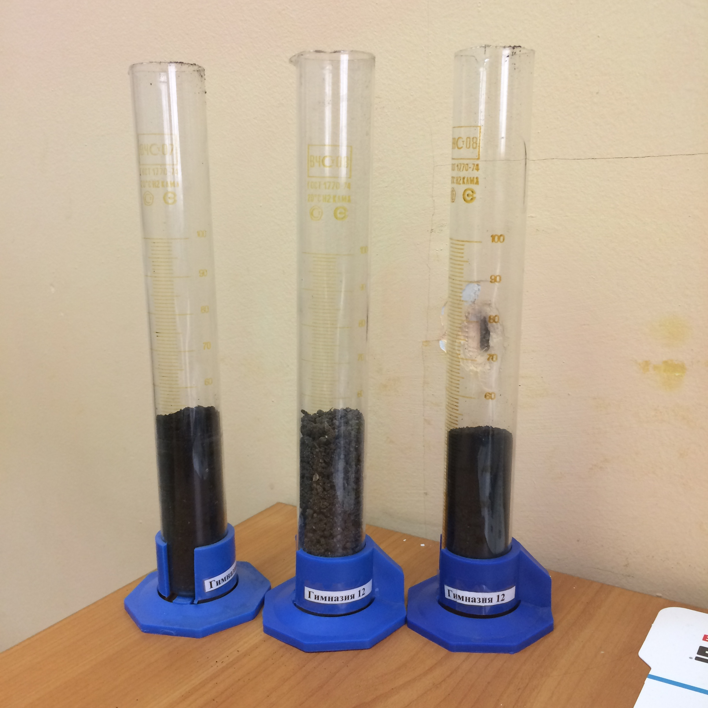
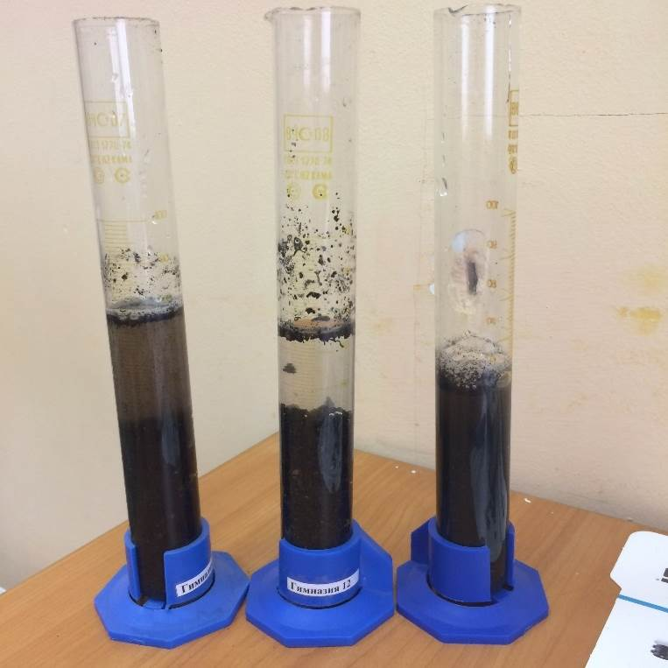
Table 2. The comparison of the soil’s porosity after we settled earthworms in it
Soil type | а, cm³ | b, cm³ | c, cm³ | Porosity (%)
Gray forest soil | 50 | 50 | 76 | 48
Loam | 50 | 50 | 70 | 60
Peat | 50 | 50 | 59 | 82
Photos 8,9. Measurements of the soil’s porosity

Slide 14
Experiment 2
Table 3 and Diagram 1. The comparison of the soil porosity with worms and without their effect
Soil type | Porosity with worms, (%) | Porosity without worms, (%)
Gray forest soil | 48 | 40
Loam | 60 | 52
Peat | 82 | 70
Gray forest
Loam
Peat
Conclusion: if we add the worms in the soil, the porosity of the soil will increase

Slide 15
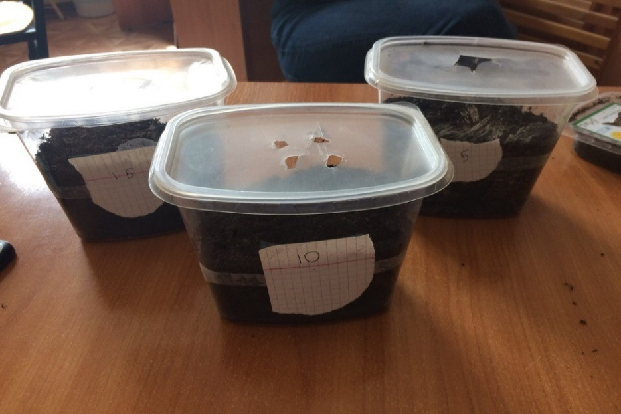
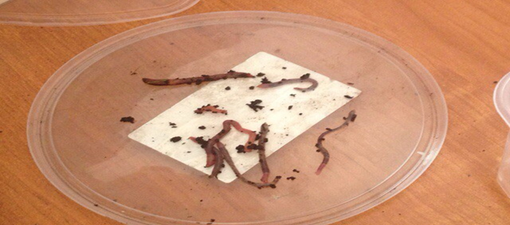
Experiment 3
Purpose: to define the dependence of the change in soil porosity on the number of worms.
Tools and materials: peat (600 cm³), 5, 10 and 15 worms, a beaker, water.
Photo 10. Soil samples with different number of earthworms
Photo 11. Earthworms

Slide 16
Table 3 and Diagram 2. The comparison of the soil samples’ porosity with different number of worms
Experiment 3
Number of worms in soil samples | а, cm³ | b, cm³ | c, cm³ | Porosity (%)
5 | 50 | 50 | 64 | 72
10 | 50 | 50 | 59 | 82
15 | 50 | 50 | 55 | 90
Conclusion: the more worms are contained in the soil, the higher value of the soil porosity.

Slide 17
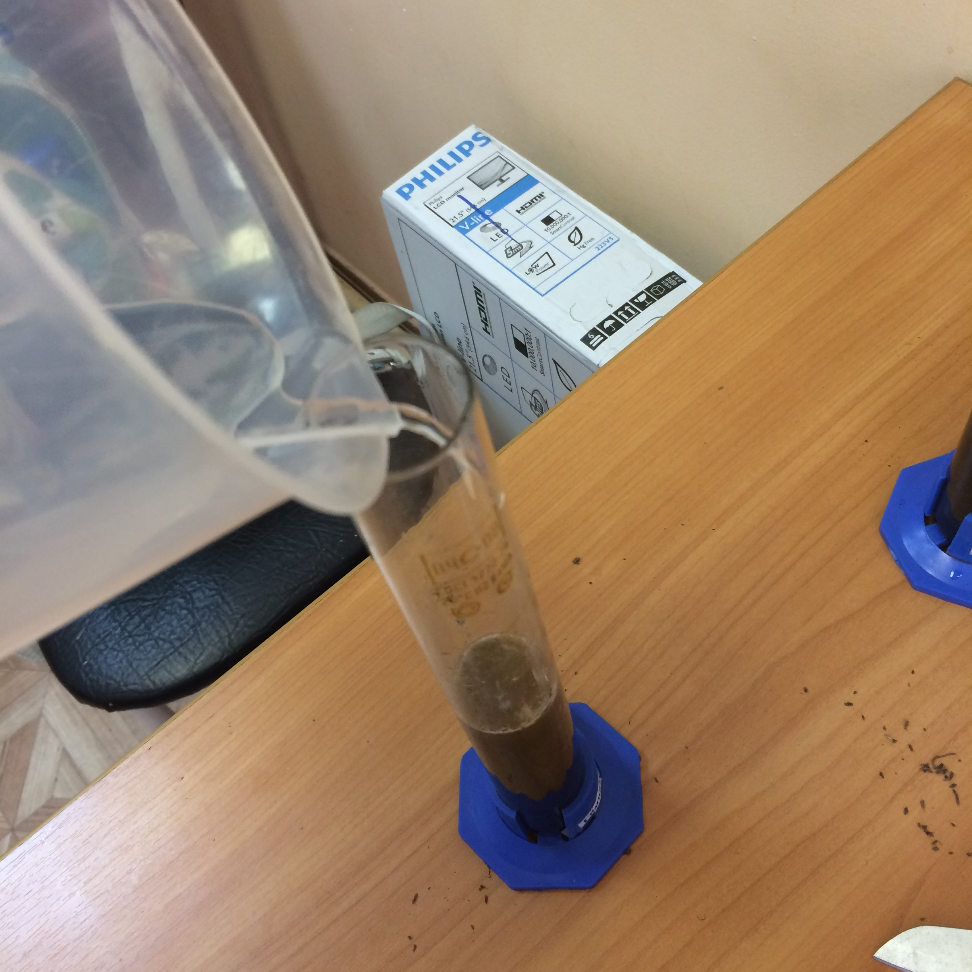
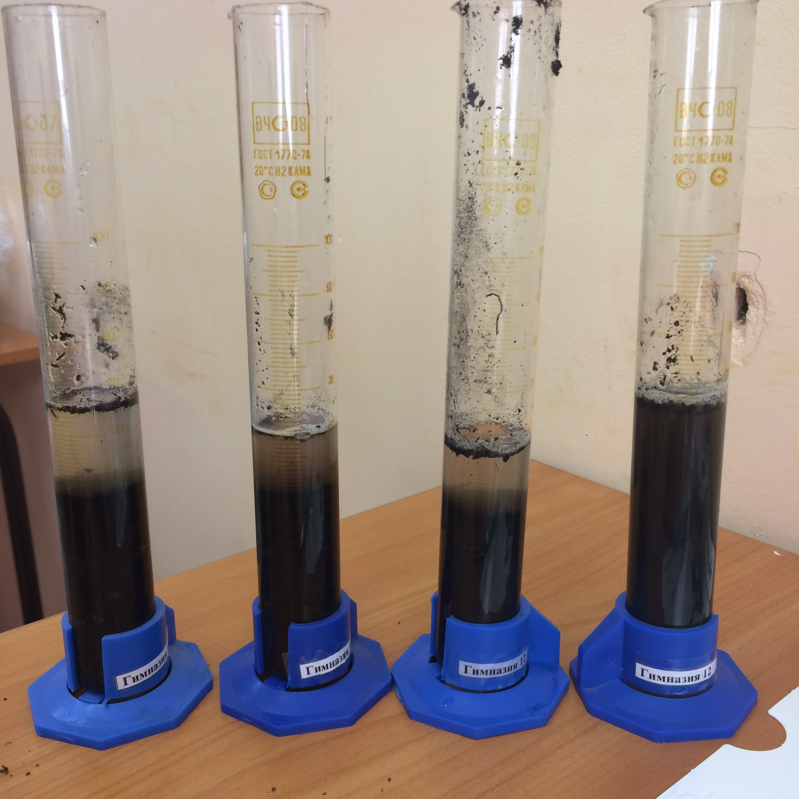
Experiment 4
Purpose: to define the dependence of the change in soil porosity on the biological activity of worms.
Photos 12,13. Measurements of the soil’s porosity

Slide 18
Table 4 and Diagram 3. The comparison of the soil porosity at different temperatures
Experiment 4
Temperature, °C | а, cm³ | b, cm³ | c, cm³ | Porosity (%)
+ 4 | 50 | 50 | 64 | 72
+ 15 | 50 | 50 | 61 | 78
+ 20 | 50 | 50 | 59 | 82
+ 39 | 50 | 50 | 64 | 72
Conclusion: the highest soil porosity was at the optimum temperature for earthworms (20 ° C). Both at +39°C and at +4°C the activity of worms was slower, as they were under unfavorable conditions.

Slide 19
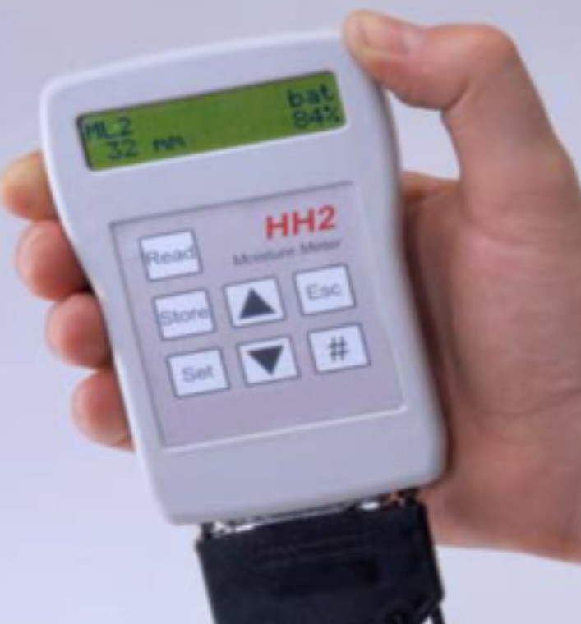

Experiment 5
Purpose: to define the dependence of the change in soil porosity on its humidity.
Tools and materials: peat (600 cm³), 10 worms, a hygrometer, a beaker, water.
Photos 14,15. A hygrometer and a beaker with water

Slide 20
Table 6 and Diagram 4. The comparison of soil porosity with its humidity
Experiment 5
Humidity of the soil, (%) | а, cm³ | b, cm³ | c, cm³ | Porosity (%)
84 | 50 | 50 | 62 | 76
70 | 50 | 50 | 56 | 88
50 | 50 | 50 | 58 | 84
30 | 50 | 50 | 59 | 82
10 | 50 | 50 | 64 | 72
Conclusion: earthworms show the greatest activity in soil with the humidity about 70%.

Slide 21
Experiment 6
Purpose: to define the dependence of the change in soil porosity on its salinity.
Tools and materials: peat (600 cm³), 10 worms, a beaker, solutions of sodium chloride (NaCl) and sodium bicarbonate (NaHCO3), water.
Photos 16,17. A sample of NaHCO3 and saline soils

Slide 22
Table 7 and Diagram 5. The comparison of the saline soils’ porosity
Experiment 6
Mass of salts, g (NaCl — NaHCO3) | а, cm³ | b, cm³ | c, cm³ | Porosity (%)
16 — 40 | 50 | 50 | 62 | 74
40 — 90 | 50 | 50 | 56 | 70
Clear sample without salts | 50 | 50 | 58 | 82
Conclusion: with an increase of the salts’ concentration in the soil, the activity of earthworms harshly decreases, hence the porosity of the soil practically does not change.

Slide 23
Conclusions
Porosity is one of the most important feature of soils, it depends on the soil’s type, structure and the amount of worms;
The optimum temperature for the earthworms is in the range of +20 °C at a humidity of 70%;
With an increase in the concentration of salts in the soil, the activity of earthworms harshly decreases.

Slide 24
References
Voroney, R. Paul & Heck, Richard J. (2007). "The soil habitat". In Paul, Eldor A. Soil microbiology, ecology and biochemistry;
Alan D. Blaylock, 1994, Soil Salinity and Salt tolerance of Horticultural and Landscape Plants.
http://bigy.ru/biologi10p/inorganics
https://ru/wikipedia.org/wiki/%D9%B8%EB%EE%EA
http://eko-jizn.ru/?p=4051
https://en.wikipedia.org/wiki/Soil_salinity
http://slawa.su/zdrava/zdrava.html

Slide 25
The 6th International Young Naturalists’ Tournament
Problem № 7 «Worms»
Team «12FM»
Petr Semenikhin
chnmk@mail.ru

