Slide 1



Greenhouse
International Young Naturalist’s Tournament
Problem № 10
Reporter – Artur Nakhatakian,
Team – «12 kids of science»,
Russia, Voronezh

Slide 2
The task
A hot object placed in the open air would gradually cool down. We can slow down this process by containing the object in a greenhouse. Compare different mechanisms of heat loss by the object and explain how the presence of a greenhouse affects them.

Slide 3
Goal
Compare different mechanisms of heat loss by the object and explain how the presence of a greenhouse affects them
Tasks
Investigate the heat loss due to mechanisms of
  Convection
  Conduction
  Radiation
Conduct the experiment in lab and outside

Slide 4
Theoretical part

Slide 5
The greenhouse
Without greenhouse
With greenhouse
T₀
outer space
T₀
transparent walls from plastic film
T₂
outer space
greenhouse
T₁
T₁
heated object
heated object
Object loses heat
Greenhouse slows down the cooling

Slide 6
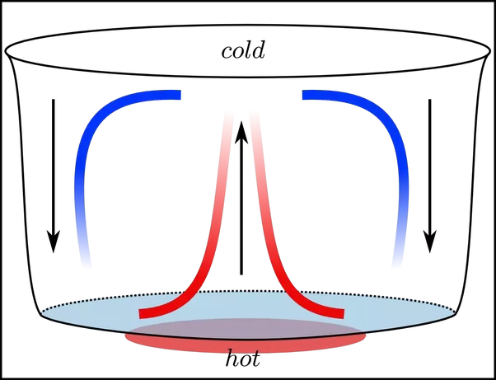
The mechanisms of heat transfer
Conduction
Radiation
Convection
Contact between molecules
Electromagnetic waves
Motion of molecules in liquid or gas

Slide 7
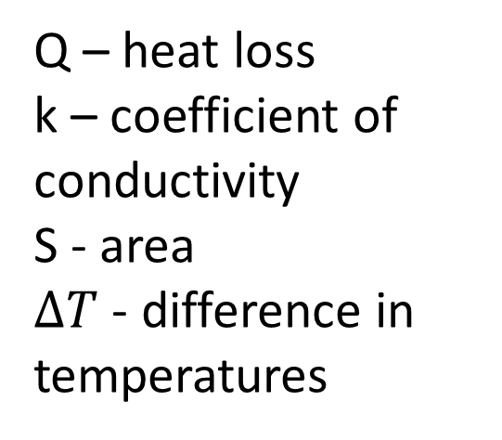
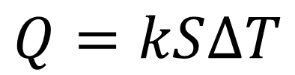
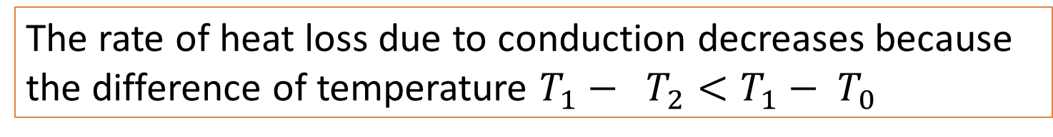
Conduction
Without greenhouse
With greenhouse
$$Q=kS∆T$$
T₀
T₀
Q – heat loss
k – coefficient of conductivity
S - area
$∆T$ - difference in temperatures
T₂
T₁
T₁
The rate of heat loss due to conduction decreases because the difference of temperature $T_{1}− T_{2}<T_{1}− T_{0}$

Slide 8
Convection
Without greenhouse
With greenhouse
Cold air takes its place
Warm air rises
The rate of heat loss due to convection decreases, because structure is not open to the atmosphere, so the warmed air cannot escape

Slide 9
Radiation
Without greenhouse
With greenhouse
the infrared waves
The rate of heat loss due to radiation decreases, because infrared radiation reflects from the plastic-glass walls

Slide 10
Experimental part

Slide 11
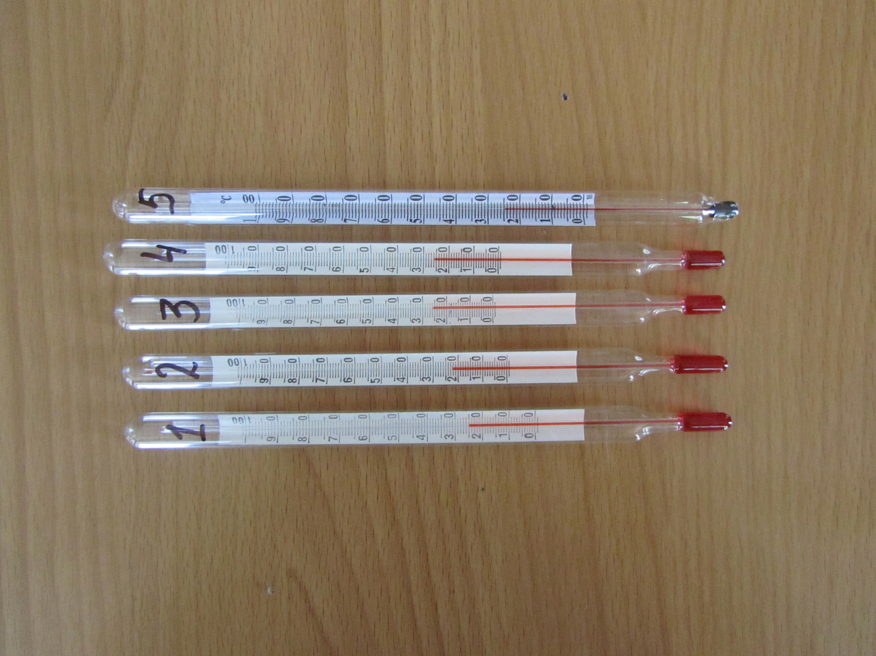
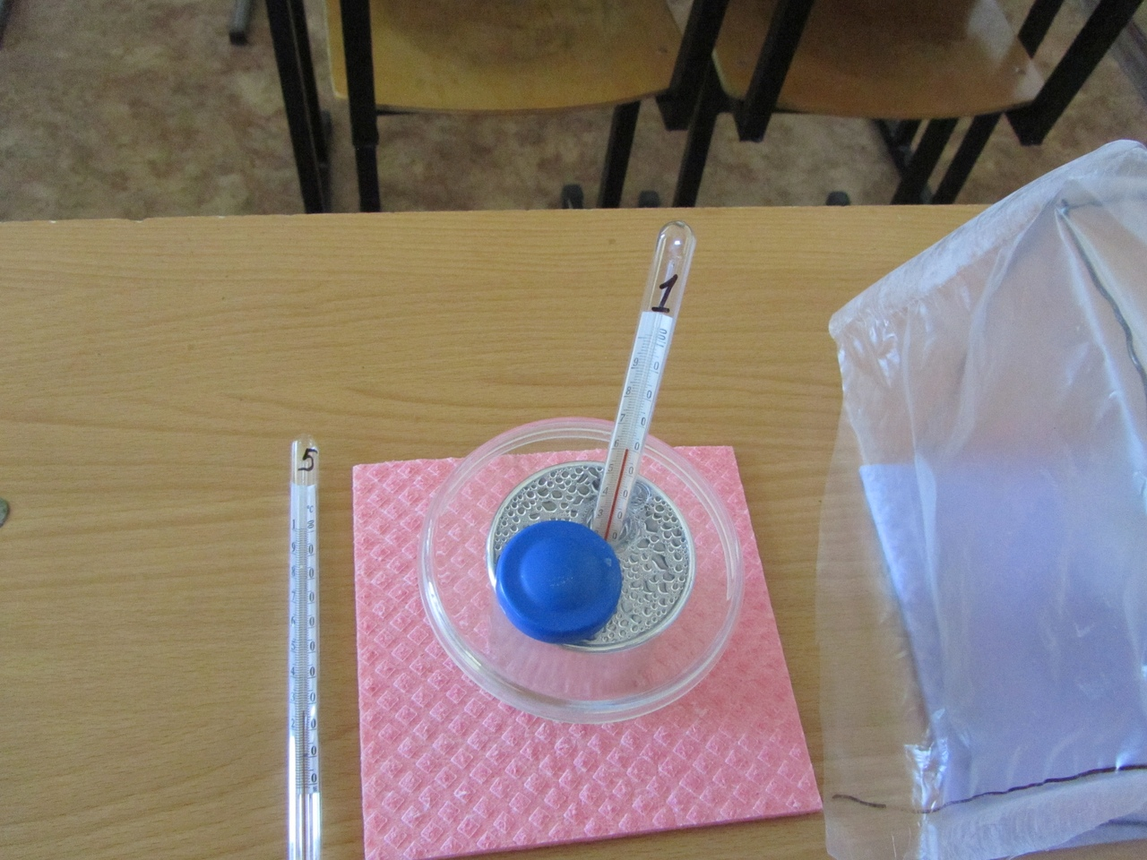
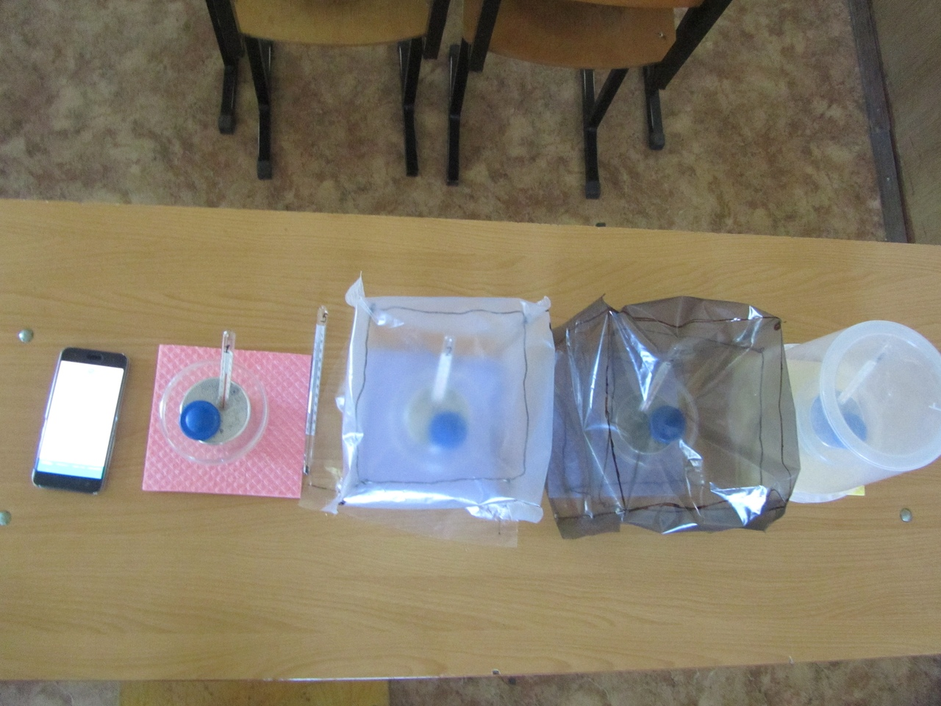
Equipment
4 vessels with covers
Hot water: m = 300 g, T_{water} = 80ºC
Greenhouses
Black dye
Thermometer

Slide 12
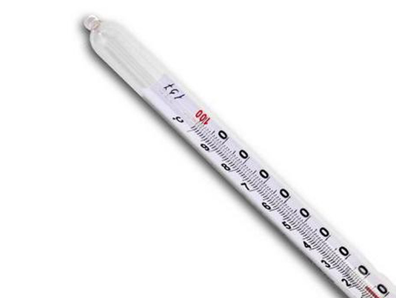

Laboratory experiment
Thermometer
Greenhouse
Cover
Water
Aluminum vessel

Slide 13
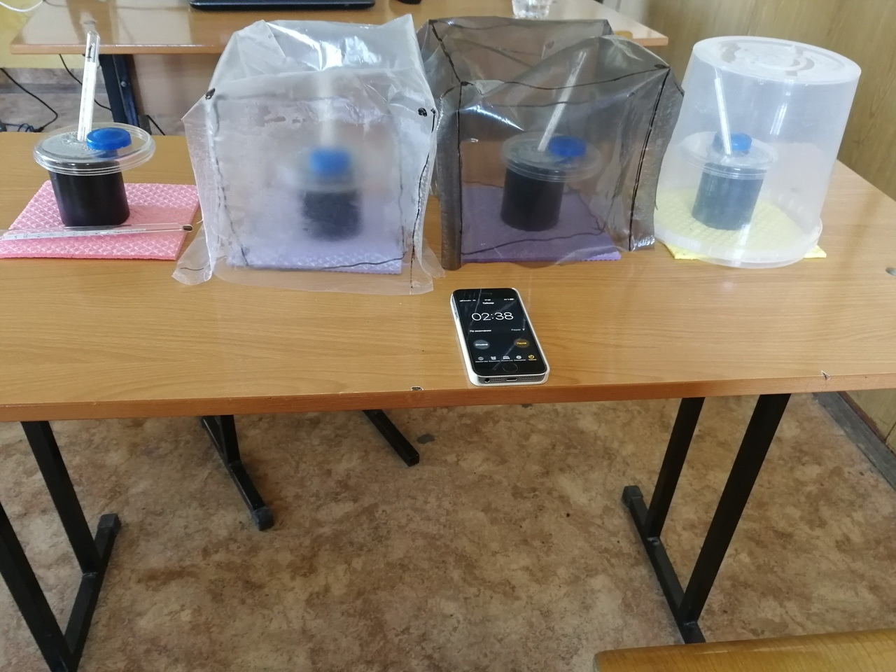
The greenhouses
The control
0.2 m x 0.2 m x 0.2 m
Black polyethylene film
Width of the film: 0,1 mm
D = 0.2 m, H = 0.2 m
Polypropylene walls
Width of the walls: 0,1 mm
0.2 m x 0.2 m x 0.2 m
Transparent polyethylene film
Width of the film: 0,1 mm

Slide 14
The temperature VS time

Slide 15
Black vessels VS reflecting vessels
Reflecting vessels
Black vessel: heat loss due to radiation increases
Black vessels

Slide 16
The temperature VS time

Slide 17
Black VS Reflecting

Slide 18
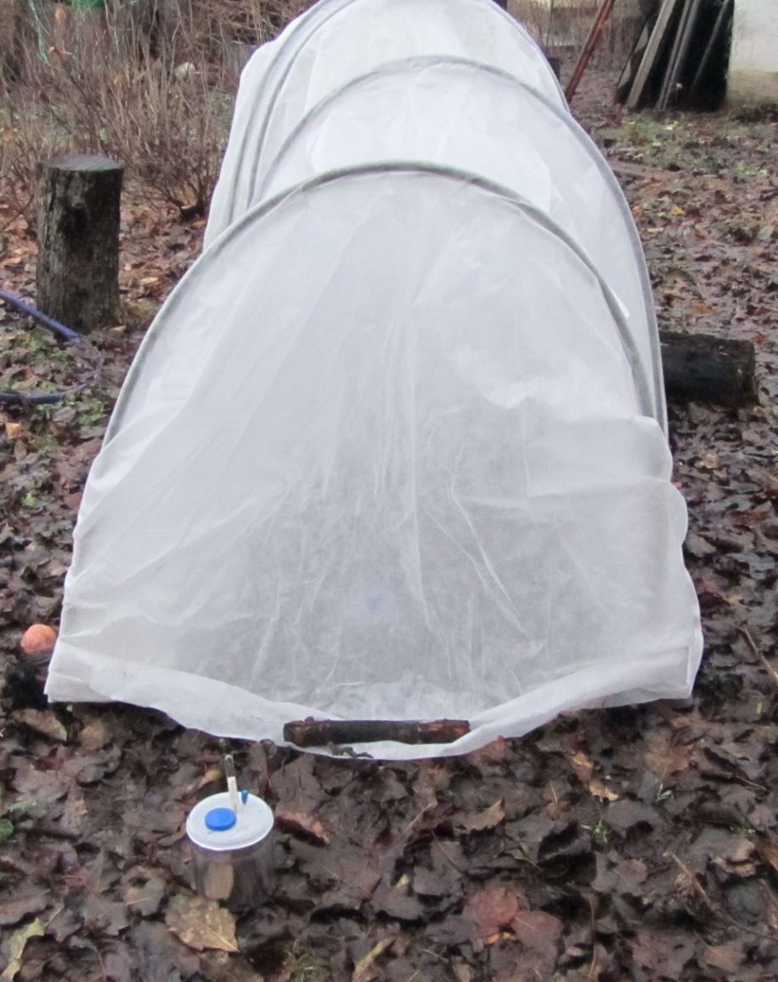
Real-life experiment
Camera records the thermometer reading
Calorimeter in the greenhouse
Calorimeter in the outer space

Slide 19
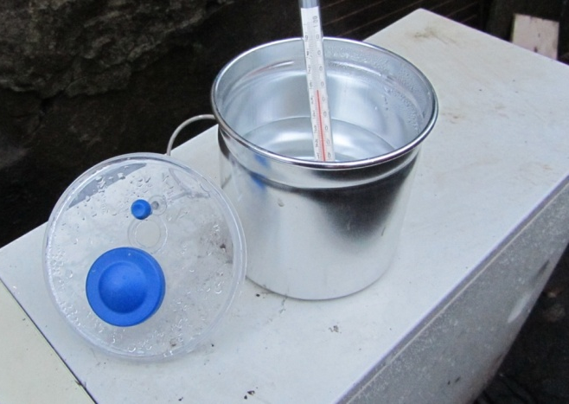
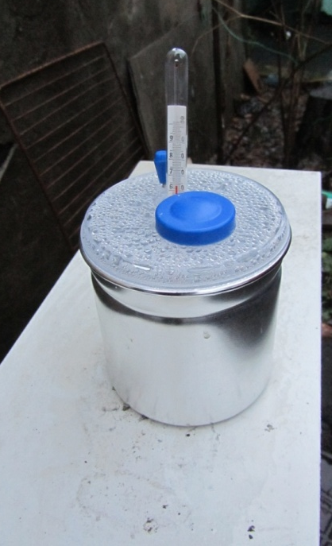
The equipment
Hot water,
m = 300 g, T_{water} = 80ºC
2 calorimeters
greenhouse:
Length=1,5 m
  Height=0,85 m
  Width=1m
  material
Thermometer
Camera

Slide 20
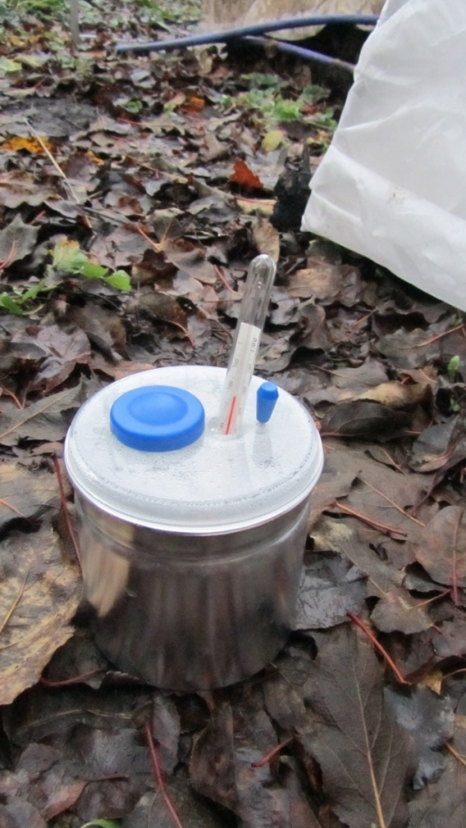
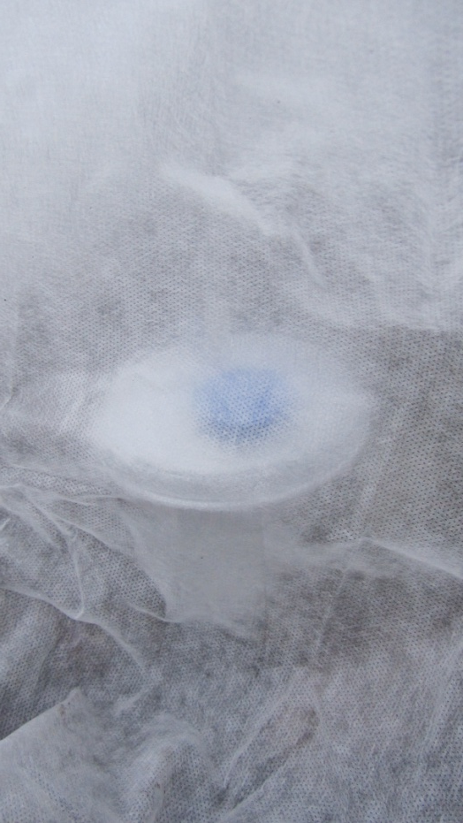
Experimental process
2 calorimeters with hot water are placed:
  One in the greenhouse
  Other near the greenhouse
The temperature of water is recorded on camera.
The temperature dependence over time is investigated.
T₀ = +4⁰С
Experiment lasted for 120 min

Slide 21
The experimental results

Slide 22
Conclusion
  We explained how the greenhouse slows down the cooling of heated object by the mechanisms of:
    Convection
    Conduction
    Radiation
  We experimentally investigated the change of temperature over time in greenhouses with different parameters

Slide 23
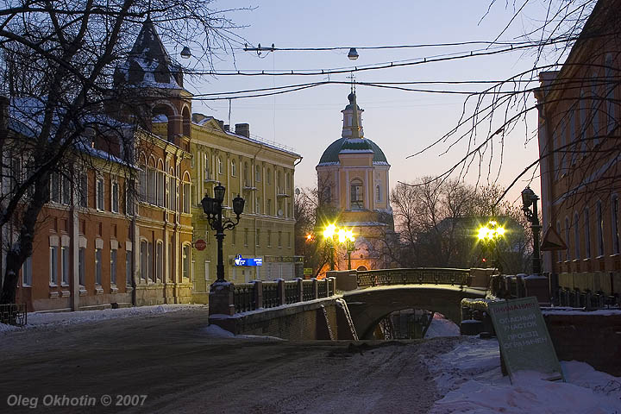
Thank you for your attention!

Slide 24
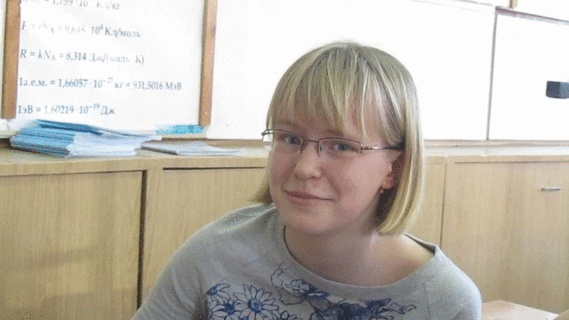
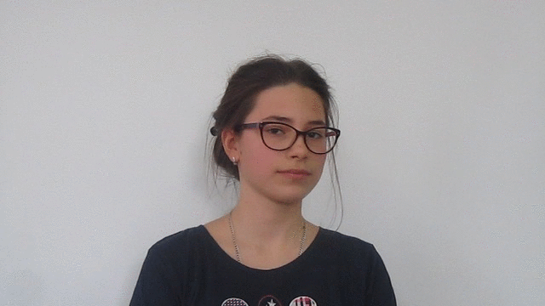
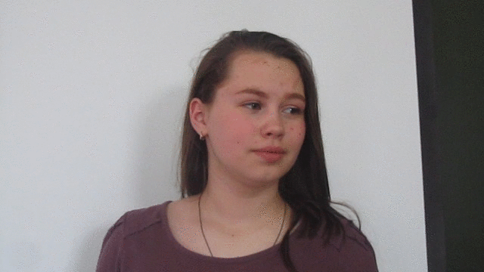
Наша команда

Slide 25
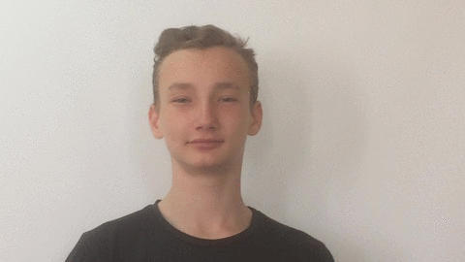
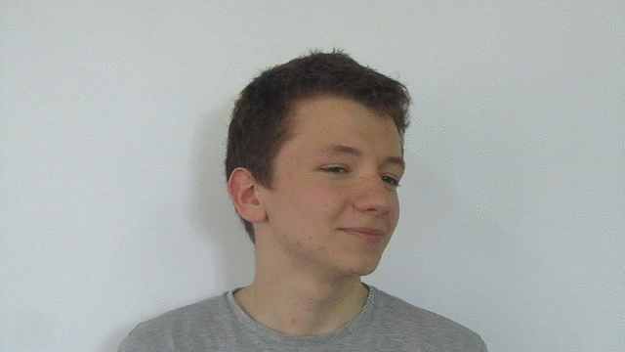

Наша команда

Slide 26
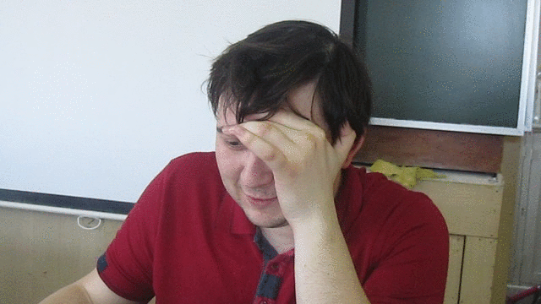
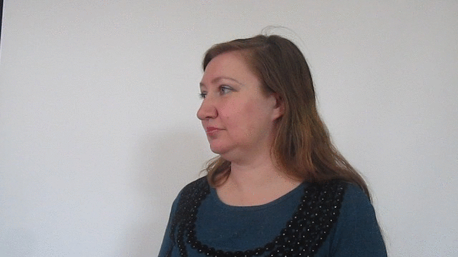
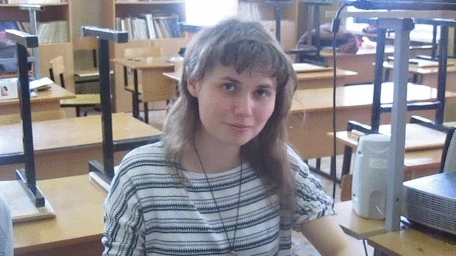
Руководители команды

Slide 27
The temperature VS time

Slide 28
Conduction
1.
hot air
hot object
conduction

