Slide 1
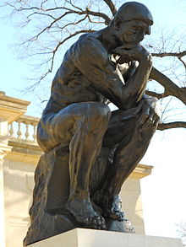
Problem №2
«All roads lead to Rome»
Prepared by team: “Voronezh”
Speaker: Vadim Krokhin

Slide 2
Condition of the problem.
Open a random Wikipedia article and click on the first link in the article. Keep clicking on the
first link of each following article. It is argued that you will quickly end up on the page
Philosophy. Investigate whether this is true. How can one describe such an observation?

Slide 3
Goal and tasks
Goal:
Find out whether this statement is true and, if it is possible, describe it.
Tasks:
Check the truthfulness of the proposed statement.
Explain the results.

Slide 4
Let’s check
Python program
Random page
First link on pages
The program stops working when:
  Loop starts

Slide 5
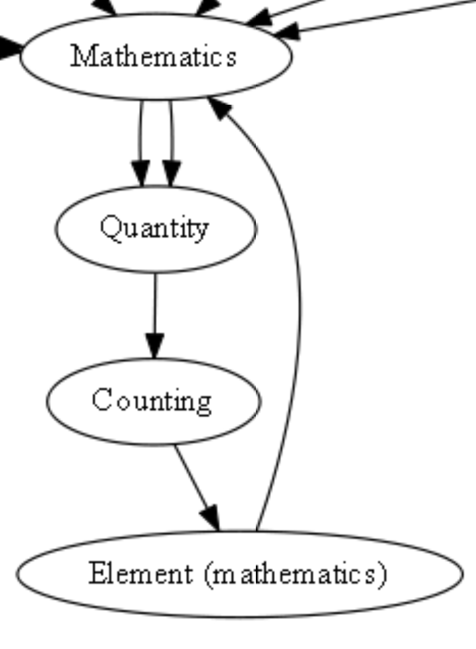

Slide 6
Let’s check
Python program
Random page
First link on pages
The program stops working when:
  Loop starts
  No links on a page
  The program on the Philosophy page
Graph

Slide 7
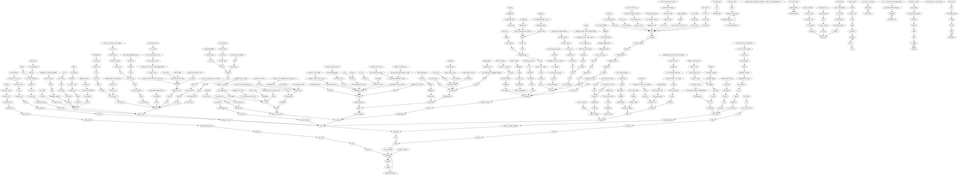

Slide 8
Results
We used 2100 pages and had results: now only 8% of links lead to Philosophy page.
Experiments were conducted 29.06.2018-02.07.2018

Slide 9
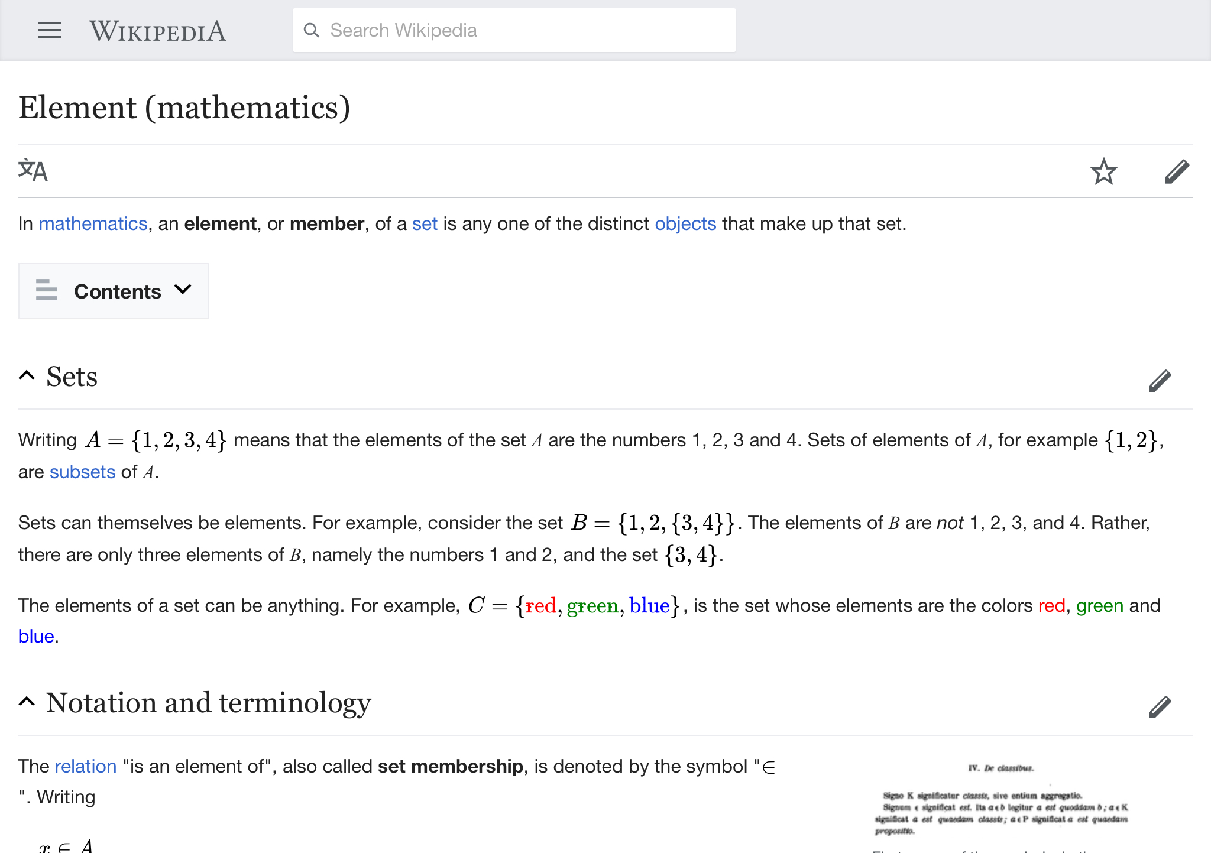

Slide 11
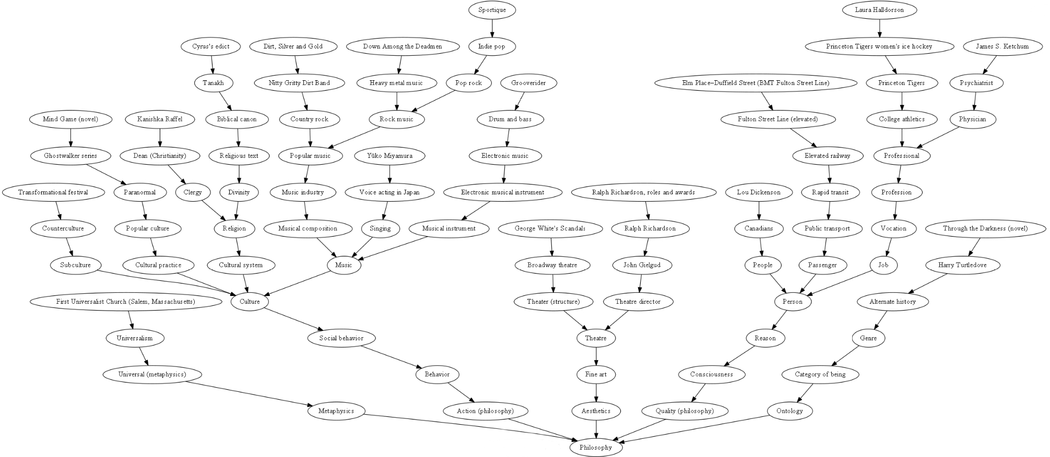

Slide 12
Why it could be?

Slide 13
What is philosophy?
Philosophy is a special method of cognition based on conclusions.

Slide 14
Conclusions
Now the statement isn’t correct.
We explained the results.
We provided an explanation of the phenomenon which can not realized now.

