Slide 1
Problem №1
Buffon’s needle

Slide 2
Condition of the problem
Draw a series of parallel equally spaced lines on a horizontal surface. Pick a bunch of sticks (e.g.
matches or needles) slightly shorter or longer than the separation between the lines, and
randomly drop them on the surface. It is claimed that the number of times the sticks cross the
lines allows estimating the constant π to a high precision.

Slide 3
Goal and tasks
Goal:
explore how accurate the value of the number π can be obtained by the method of buffon
Tasks:
Calculate the probability of crossing the lines with sticks at different distances between them
Calculate the number π by the Buffon theorem
Compare the results with the table value of the number π
Determine inaccuracy this exploration

Slide 4
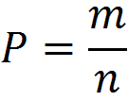

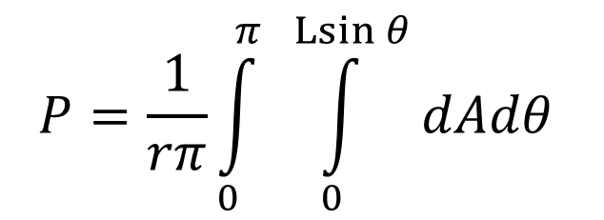
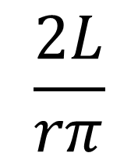

Mathematical model
- probability
- number of favorable events
- number of events
=
=>

Slide 5
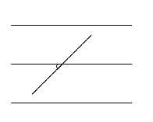

L – needle length
r – distance between lines
Θ – angle between needle and straight line
А - distance between the beginning of the needle and the nearest straight line
r
θ
L
A
Inaccuracy (∆)= $\frac{π\left(table\right)−π(obtained)}{π(table)}∗100\%$

Slide 6
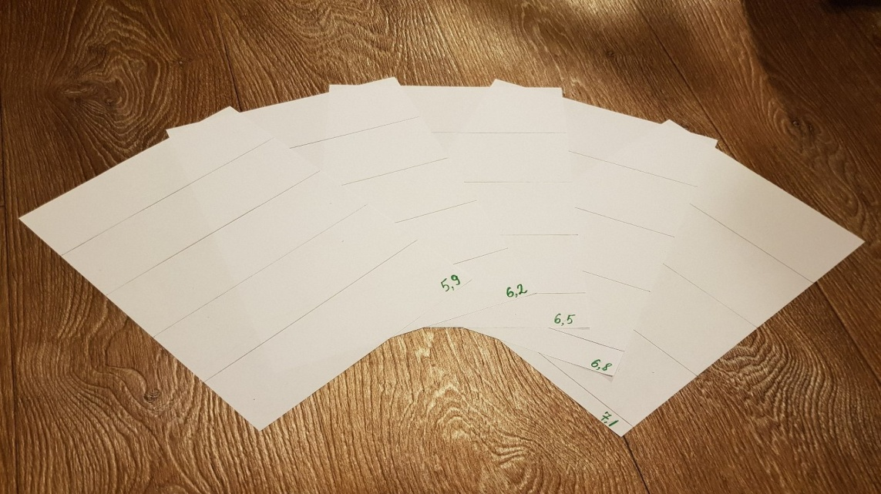
Conducting experiments
Number of Sheets: 5
Sheet format: А4
Needle length (L, cm): 6.5
The distance between the straight lines (r, cm): 5.9, 6.2, 6.5, 6.8, 7.1
The deviation of r from L: -10%, -5%, 0%, 5%, 10%

Slide 7
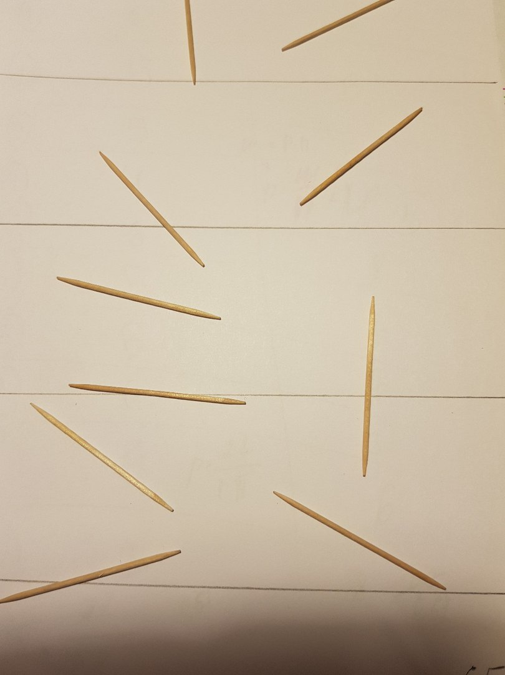
Conducting experiments
Demonstration of the possible position of sticks on a piece of paper

Slide 8
The dependence of the probability on the throw height
h | P
10 | 0,628
20 | 0,634
30 | 0,640
40 | 0,638
50 | 0,626
Hence: the probability of intersecting lines with a needle is independent of the throw height

Slide 9
Experiment №1
h throw - 20 cm;
n (throws) = 500;
m (number of intersections) = 351;
P = 0.702; r = 5.9 cm
$$P=\frac{2L}{πr}=>π=\frac{2∗6,5 cm}{0,702∗5,9cm}=3,1387319523≈3,1387$$

Slide 10
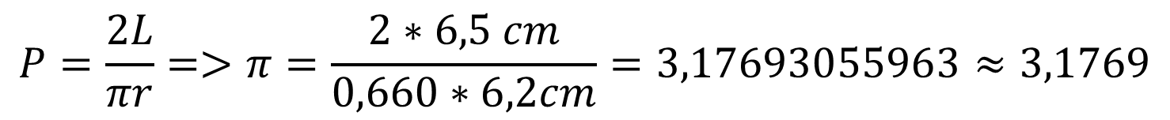
Experiment №2
h throw - 20 cm;
n (throws) = 500;
m (number of intersections) = 330;
P = 0.660; r = 6.2 cm
$$P=\frac{2L}{πr}=>π=\frac{2∗6,5 cm}{0,660∗6,2cm}=3,17693055963≈3,1769$$

Slide 11
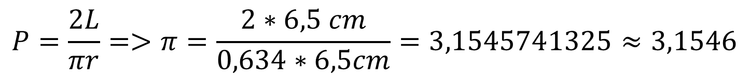
Experiment №3
h throw - 20 cm;
n (throws) = 500;
m (number of intersections) = 317;
P = 0.634; r = 6.5 cm
$$P=\frac{2L}{πr}=>π=\frac{2∗6,5 cm}{0,634∗6,5cm}=3,1545741325≈3,1546$$

Slide 12
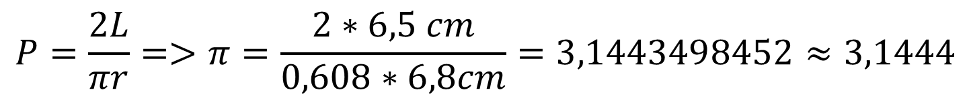
Experiment №4
h throw - 20 cm;
n (throws) = 500;
m (number of intersections) = 304;
P = 0.608; r = 6.8 cm
$$P=\frac{2L}{πr}=>π=\frac{2∗6,5 cm}{0,608∗6,8cm}=3,1443498452≈3,1444$$
Δ=0,1%

Slide 13
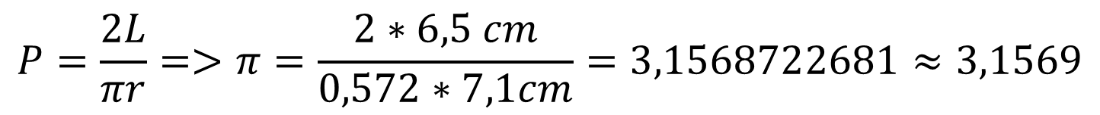
Experiment №5
h throw - 20 cm;
n (throws) = 500;
m (number of intersections) = 290;
P = 0.572; r = 7.1 cm
$$P=\frac{2L}{πr}=>π=\frac{2∗6,5 cm}{0,572∗7,1cm}=3,1568722681≈3,1569$$

Slide 14
Table of values obtained during the experiment
№ | r (cm) | P | π(obtained) | Δ
1 | 5,9 | 0,702 | 3,139 | 0,1
2 | 6,2 | 0,660 | 3,177 | -1,1
3 | 6,5 | 0,634 | 3,155 | -0,4
4 | 6,8 | 0,608 | 3,144 | -0,1
5 | 7,1 | 0,580 | 3,157 | -0,5
-1,5 ≤ Δ ≤ 1,5

Slide 15
Conclusion:
We calculated the probability of crossing lines with sticks at different distances between them.
By the formula of Buffon we calculated the number π.
The obtained number π was compared with the tabulated values.
It was found that the inaccuracy ranged from -1.5% to 1.5%

Slide 16
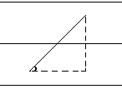
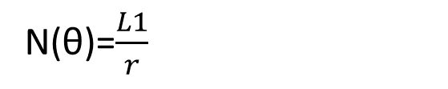
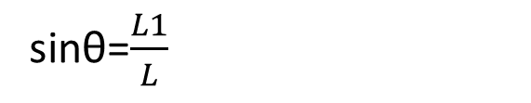
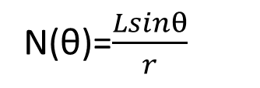
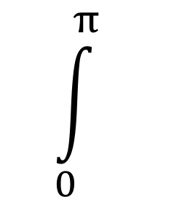
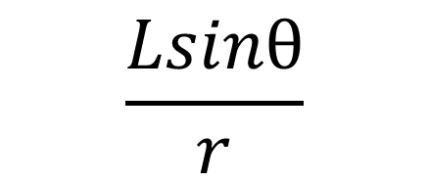
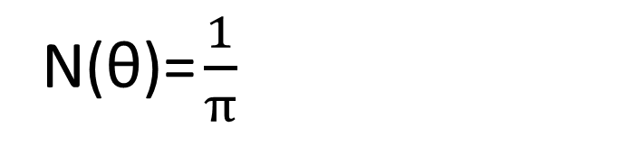
r
L
L1
θ

