Slide 1
Collision
Prepared by Pilyakin Alexandr
Team:Voronezh

Slide 2
Condition of this problem
A highly elastic Super Ball collides with a rigid surface. How can one determine the collision time? Propose various techniques and compare the experimental results.

Slide 3
Demonstration of the process of collision

Slide 4
Purpose and tasks
Purpose:
Investigate the collision process
Tasks:
Conduct experiments on this problem
Construct a theoretical model of the collision process
Compare the theoretical results of the time measurement with the experimental
Make conclusions

Slide 5
Equipment
We used 2 different balls(kel=const,
ρ(density) =const) ,a high-frequency camera at 960 fps(frames rep second), a tape measure, tile floor

Slide 6
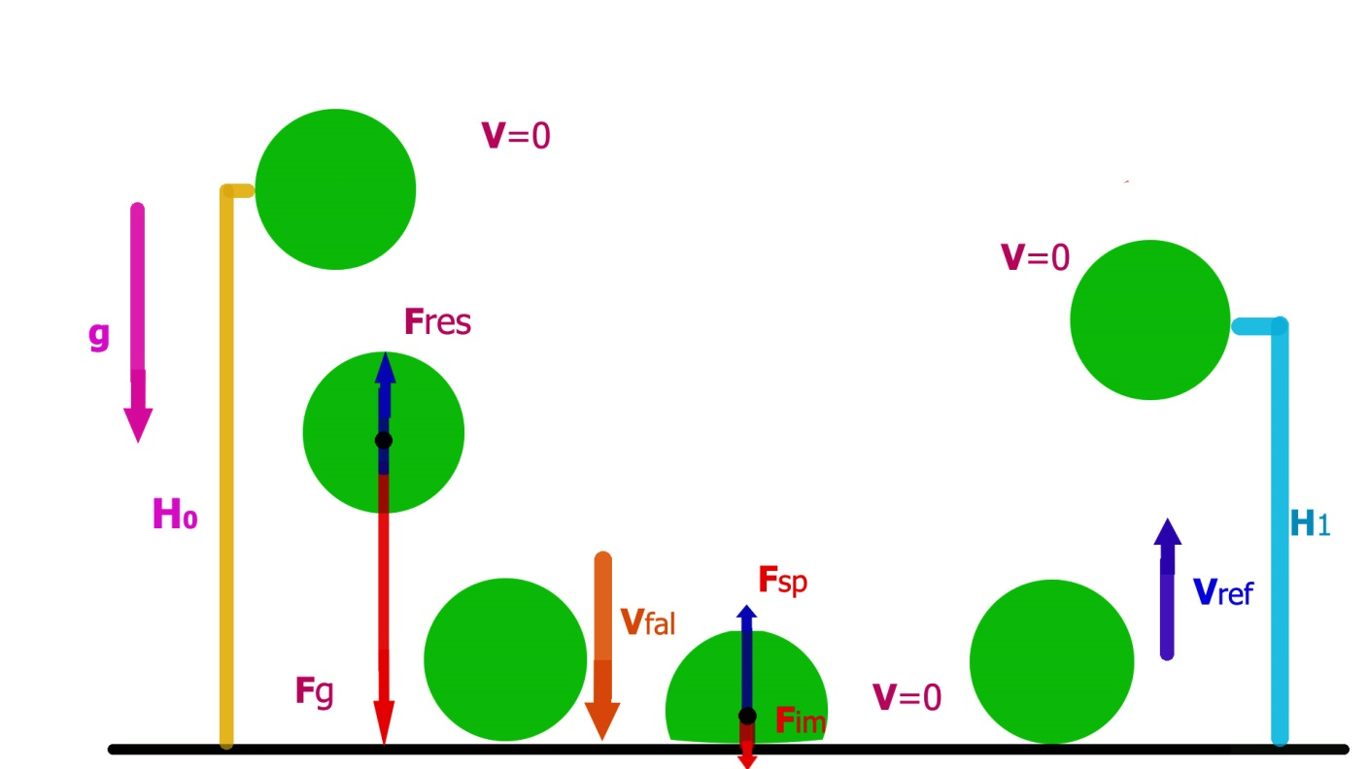
Dynamic of impact
Fim-force of the impact
Fres-force of the resistance of air
Vfal- Velocity at which falls ball
Fsr-force of the support reaction
Vref-Velocity at which the body is reflected

Slide 7
Approximations
Fres is very small(because the speed of falling balls is very small from the heights that we used in the experiments)
∆Q of losses decreases like an arithmetic progression Qn=Qn-1 –ΔQ; ΔQ=Qf/N
For Fel the Hooke’s law if fulfilled
Neglecting the energy losses on the sound
Fel=Fsr
Neglecting the rotation of the ball
Fel=force of the elastic (for Hooke’s law)

Slide 8
Help about used balls
Both balls are made of the same material, namely from polybutadiene rubber with a density of 930 kg/m3

Slide 9
The theoretical part

Slide 10
mgH0=Qf
Qf=NQ1/3
mgH0=NQ1/3
Qn-extract energy at each stroke
Qf- full exrtact energy
N-number of impacts

Slide 11
Law of conservation of energy
1)-Q1=mV ² ref1/2 –mV²fal1/2=mV²ref1/2 – mgH0
2)mV²ref1/2=Fsr1Δx1
Law of conservation of impulse
Fsr1 tcol1=mVref1+mVfal1
Dynamic of collision
Fsr=mg+Vfal²m/2Δx
tcol-time of collision
tfal-time of falling ball
tcol n-time of collision at each stroke
tfal n-time of falling ball of each falling

Slide 12
The final system of equations
mgH0=N/3 Q1
mVref1 ²/2 –mgH0=-Q1
Fel1Δx1=mV ref1²
Fel1tcol1=mVref1+mVfal1
Fel1=mg+V fal1²m/2 Δx1

Slide 13
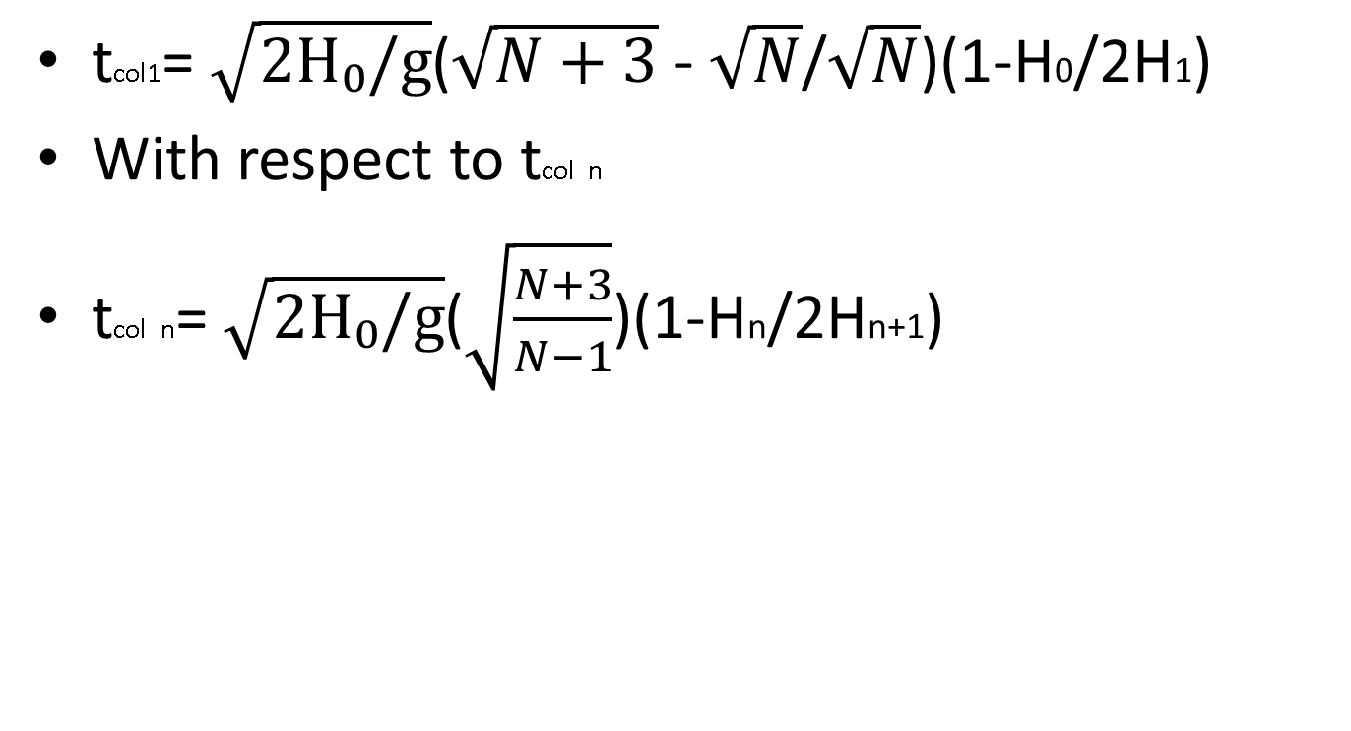
Solving this system with respect to tcol we obtain
N-number of impacts
H0- beginning height

Slide 14
The experimental part

Slide 15
Results of the experiments

Slide 16
Graph for small ball
tcol,sec
2
H0,m

Slide 17
Graph for big ball
tcol,sec
H0,m
Notes:
<номер>

Slide 18
Mini-conclusions
From the graphs we have obtained the following results.
Positive: theoretical and practical values of the same order, and they approximate at H0=0 to tcol=0.
But there is a negative result: the practical and the theoretical graphics are different. The reason for our significant approximations.

Slide 19
Mini-conclusion
The collision time depends on the initial drop height: higher the initial fall height therefore longer the impact time

Slide 20
Conclusions
We conducted experiments to find the time of impact of an elastic ball at its rebounds from a solid surface
We built a theoretical model of the collision of an elastic ball with a solid surface
The obtained theoretical results are well correlated with the practical ones, however are not enough approximate with the following approximations: the absence of air resistance force and the uniform distribution of the extract energy by the number of impacts
Two main control parameters affecting the studies are revealed, namely: the initial height of the fall and the geometric sizes of the ball(i.e. the force of the air resistance)

Slide 21
Sources of literature
Elementary physics student, Landsberg G.S.Vol.1. Mechanics. Heat. Molecular physics
http://fizportal.ru

Slide 22
Additional slides

Slide 23
Extract energy
mgH0=Qf
Qf=N(Q1-2∆Q)
Qf=NQ1-2N∆Q=NQ1-2Qf
Qf=NQ1/3
mgH0=NQ1/3

Slide 24
The law of conservation of energy
-Q1=mVref1²/2 - mVfal1²/2=mVref1²/2 - mgH0
mVref1 ² /2=k∆x1 ² /2
Fel1=k∆x1
mVref1 ² =Fel1∆x1
The law of conservation of impulse
Fel1tcol1=mVref1+mVfal1

Slide 25
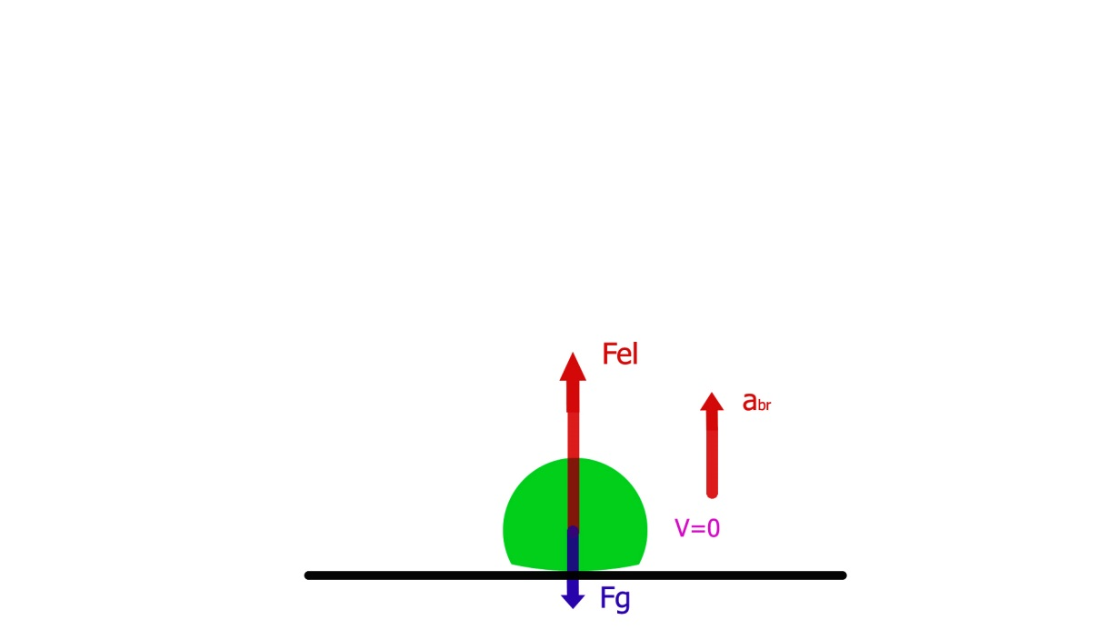
Dynamic of impact
R=mabr
Fel+mg=mabr
2abr∆x=Vfal²
Fel=mg+Vfal²m/2∆x
abr-acceleration of braking

Slide 26
The account for first group of data for small ball
Given:
Height=1 m
N=21
Height of reflection=0.7 m
Result:
Practical: ≈0.015 sec
Theoretical: ≈0.012 sec

Slide 27
The account for second group of data for small ball
Given:
Height=1,5 m
N=21
Height of reflection=1.1 m
Result:
Practical: ≈0.03 sec
Theoretical: ≈0.021 sec

Slide 28
The account for third group of data for small boy
Given:
Height=2 m
N=29
Height of reflection=1.37m
Result:
Practical: ≈0.04sec
Theoretical: ≈0.024 sec

Slide 29
The account for first group of data for big ball
Given:
Height0= 1 m
N=30
Height of reflection=0,7 m
Result:
Practical: ≈0.018 sec
Theoretical: ≈0.014 sec

Slide 30
The account for second group of data for big ball
Given:
Height0=1.5 m
N=35
Height of reflection=0.9 m
Result:
Practical: ≈0.025 sec
Theoretical: ≈0.015 sec

Slide 31
The account for third group of data for big ball
Given:
Height0=2m
N=31
Height of reflection=1.6m
Result:
Practical: ≈0.04 sec
Theoretical: ≈0.022 sec

Slide 32
Experiment with 1m height and small ball

Slide 33
Experiment with 1.5 m height and small ball

Slide 34
Experiment with 2m height and small ball

Slide 35
Experiment with 1m height and big ball

Slide 36
Experiment with 1.5m height and big ball

Slide 37
Experiment with 2m height and big ball

