Slide 1

Problem №8 «Fair coin»
Prepared by team: “Voronezh”
Speaker: Vadim Krokhin
https://dribbble.com/shots/3535524-Coin-Toss-Animation

Slide 2
Conditions of the problem
In many cases, disputes are resolved with a coin toss. It is presumed that this procedure gives equal chances of winning to both sides. Investigate how the chances depend on tossing mechanism and the coin properties.

Slide 3
Goal and tasks
Goal:
Investigate how the chances depend on tossing mechanism and the coin properties.
Tasks:
Check whether this way gives an equal chance of winning each sides.
Carry out a series of experiments with changing the tossing method and the properties of coins.

Slide 4
Theoretical part

Slide 6

$$m_{coin}g$$

Slide 7

$$m_{plummet}g$$
$$m_{coin}g$$

Slide 8

$$m_{plummet}g$$
$$m_{coin}g$$

Slide 9

$$m_{plummet}g$$
$$m_{coin}g$$

Slide 10


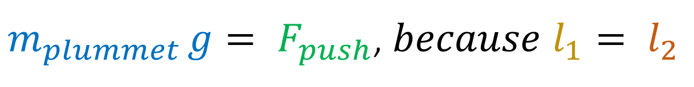


$m_{plummet }g= F_{push}$, $because$ $l_{1}= l_{2}$
$$m_{plummet}g$$
$$l_{2}$$
$$F_{push}$$
$$l_{1}$$
$$m_{coin}g$$

Slide 11




$$F_{push}$$
$$ω$$
We didn’t take into account strength of air resistance, because it’s constantly changing.
$$ω$$
$$m_{coin}g$$

Slide 12

$m_{coin}$ – mass of the coin
$m_{plummet}$ – mass of the plummet
$F_{push} −$force of the push
$l_{1}$ and $l_{2} −$lever’s arms
$ω$ – angular velocity

Slide 13
Control parameters of the toss
The location of the coin, that is, the side located on top of the coin in the first moment.
Toss height.
The rotation frequency.
Parameters 2 and 3 are related. It depends on the force of the toss and the place of application of the force.

Slide 14
Experimental part

Slide 15
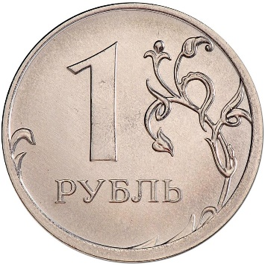
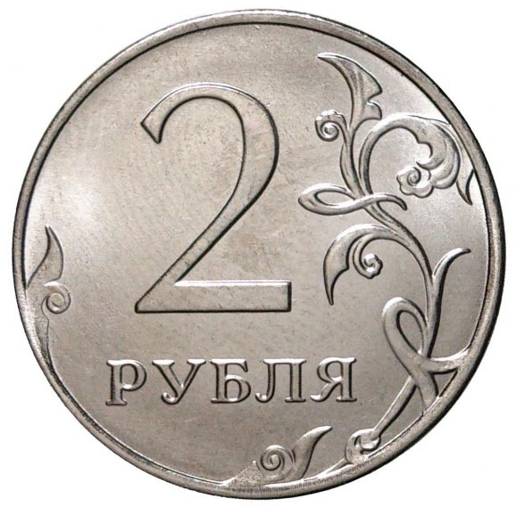
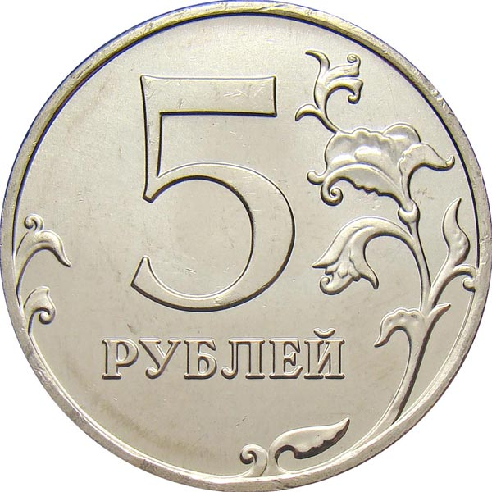
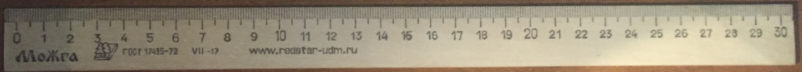
Equipment
Ruler:
Coins:
Plummets:
100 g.
150 g.
200 g.

Slide 16
Properties of coins
 | Diameter, mm | Thickness, mm | Mass, g
1 ruble coin | 20,5 | 1,5 | 3
2 rubles coin | 23 | 1,8 | 5
5 rubles coin | 25 | 1,8 | 6

Slide 17
Method 1: original

Slide 19
(The frequency of loss of the Heads)
1 ruble | 0.51
2 rubles | 0.49
5 rubles | 0.48

Slide 20
Method 2: lever

Slide 21
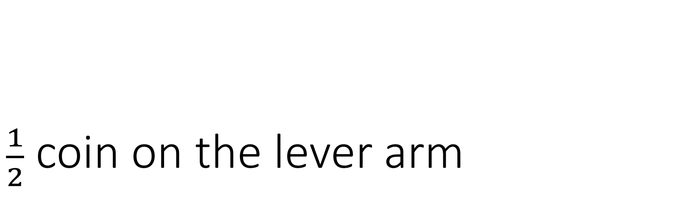
$\frac{1}{2}$ coin on the lever arm

Slide 22
(The frequency of loss of the Heads)
 | 980 N | 1470 N | 1960 N
1 ruble coin | 0.696 | 0.482 | 0.306
2 rubles coin | 0.304 | 0.704 | 0.468
5 rubles coin | 0.704 | 0.504 | 0.294
1470 N | 1960 N
0.482 | 0,306
0.704 | 0,468
0.504 | 0,294

Slide 23
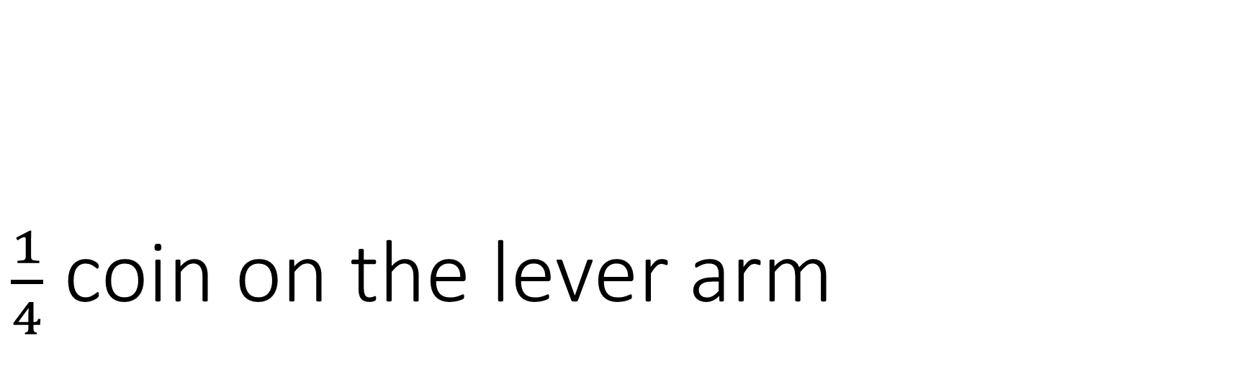
$\frac{1}{4}$ coin on the lever arm

Slide 24
(The frequency of loss of the Heads)
1/4 coin on the plane
½ coin on the plane
 | 1470 N
1 ruble coin | 0.770
2 rubles coin | 0.115
5 rubles coin | 0.290
 | 1470 N
1 ruble coin | 0.482
2 rubles coin | 0.704
5 rubles coin | 0.504

Slide 25
Why here is probability?

Slide 26
Hypothesis
The probability exists because of 2 factors. Not ideal exception of human factor and different behavior of the surface on which the coin in tossed.

Slide 27

Method №3:lever and soft surface
$\frac{1}{2}$ coin on the lever arm

Slide 28
(The frequency of loss of the Heads)
With soft surface
Without soft surface
 | 1470 N
1 ruble coin | 0.494
2 rubles coin | 0.912
5 rubles coin | 0.492
 | 1470 N
1 ruble coin | 0.482
2 rubles coin | 0.704
5 rubles coin | 0.504

Slide 29
Control parameters of the toss
The location of the coin, that is, the side located on top of the coin in the first moment.
Throw height.
The rotation frequency.
Softness of the surface.
Parameters 2 and 3 are related. It depends on the force of the toss and the place of application of the force.

Slide 30
Conclusions

Slide 31
We checked: Does this way gives an equal chance of winning? The answer is – NO! With a proper tossing the chance of falling out of a specific side is much greater.
We conducted series of experiments with changing parameters such as throw method, the surface on which the coin in tossen, the force of the toss, the place of application of force, the mass and diameter of the coin.

Slide 32
Thank you for attention

