Slide 1
Problem №4
Quark
Presented by team «Voronezh»,
Reporter: Ilia Voronin.

Slide 2
Condition of problem
Quark, cottage cheese, and similar varieties of white acid-set cheese can be produced from milk. Investigate this process experimentally and study the properties of the resulting product.

Slide 3
Goal and tasks
Goal: produce a quark, investigate the process
Tasks:
Investigate the structure of milk and proteins
Study process of denaturation and coagulation.
Bring the knowledge gained about the processes into life to make quark.

Slide 4

Limitations
Description of the problem doesn’t tell us, must whether quark be eatable. In some of our experiments, it is not.

Slide 5
Qualitative level
When milk is contained in room temperature for a while, or heated with acid product (example:sour cream), it forms caseous clots.
This clots, when unwanted moisture is removed, become our quark.
This happens from denaturation of main milk protein- casein.

Slide 6
Theoretical PART

Slide 7
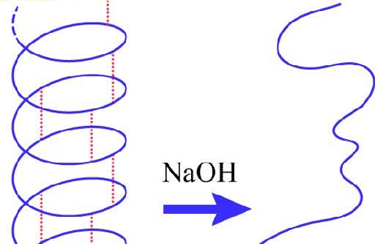
Denaturation
Denaturation- destruction of organization levels of proteins.

Slide 8
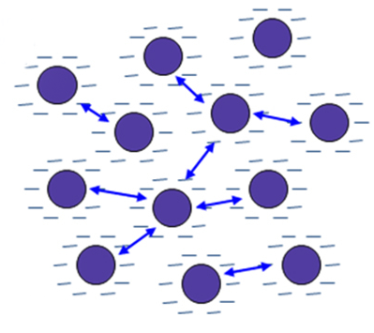
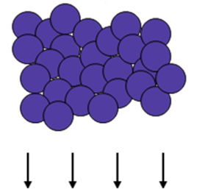
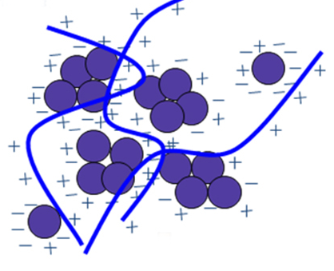
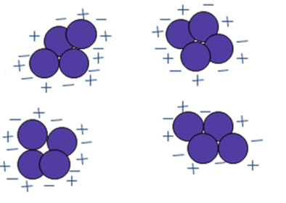
Coagulation
We started our denaturation. Colloid structures were disbalanced
Notes:
2- добавление коагулянта. 3- флоккуляция, 4-выпадение осадка

Slide 9
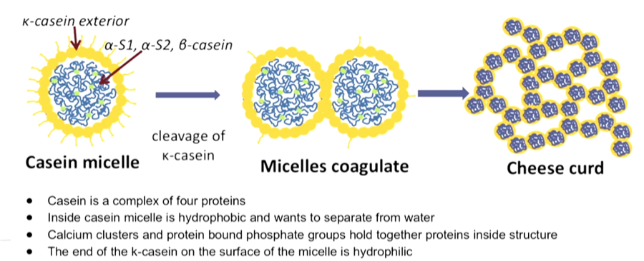
How and why denaturation works?

Slide 10
How we can cleave к-casein?
We can change level of pH to the 4,7- isoelectrical point of casein. Charges of micelles will be disbalanced and reaction will start.
We can add to milk salts of heavy metals– they(in most common situations) will change pH, and be coagulants for quark.

Slide 11
What more?
We can use organic solvents- they will cleave к-casein thereby start denaturation, quark’ll be produced
We can use temperature influence to start denaturation- it is the most common and safe way to make quark.

Slide 12
Natural process
So, without any impact we are still getting quark! Just leave milk on the window and you will get it! But why?
The reason is– life of lactobacteries. In their lifetime they are cleaving the milk sugar- lactose to galactose and glucose.
The final product of this process- lactic acid. It is organic acid with bright acid properties. It slowly change level of pH to 4.7 and forces casein to denaturate.

Slide 13
Practical part
So, we came to research properties. We’ll do it relatively to condition of the problem:
“Investigate this process experimentally and study the properties of the resulting product”
To investigate the process, we’ll do it different ways.
What exact properties of quark I want to study?Color, structure, relative density and graininess.

Slide 14
1st method: Natural process
We can leave milk in room temperature, and it will make quark without any influence, only with lactobacterias, coming from the air.

Slide 15
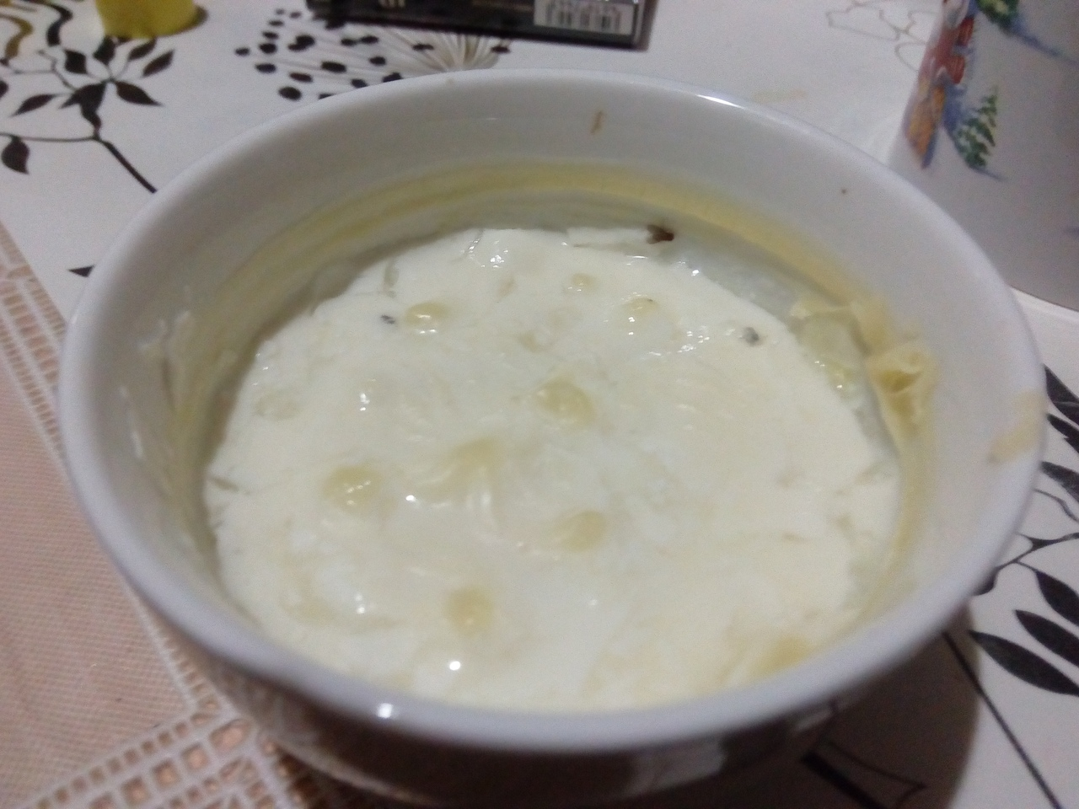

Slide 16
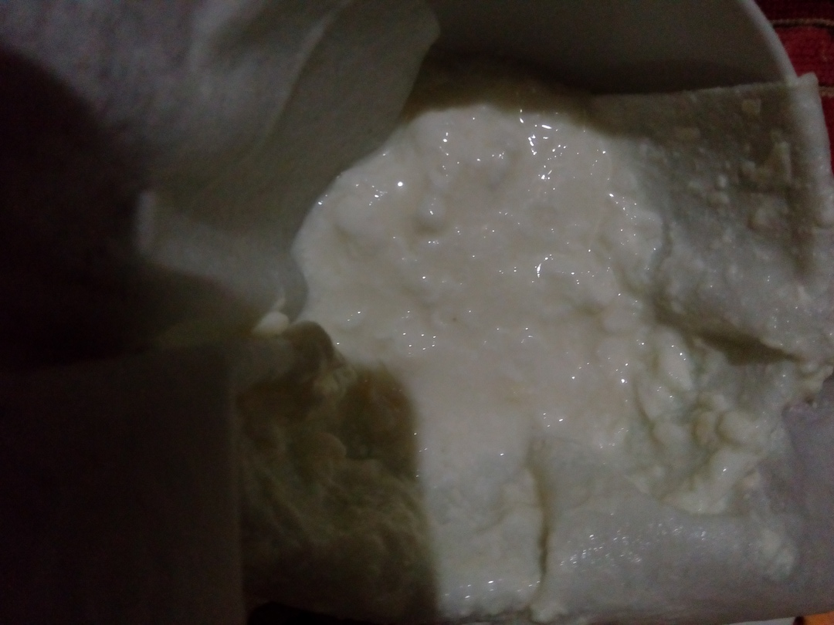
5 days

Slide 17
Intermediate conclusion
Bacteria influence give us quark, but it has too many water in it, so the structure reminds us something like gel. But solid clots is also here, with nice grains in them. This quark tastes very bitter, and to produce it we need five days and place where no one will die from its awful smell! so we’ll move to the next experiment.

Slide 18
2nd method: acidic influence
Acids change pH level of system closer to 4,7 point, where denaturation starts. We’ll use the citric acid, which has its own use in culinary.
Plus we took milk with different fattiness to find, which is the best for quark.
We’ve used 150ml of milk and 4-5g of citric acid (one tea spoon) in each experiment.

Slide 19
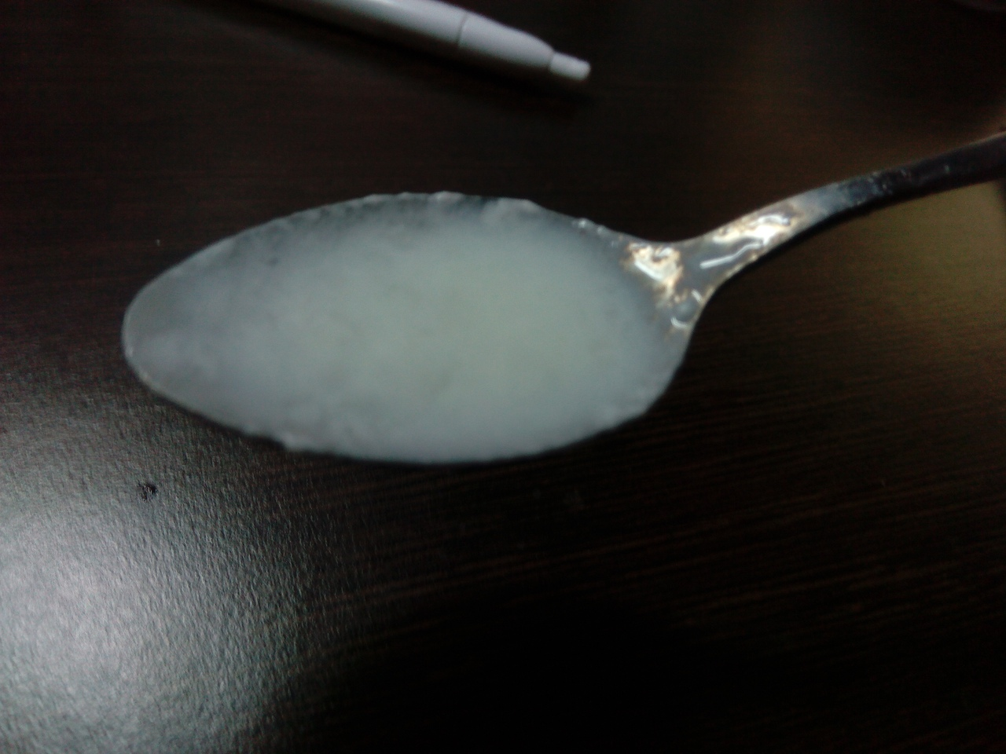
0,5% fattiness, 30 min

Slide 20
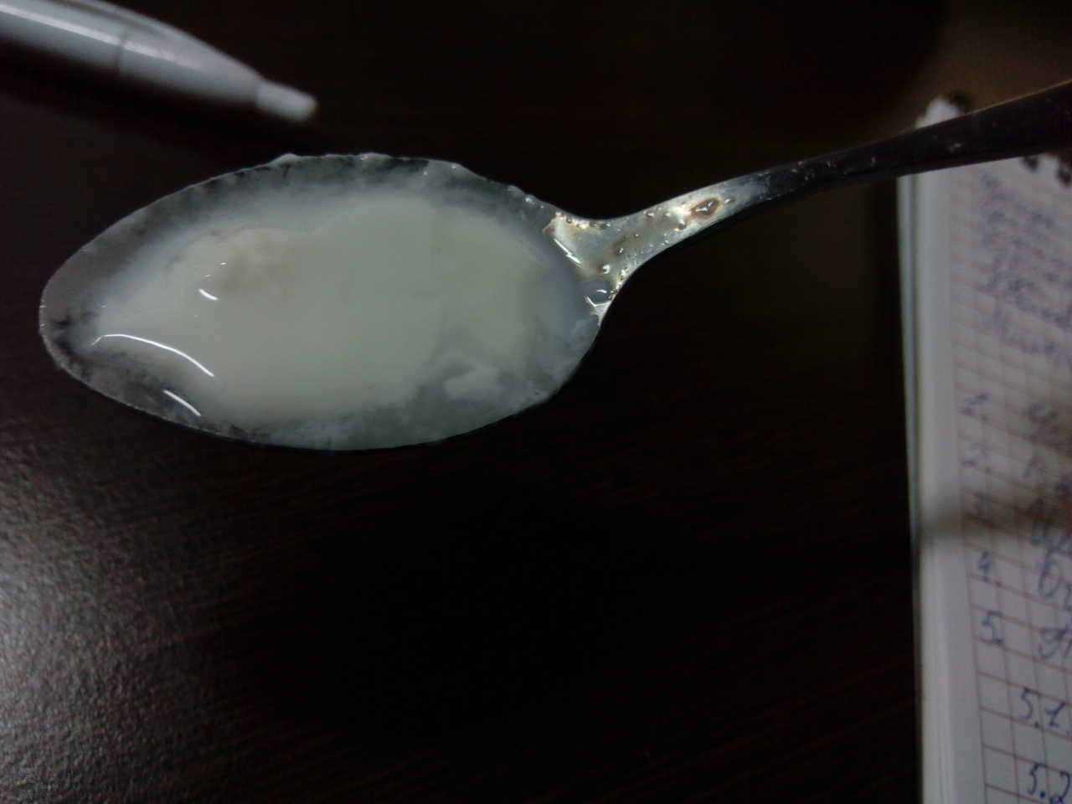
2,5% fattiness, 30 min

Slide 21
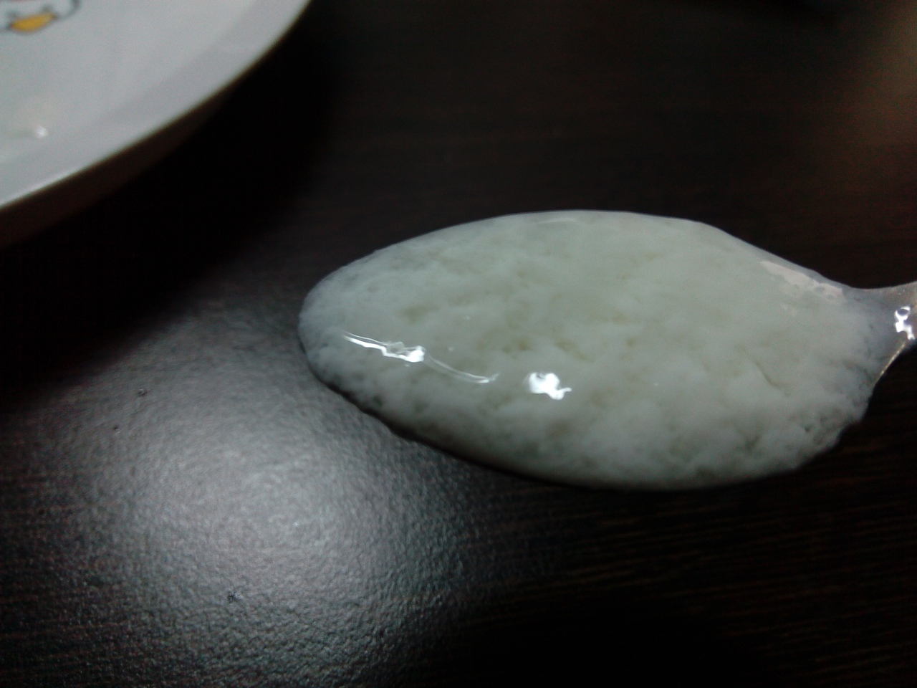
3,2% fattiness, 30 min

Slide 22
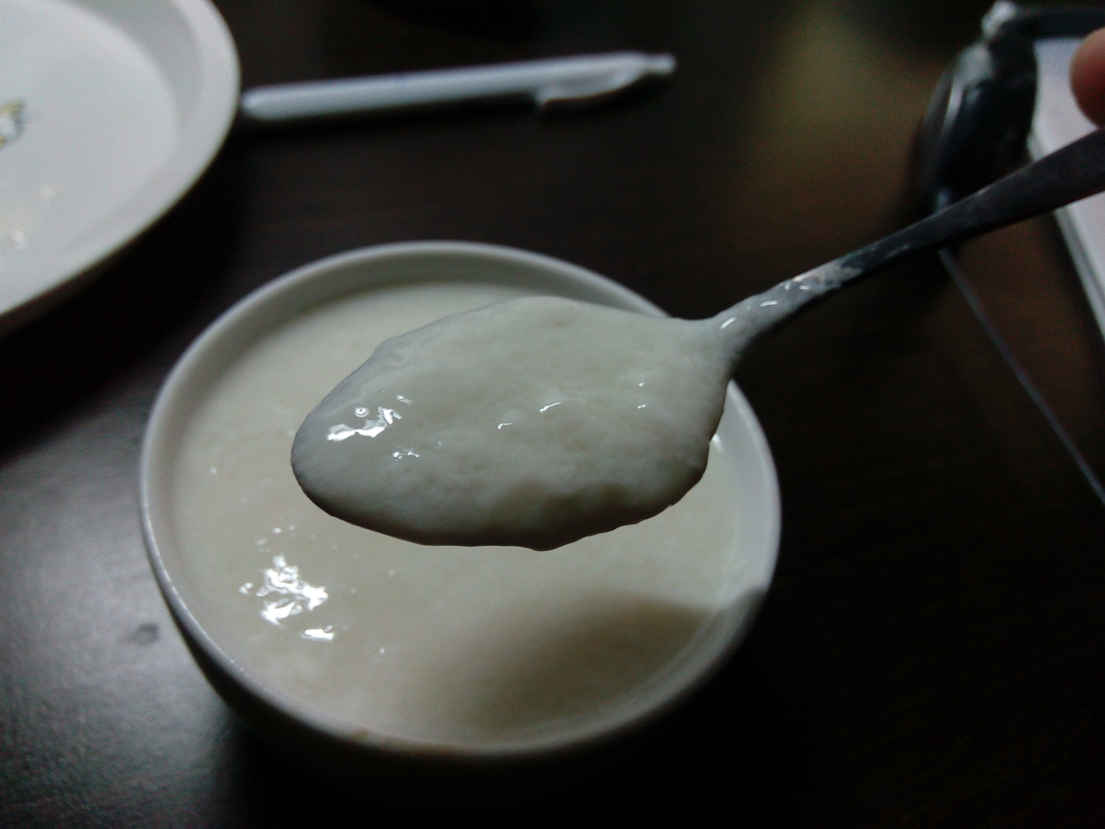
0,5% fattiness, 1 hour

Slide 23
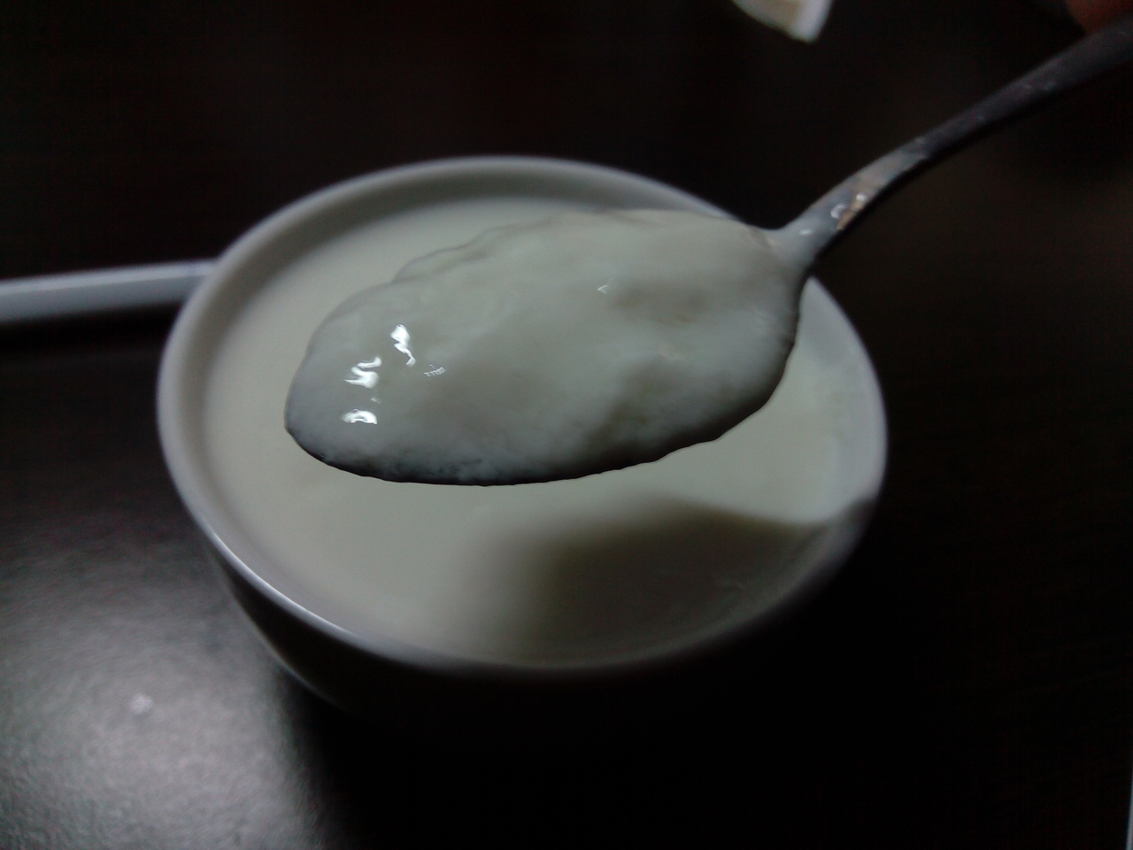
2,5% fattiness, 1 hour

Slide 24
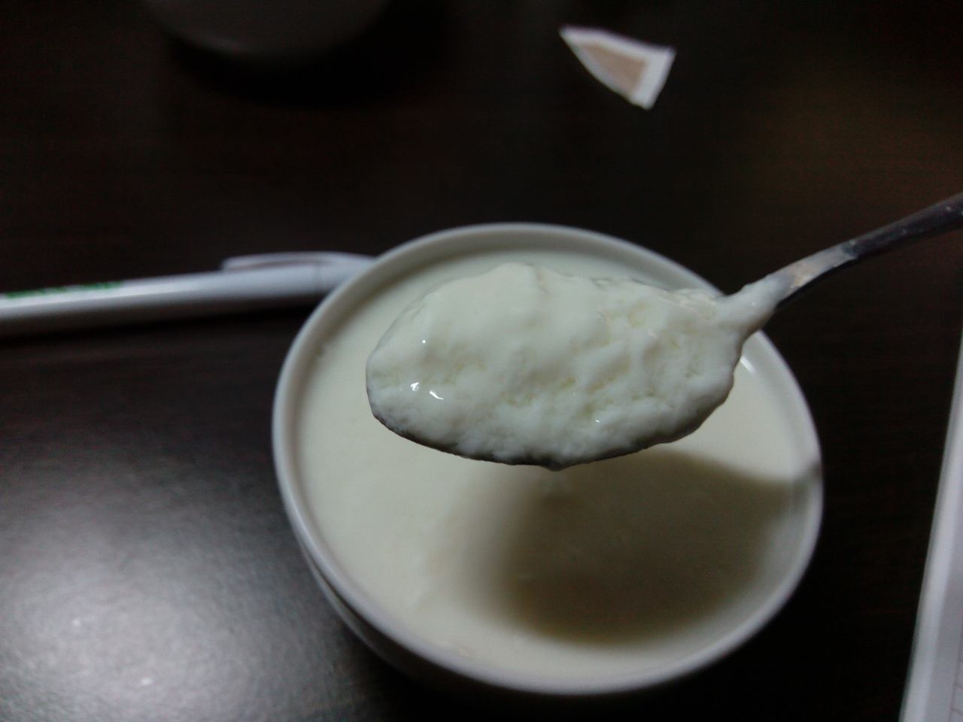
3,2% fattiness, 1 hour

Slide 25
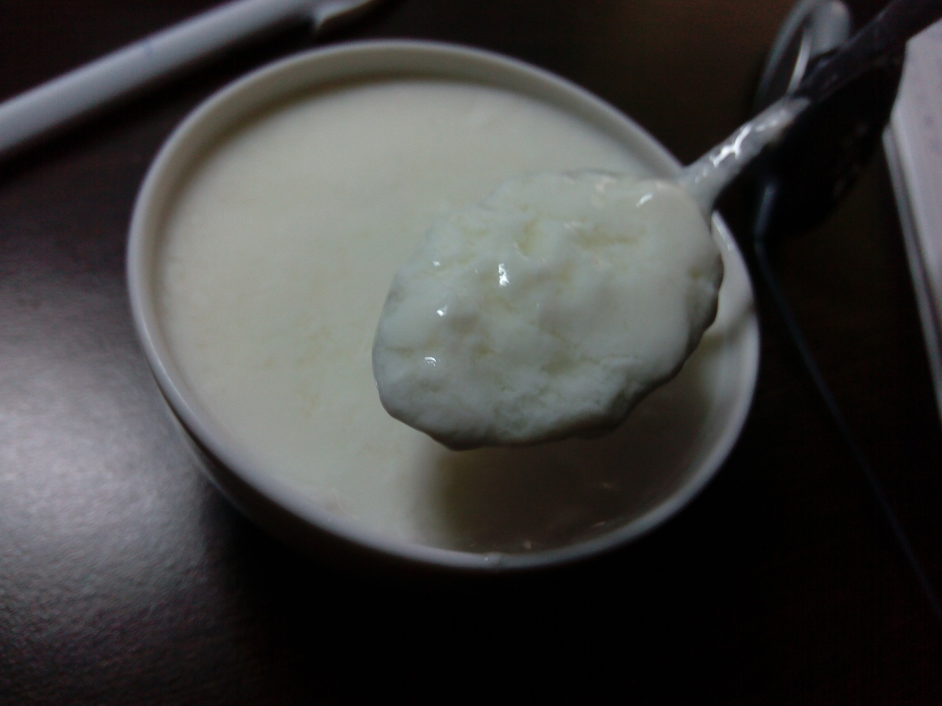
0,5% fattiness, 2 hours

Slide 26
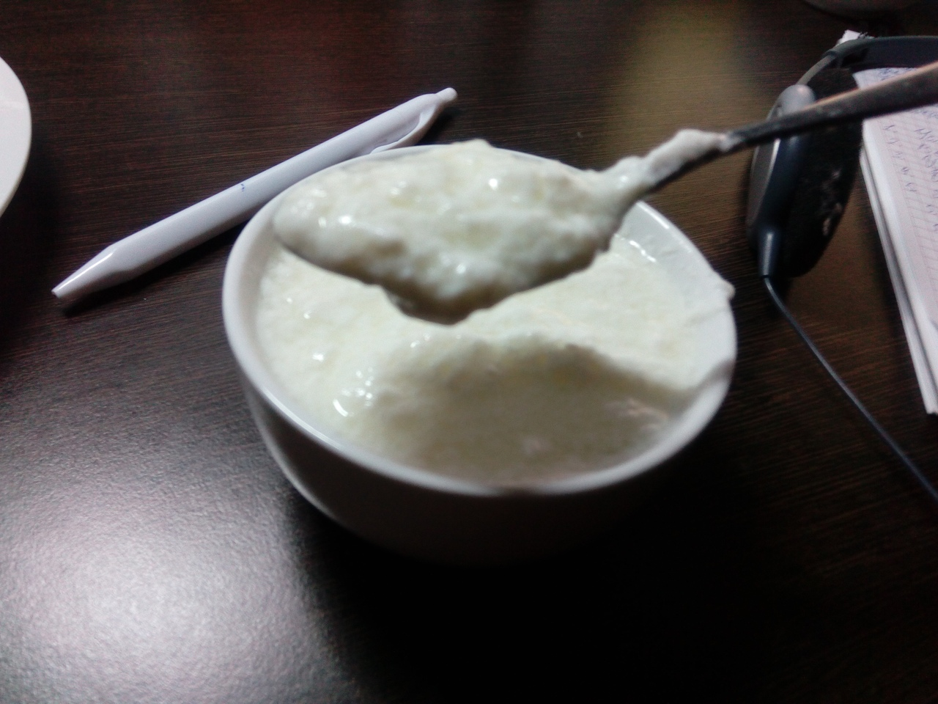
2,5% fattiness, 2 hours

Slide 27
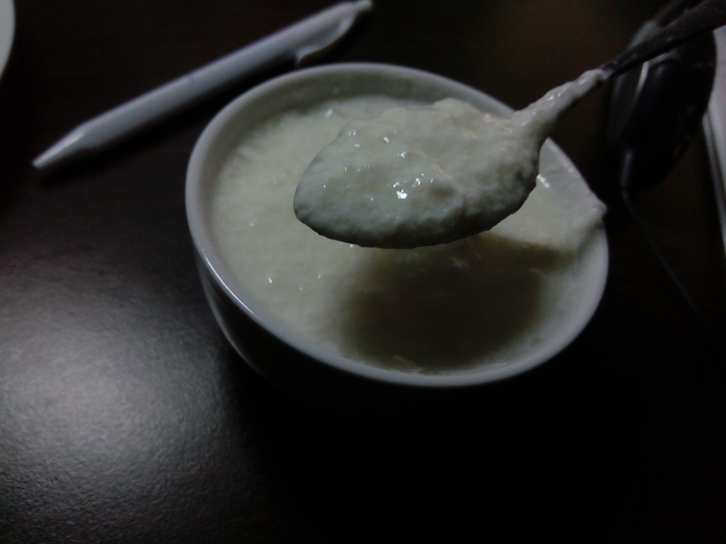
3,2% fattiness, 2 hours

Slide 28
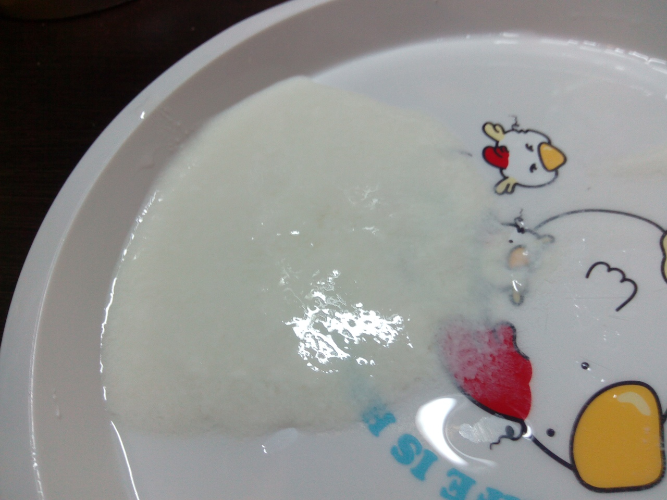
0,5% fattiness, result

Slide 29
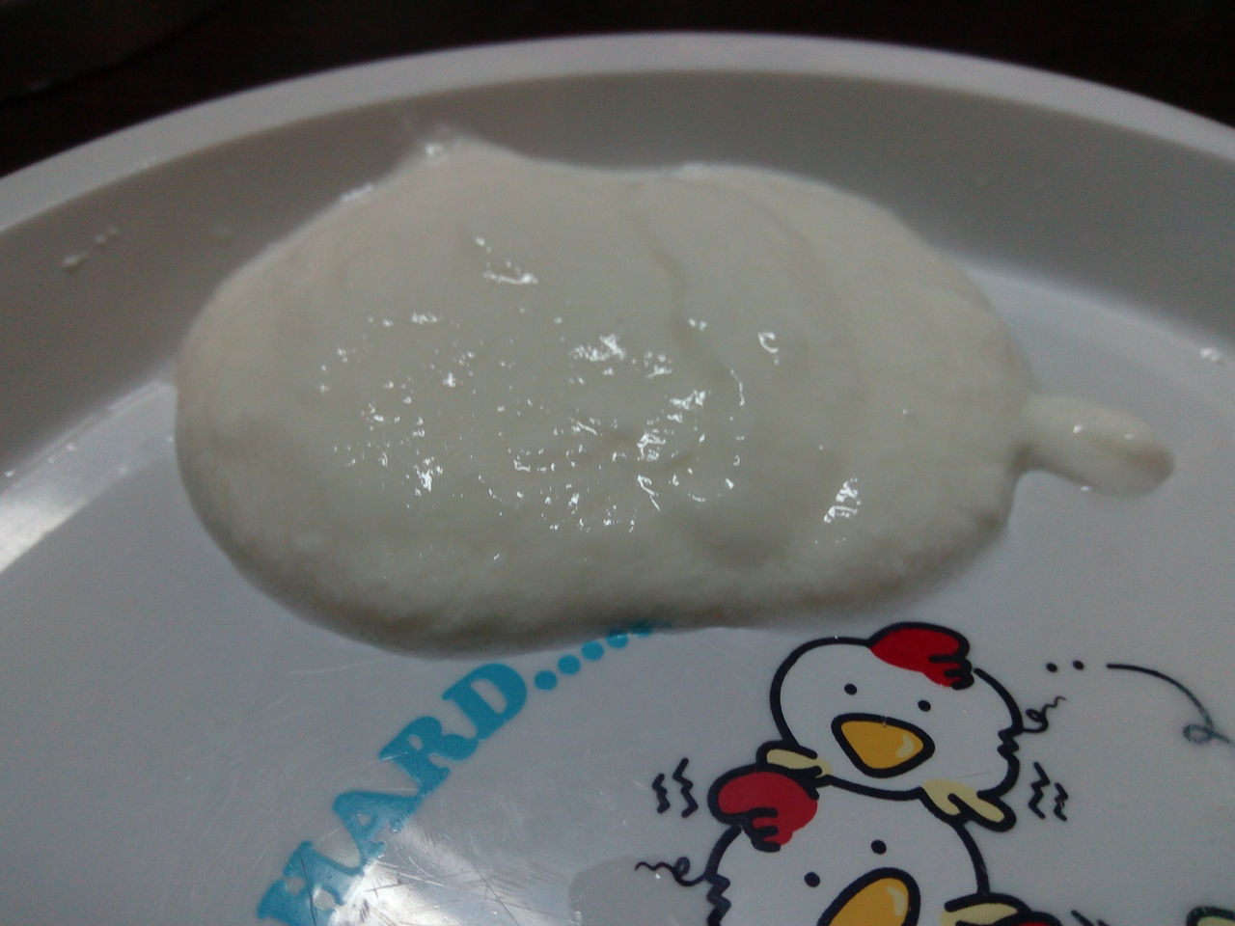
2,5% fattiness, result

Slide 30
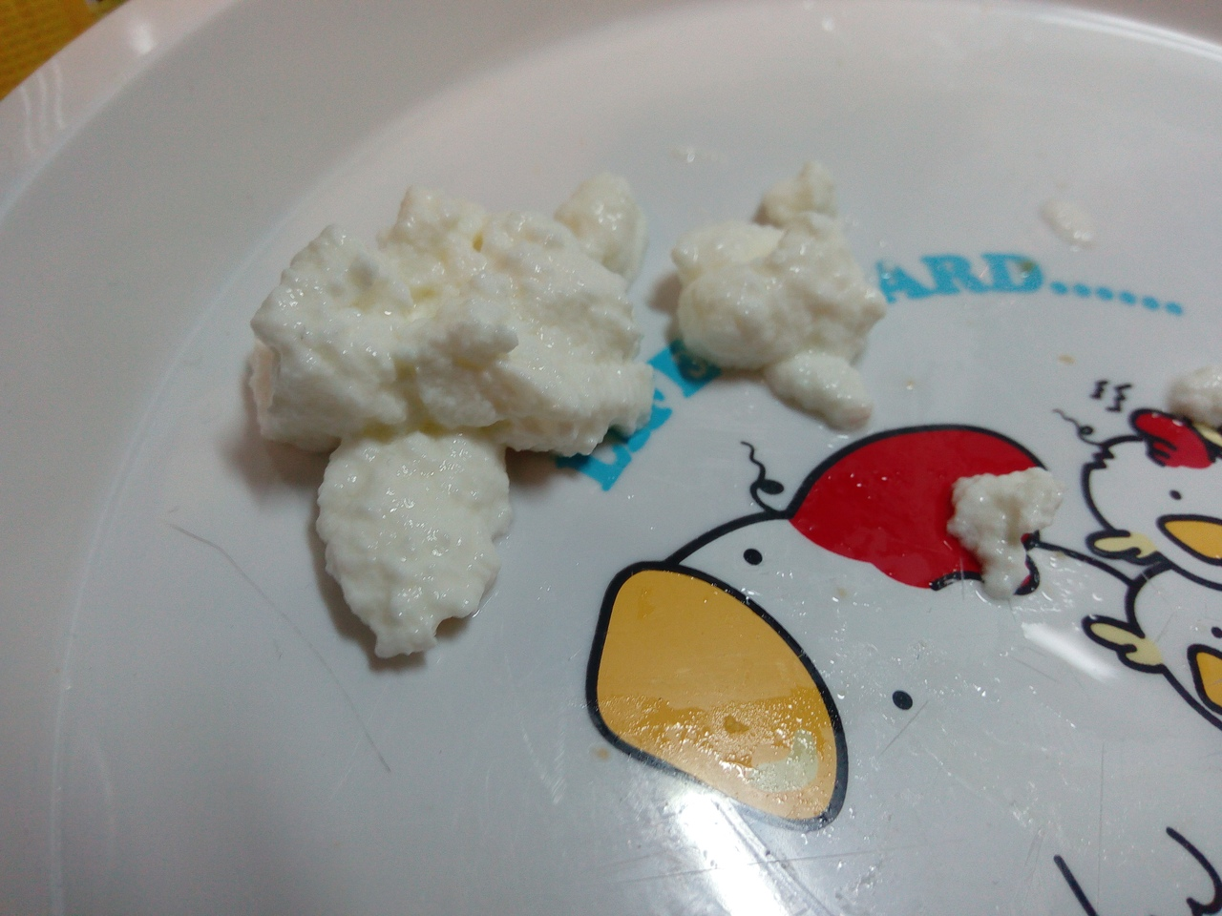
3,2% fattiness, result

Slide 31
Intermediate conclusion
The more fat milk contains, the better quark we can get.
Acidic influence give us nice quark, with clear grain structure, good density(which means quark is pretty solid) and it is really faster then natural process- only 2 hours! But it tastes acidy, so we need to move on to next method.

Slide 32
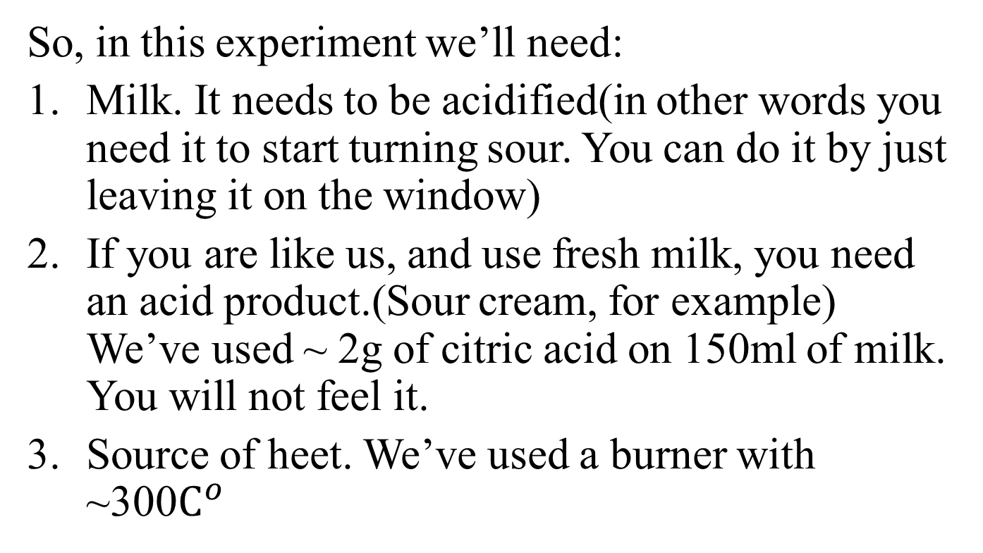
3rd method: Thermic influence
So, in this experiment we’ll need:
Milk. It needs to be acidified(in other words you need it to start turning sour. You can do it by just leaving it on the window)
If you are like us, and use fresh milk, you need an acid product.(Sour cream, for example) We’ve used ~ 2g of citric acid on 150ml of milk. You will not feel it.
Source of heet. We’ve used a burner with ~300$C^{o}$

Slide 33
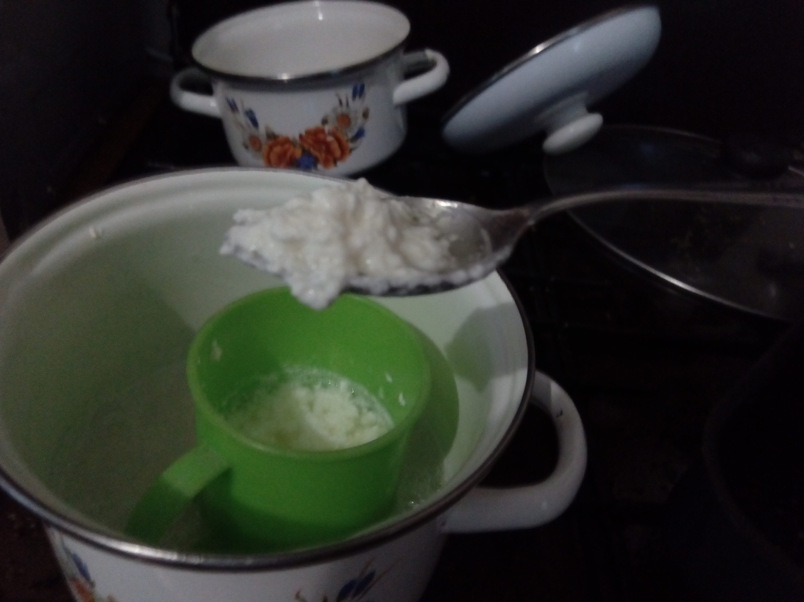
3,2% fattiness, 30 min

Slide 34
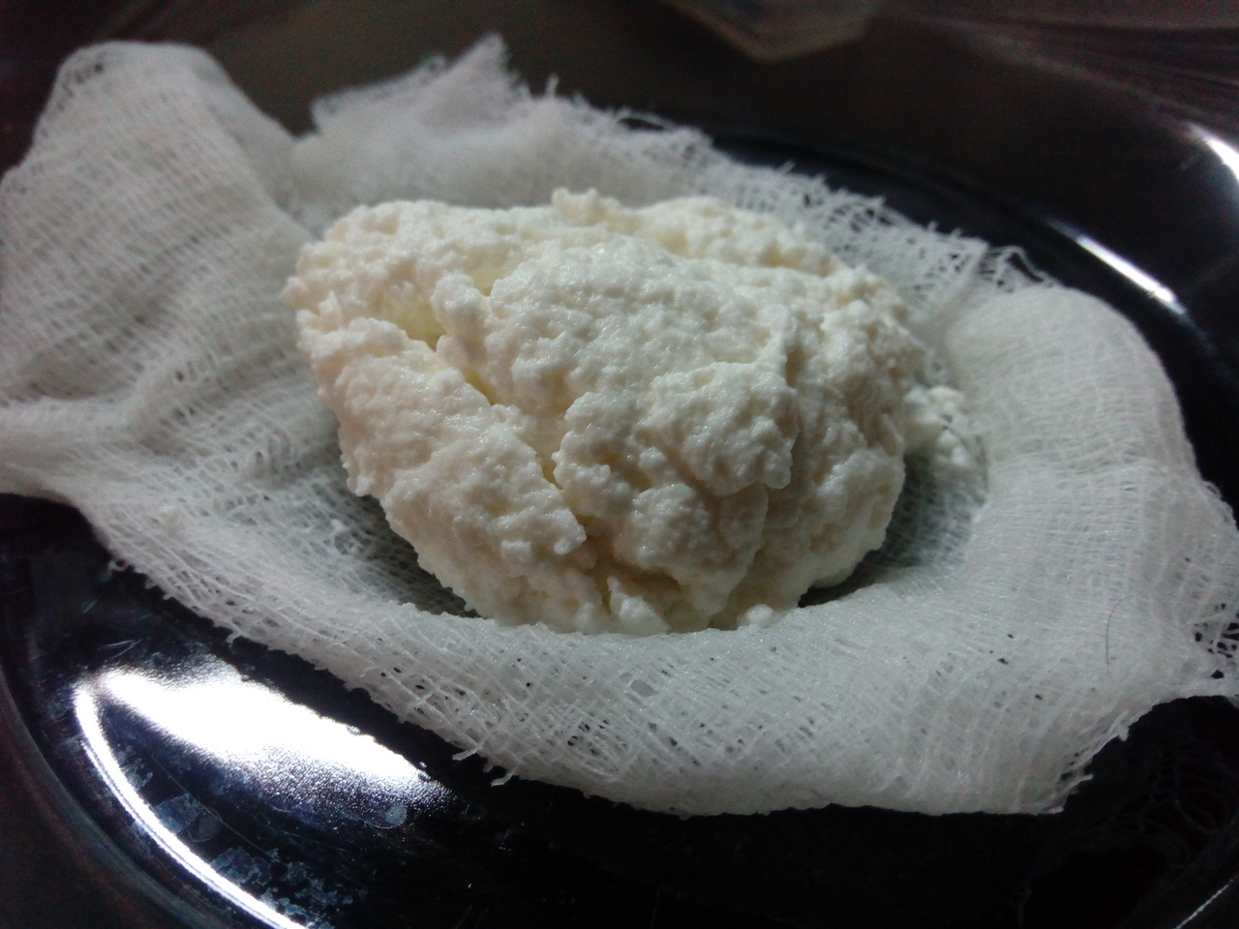
3,2% fattiness, 1 hour, result.

Slide 35
Intermediate conclusion
Thermic influence give us beautiful quark, with clear grain structure, the best density(which means quark is mostly solid) and it is the fastest process- just 1 hour! And it tastes good, there we will end.
In the end of all experiments, we’ve finally investigated the process of denaturation, by forcing milk to it with different ways.

Slide 36
Results
Type of influence | Relative density | Color | Graininess And grain size | Coagulation type | Time to produce
Thermic | Highest | Soft-beige | Larger grain, about ~1-1,5mm | Grain | ~1 hour
Acidic | Medium | white | Lesser grain, ~0.5mm | Gel | ~2 hours
Organic solvents | Lowest | Snowy white | The least grain, ~0.25mm. | Mostly gel, grain appears | Immediately
Natural process | Medium | yellowish white | Lesser grain, ~0.5-1mm | Mostly grain, gel appears | ~5 days

Slide 37
Conclusions
Process of making quark is based on denaturation-- destructing protein structures, what leads to producing quark. It may be done by many ways, but the most effective- to heat milk with acid product.
How well denaturation proceeds affects properties of quark like density, color, graininess
and grain size, coagulation type.

Slide 38
Thank you for your attention!

Slide 39
EXTRA SLIDES

Slide 40
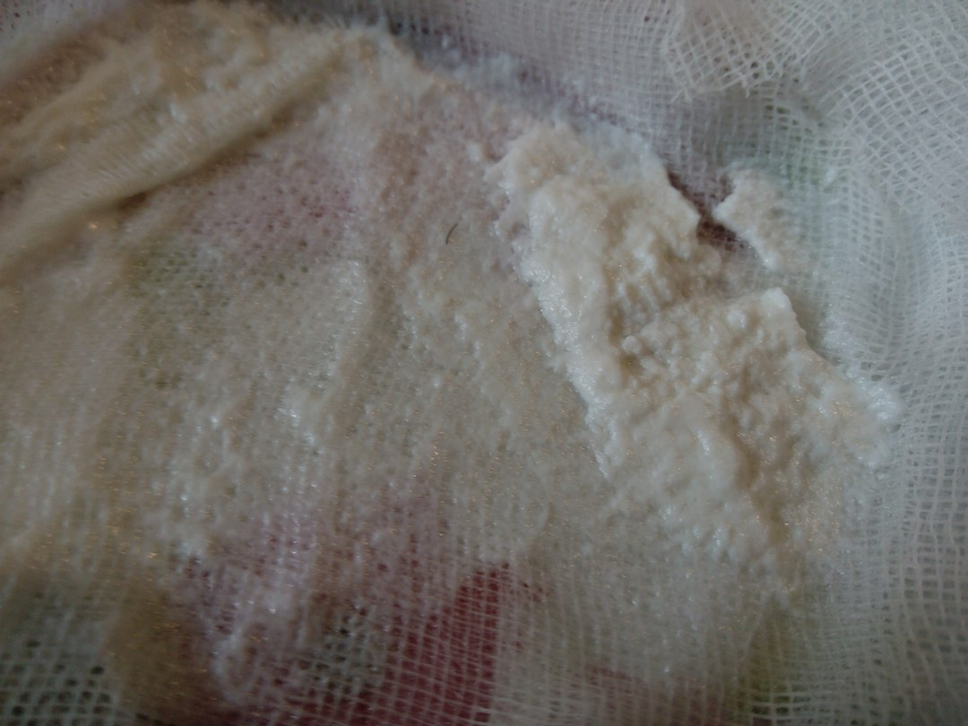

Slide 41
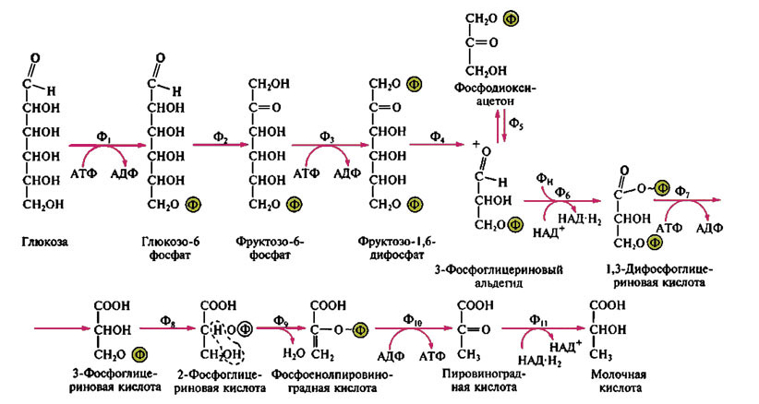

Slide 42
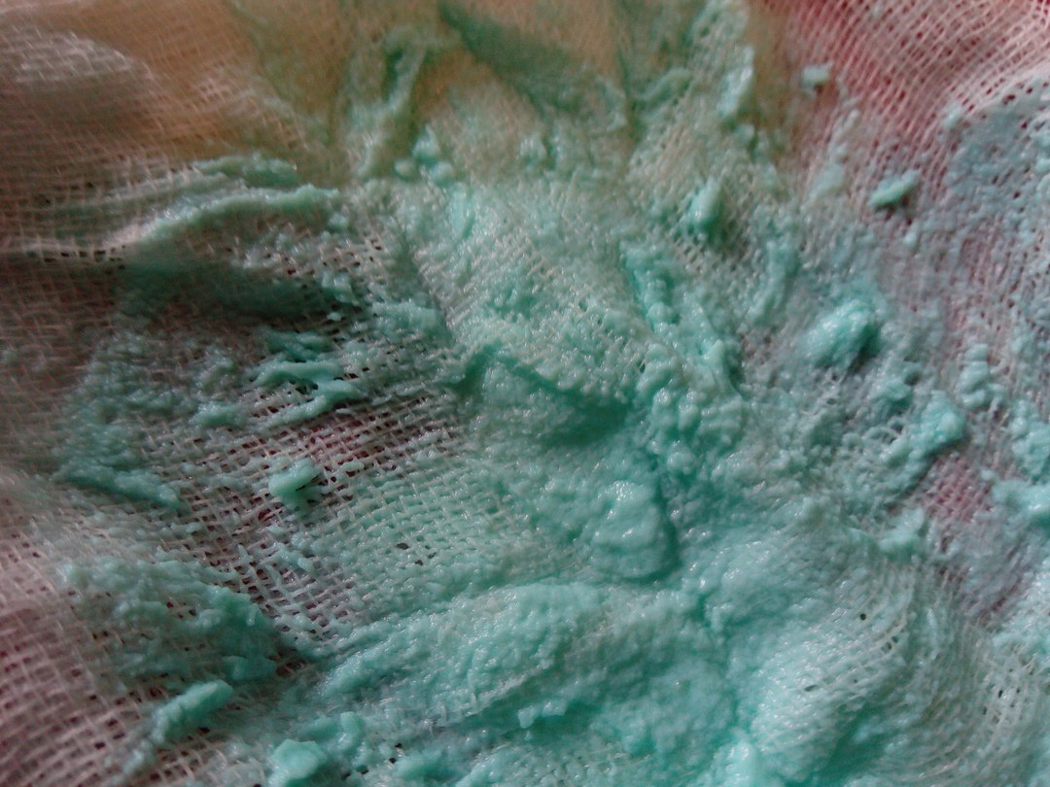
Опыт 2: Соли тяжелых металлов

