Slide 1
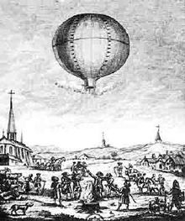
Problem №22 «Montgolfiere»
Team: Voronezh Kvantorium
Prepared by Pilyakin Alexandr

Slide 2
Condition of this problem
To heat air for a simple hot air balloon, one can even use a heater. Build such a buoyant. Explain the results for you experiments and determine important parameters

Slide 3
Equipment
We used scissors, threads, boiler, 0,5L bottle, adhesive tape

Slide 4
Goals and tasks
Goals:
Construct the model of air balloon
Determine important parameters
Tasks:
Construct the model
Find parameters
Make conclusions

Slide 5
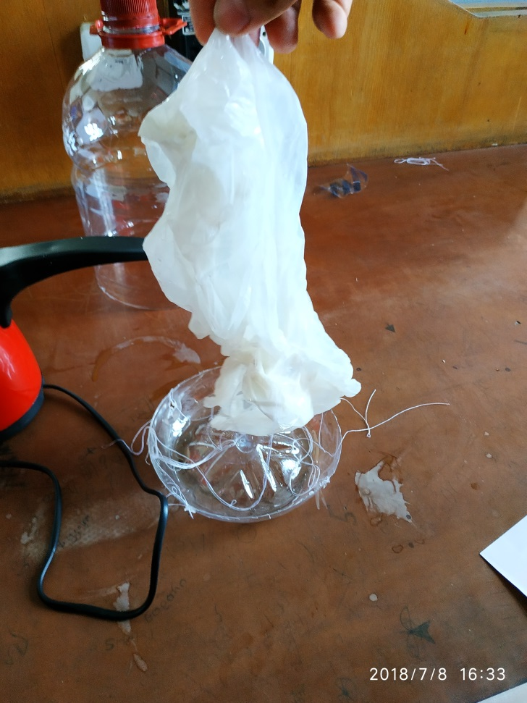
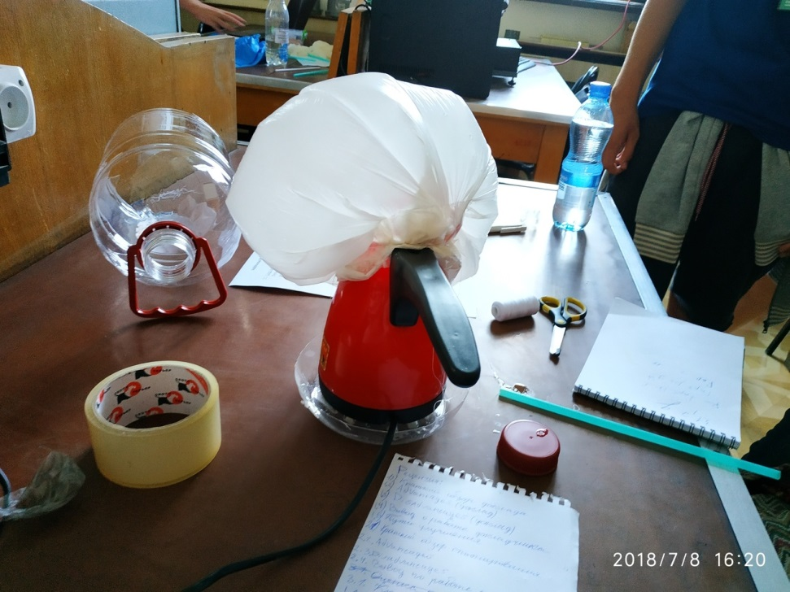
Before
After

Slide 6

Floating conditions
$$F_{p}≥mg$$

Slide 7
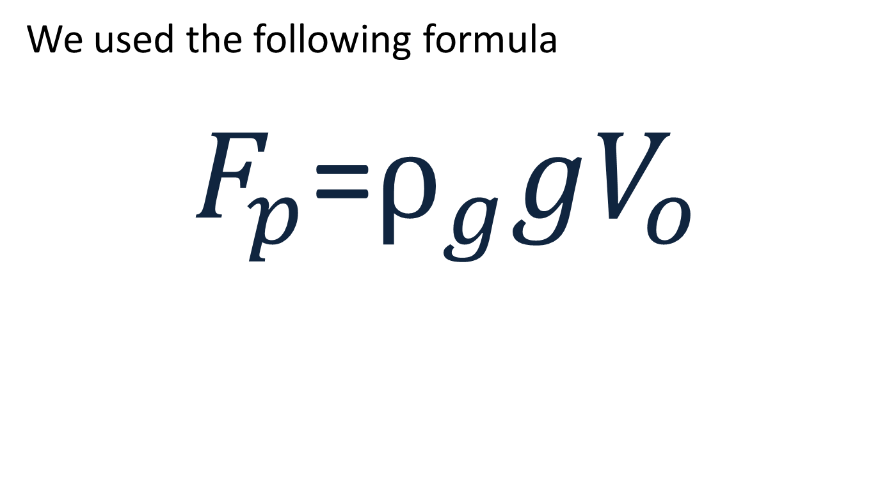
Formula
We used the following formula
$F_{p}$=$ρ_{g}gV_{o}$

Slide 8
Parameters that affect the flight
Mass of air balloon
Volume of balloon
The elasticity of the shell of the of the ball
Density of environment

Slide 9
Conclusions
We constructed the model of air balloon
We determined important parameters
We explained the results

