Slide 1
Elastic Collision
Team “Easy science”
Rostov-on-Don
Russia

Slide 2
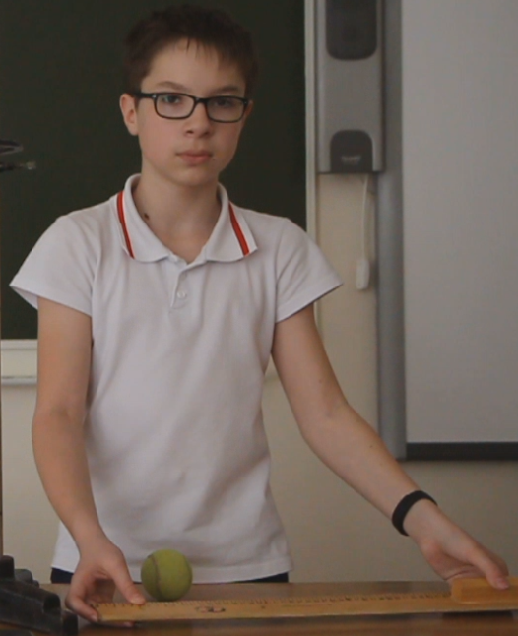
Purpose of my work
The purpose of my work is to determine the time of elastic collision of the ball with the surface.

Slide 3
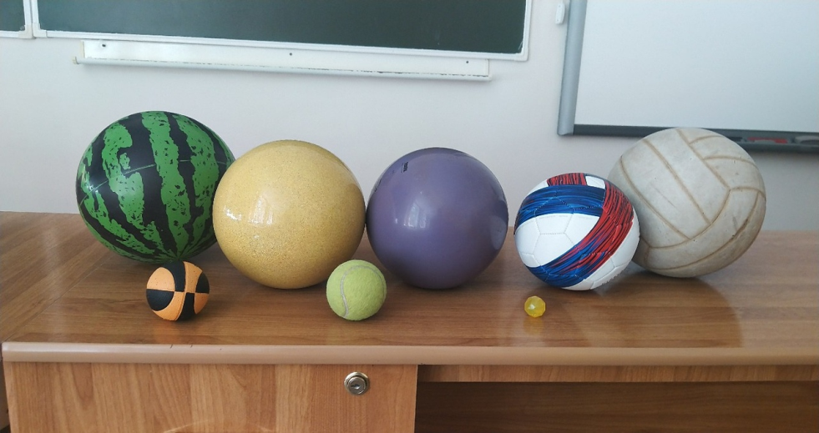
Description
The time of collision is the time of contact of hitting objects, time interaction of bodies is the time within which there is a transformation of kinetic energy into potential deformation energy and backwards.

Slide 4

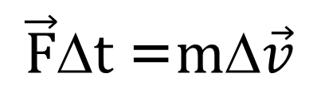
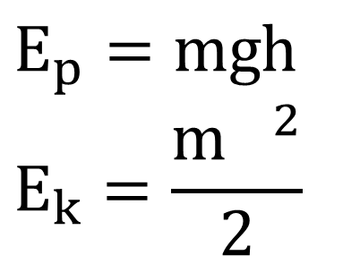
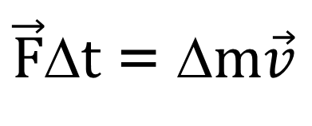
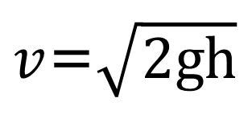
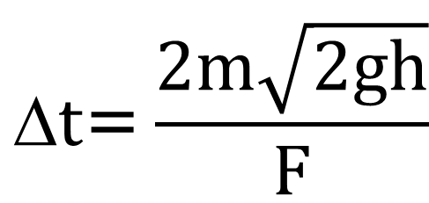
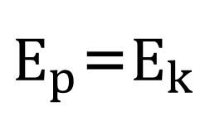
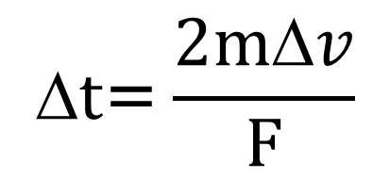
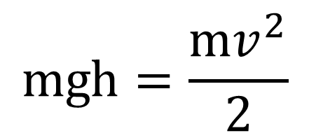
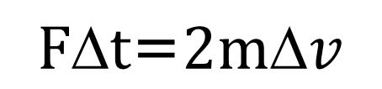
Formula for calculating the time of elastic collision
$$E_{p}=mgh$$
$$E_{k}=\frac{{m }^{2}}{2}$$
$\vec{F}\text{∆}t$=$\text{∆}m\vec{v}$
$$\vec{F}\text{∆}t \text{=}m\text{∆}\vec{v}$$
$$F\text{∆}t\text{=}2m\text{∆}v$$
$E_{p}$=$E_{k}$
$$\text{∆}t\text{=}\frac{2m\text{∆}v}{F}$$
$$mgh=\frac{mv^{2}}{2}$$
$$\text{∆}t\text{=}\frac{2m\sqrt{2gh}}{F}$$
$v$=$\sqrt{2gh}$
Notes:
Вывод формулы будем производить на основе механических законов сохранения - закона сохранения импульса и закона
сохранения механической энергии.
Применяем закон сохранения энергии $\frac{mU^{2}}{2}= mgh$ потенциальная энергия тела поднятого над землей переходит в кинетическую.
Из закона сохранения энергии выводим формулу скорости мяча $U=\sqrt{2gh}$
Определяем время соударения …

Slide 5
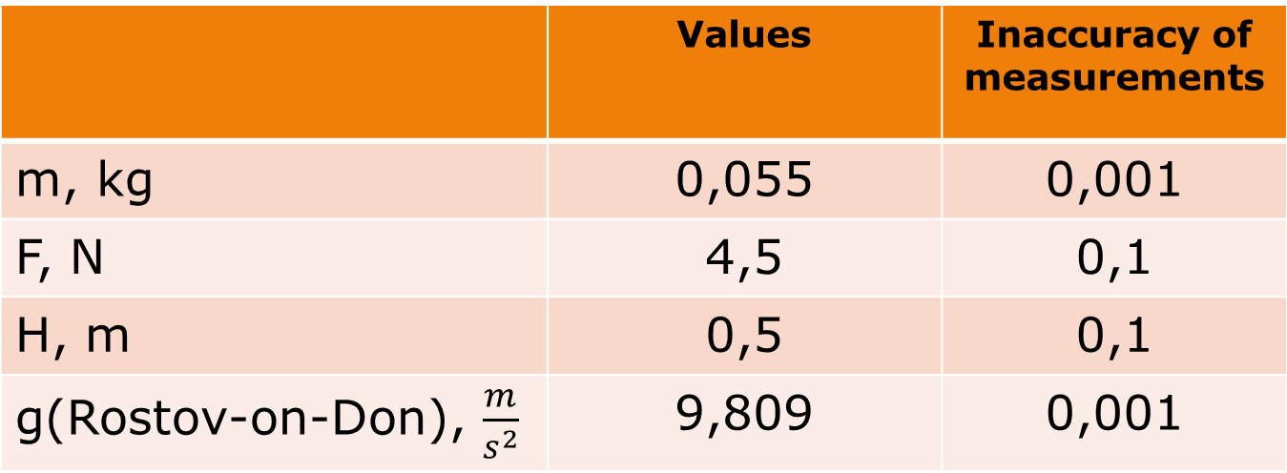
Measurements
 | Values | Inaccuracy of measurements
m, kg | 0,055 | 0,001
F, N | 4,5 | 0,1
H, m | 0,5 | 0,1
g(Rostov-on-Don), $\frac{m}{s^{2}}$ | 9,809 | 0,001

Slide 6
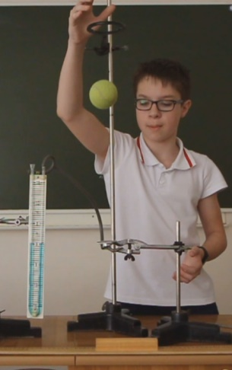
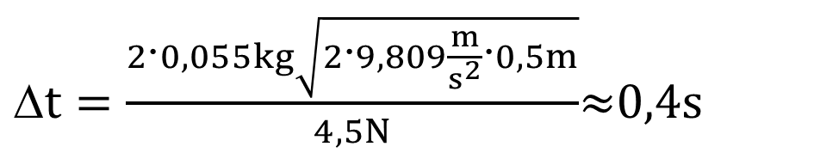

1 Experiment (tennis ball)
$$\text{∆}t\text{=}\frac{2m\sqrt{2gh}}{F}$$
$\text{∆}t=\frac{2\text{∙}0,055kg\sqrt{2\text{∙}9,809\frac{m}{s^{2}}\text{∙}0,5m}}{4,5N}$≈0,4s

Slide 7
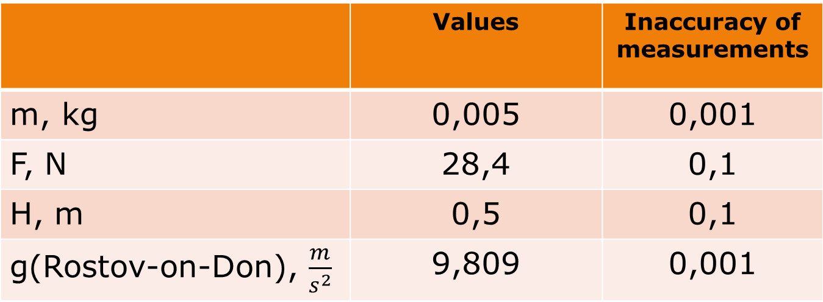
Measurements
 | Values | Inaccuracy of measurements
m, kg | 0,005 | 0,001
F, N | 28,4 | 0,1
H, m | 0,5 | 0,1
g(Rostov-on-Don), $\frac{m}{s^{2}}$ | 9,809 | 0,001

Slide 8
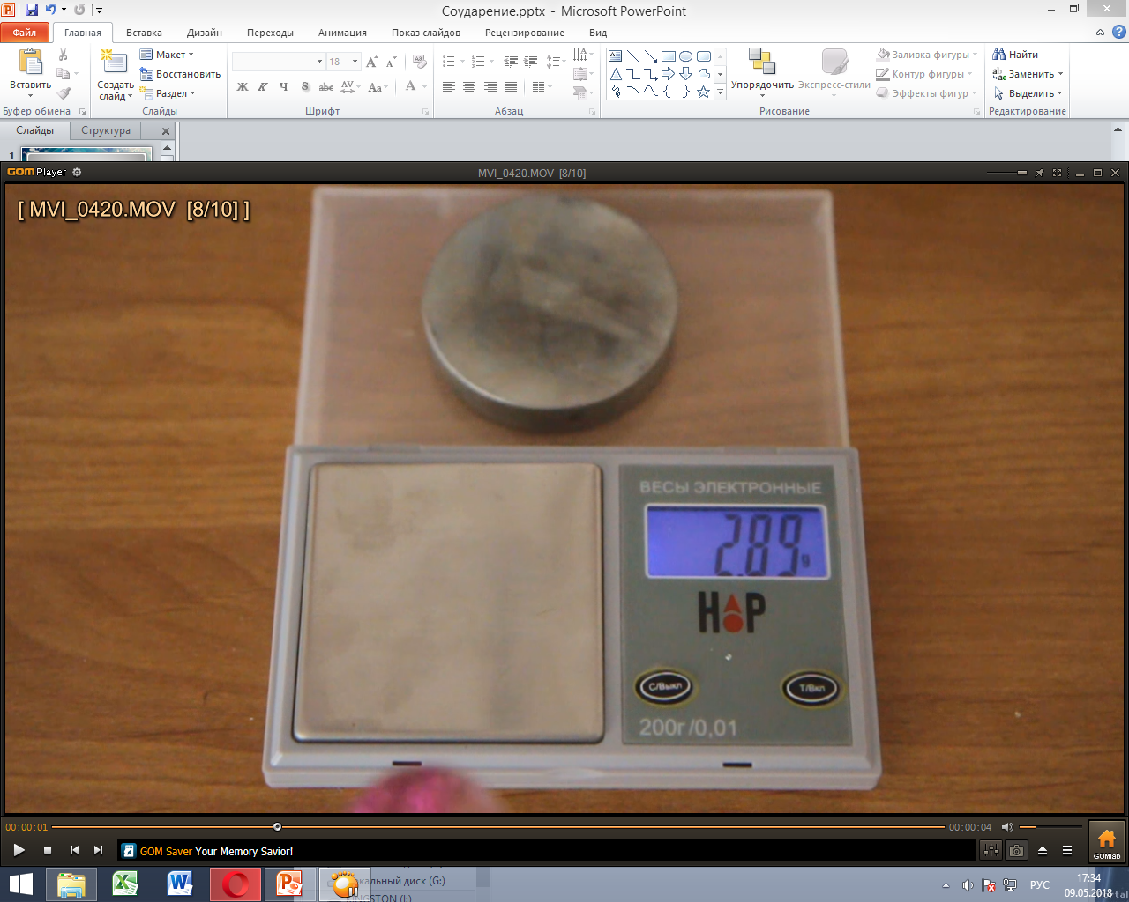
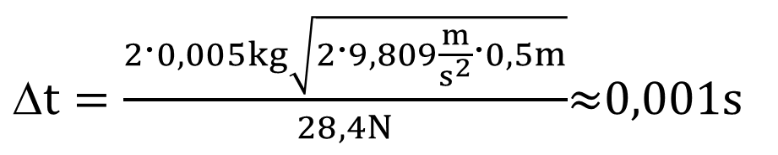
2 Experiment (bouncer)
$\text{∆}t=\frac{2\text{∙}0,005kg\sqrt{2\text{∙}9,809\frac{m}{s^{2}}\text{∙}0,5m}}{28,4N}$≈0,001s

Slide 9
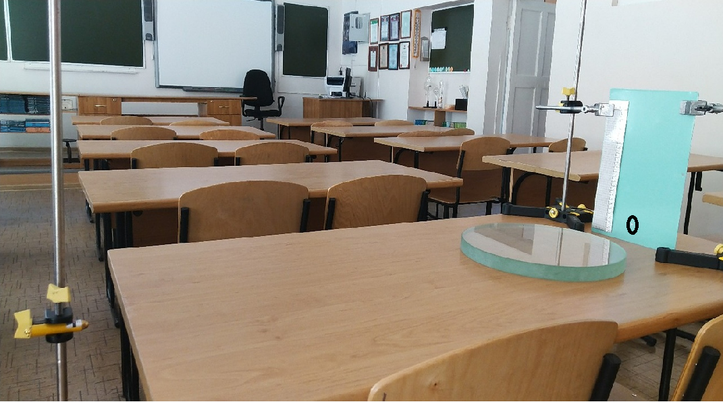
3 Experiment

Slide 10
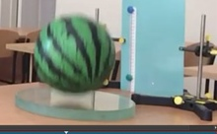
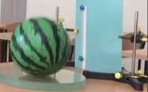
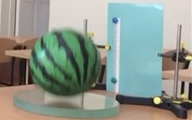
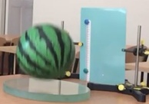

Slide 11
Conclusion
In the course of this work, it was proved that the collision of the ball with the surface is not instantaneous. The contact lasts a very short period of time.
The time of impact of three bodies with three surfaces was experimentally obtained.

Slide 12
Links
https://studfiles.net/preview/883095/page:2/
http://www.its-physics.org/uprugie-i-neuprugie-soudareniya

Slide 13

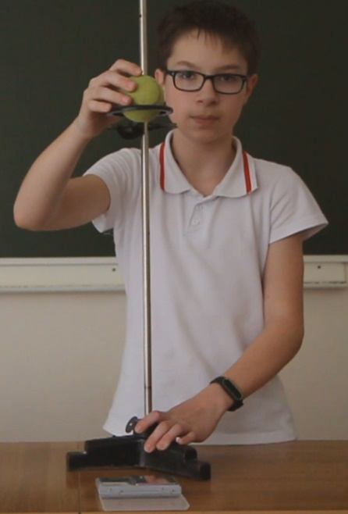
Thanks for a watching

