Slide 1
Theme: №22 Montgolfiere
By team “Easy Science”
Rostov-on-Don
Russia
ES

Slide 2
Task:
Heat air for a simple hot air balloon with an electric heater. Build such a buoyant. Explain the results for you experiments and determine important parameters.

Slide 3
Hypothesis:
Heating air in the balloon will make it fly as the Archimedes' force become stronger than the force of gravity. It is possible to use a toaster and a boiler as heaters.
ES

Slide 4
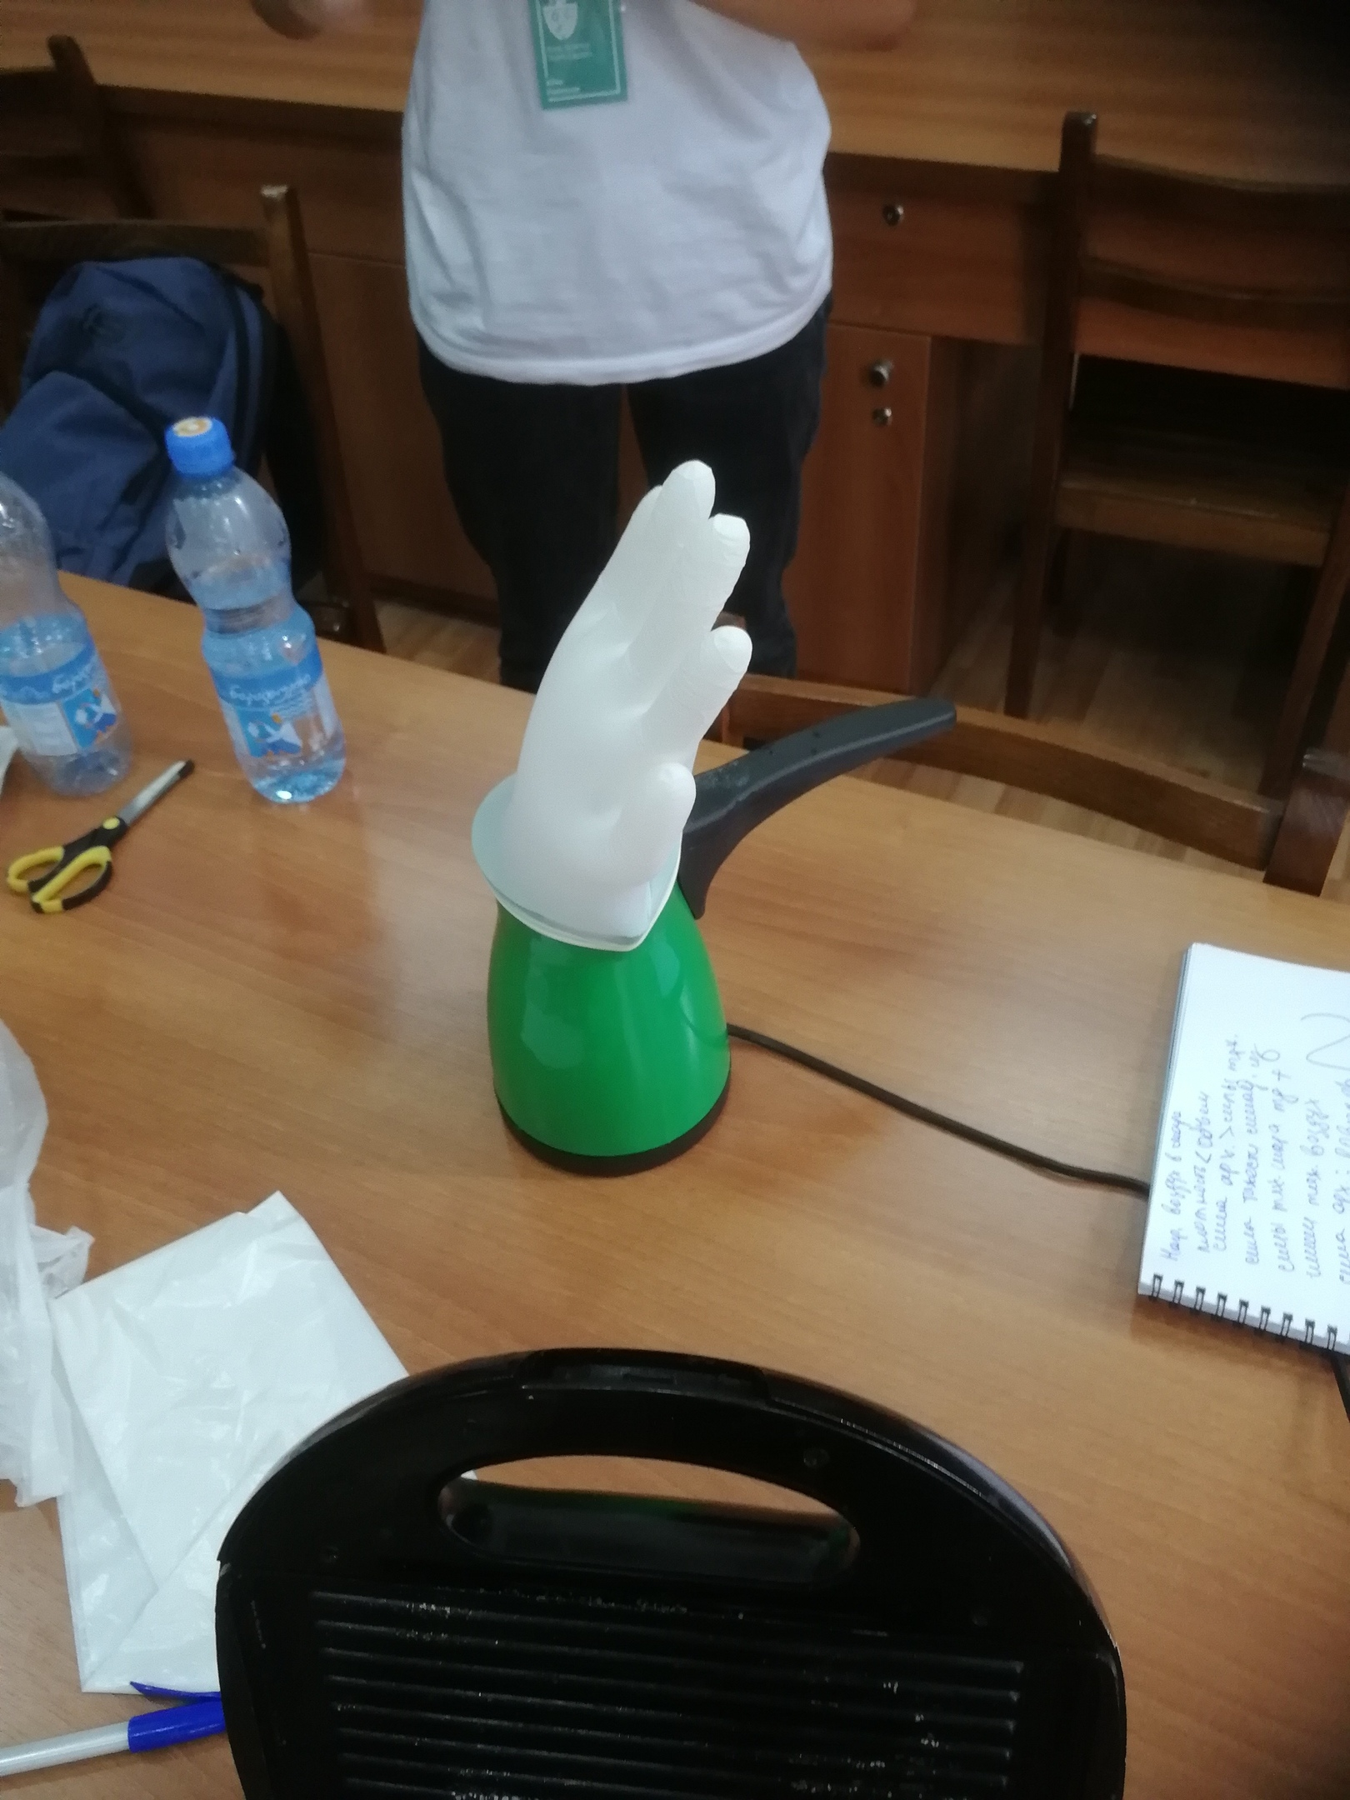
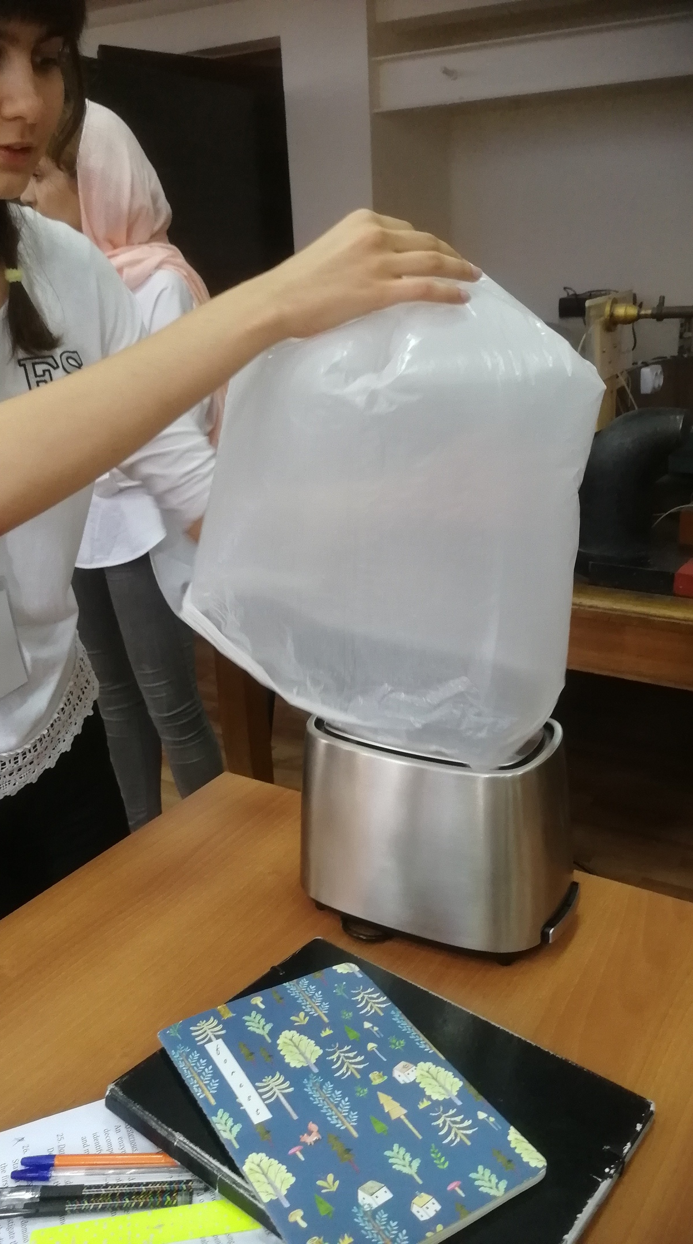
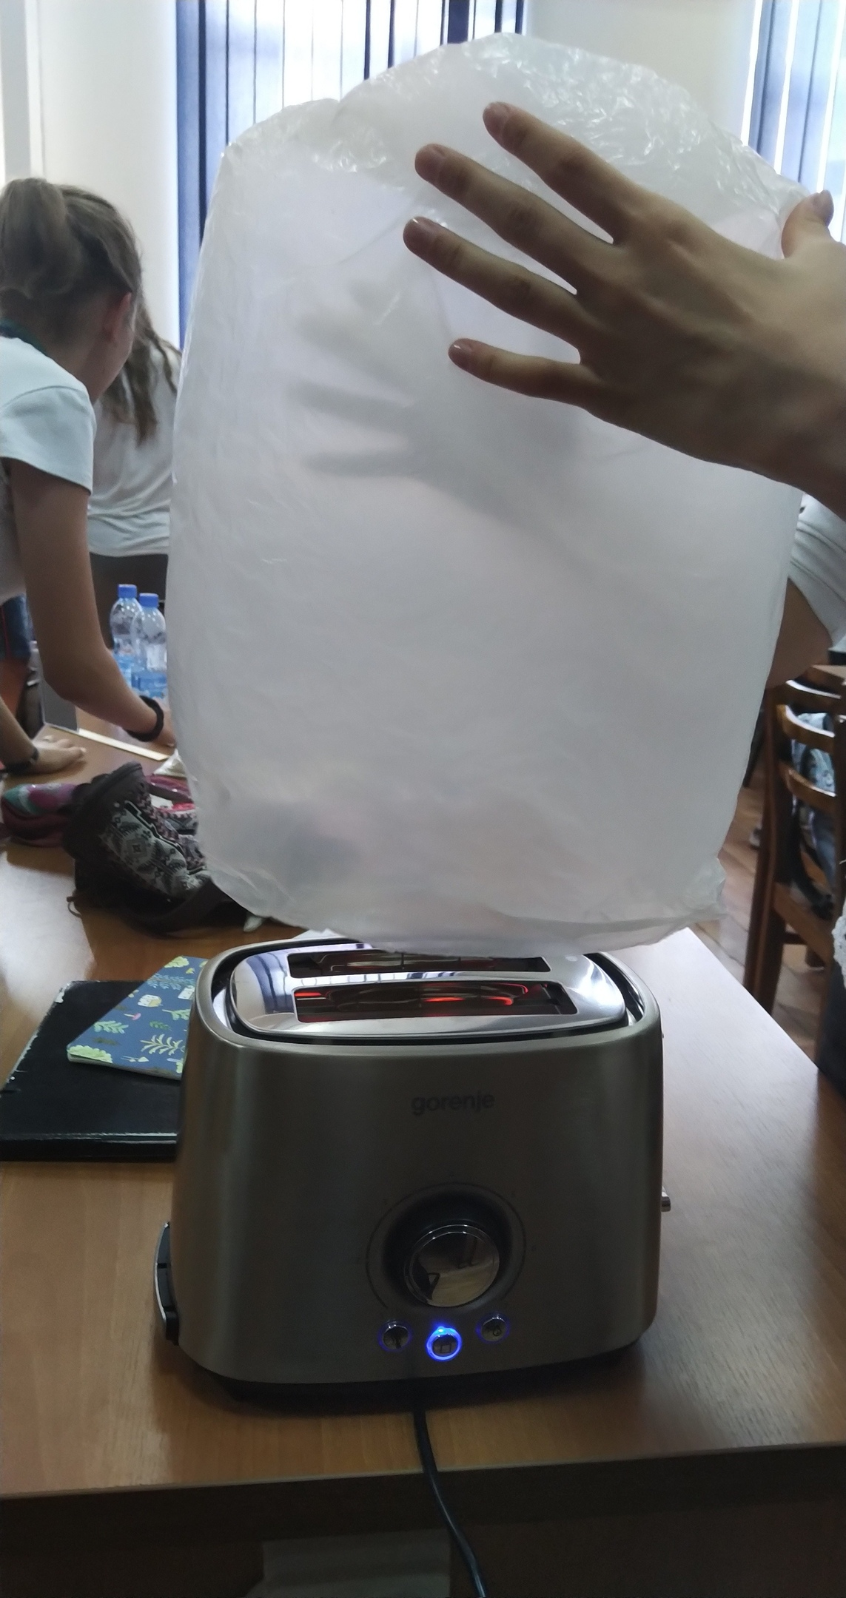
Experiment
ES

Slide 5











Theory:
$$F_{G}=mg$$
$$F_{A}>F_{G}+F_{r}$$
$$m=ρV$$
$$F_{L}=F_{A}−F_{G}$$
$$ρ_{air}=1kg/m^{3}$$
$$F_{A}=ρ_{outer air}gV_{balloon}$$
$$V=\frac{4}{3}πr^{3}$$
$$F_{G}=F_{G of the balloon}+F_{G of the air}$$
$$V_{balloon}=\frac{4}{3}∙3,14∙{20}^{3}{cm}^{3}=0.0335m^{3}$$
$$F_{G of the balloon}≪ F_{G of the air}$$
$$m_{air}=1\frac{kg}{m^{3}}∙0.0335 m^{3}=0.0335 kg$$
$$F_{G}=0.0335 kg∙9.8\frac{m}{s^{2}}=0.3283 N$$
ES

Slide 6





$$c=1005 J/kg℃$$
$$t_{0}=33℃$$
$$t_{2}=70℃$$
$$Q=cm∆t$$
$$Q=1005\frac{J}{kg}℃∙0.0335 kg∙\left(70−33\right)℃=1246 J$$
ES

Slide 7
accuracy Estimation
Inaccuracy may be caused by high humidity of the air in the laboratory and lack of time. In the first experiment a boiler with hot water was used for heating the air which also influenced the density of air. The garbage bags and the glove also do not have mathematical shape.
ES

Slide 8
Conclusion
Our hypothesis was proved by the experiments. With the help of calculations and the Internet we determined such parameters as density of air at 70ºC, its value, specific heat and the amount of heat required for building the air balloon in particular conditions.
ES

Slide 9
Thank you for your attention!
ES

